Slide 1
Innovations in Retrofit: Engagement and Communication

Slide 2
Dr Katherine Sugar
Energy Demand Research Centre
University of Manchester

Slide 3
James Ellwood, Plymouth Energy Community and Jenny Challenger, 361 Energy

Slide 4
Far SW LEAD Marketing and engagement
Lessons learned so far

Slide 5


Market research
Market segmentation – identifying the groups that make up the 'able to pay' market
Primary research - focus groups and surveys
Style & Comms guide created
Plymouth Energy Community (PEC) | Understanding our retrofit clients

Slide 6
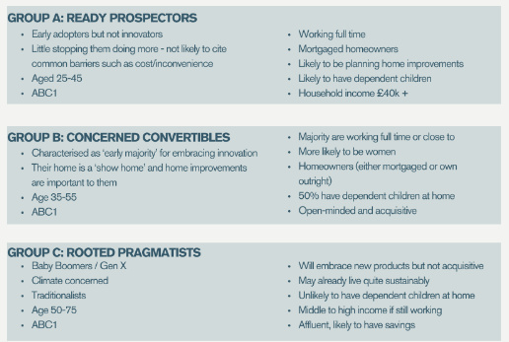
Values modes
nationally representative database of hundreds of cross-indexed focus groups
12 psychographic types, in 3 groups:
Prospector group – outer-directed, esteem driven
Pioneer group – inner-directed, innovators
Settler group – sustenance-driven
Same outcomes - Different motivations

Slide 7
Commonalities for messaging
A high level of confidence and recognition of the term ‘retrofit’ but some misunderstanding of its relation to preparing homes for improved energy efficiency
Self-preservation comes first, even though people are generally concerned for the environment
Triggers for engaging in home retrofit are specific to individuals and households, and can be connected to life events such as moving house, rather than being defined by ‘typology’ or ‘segment’.

Slide 8
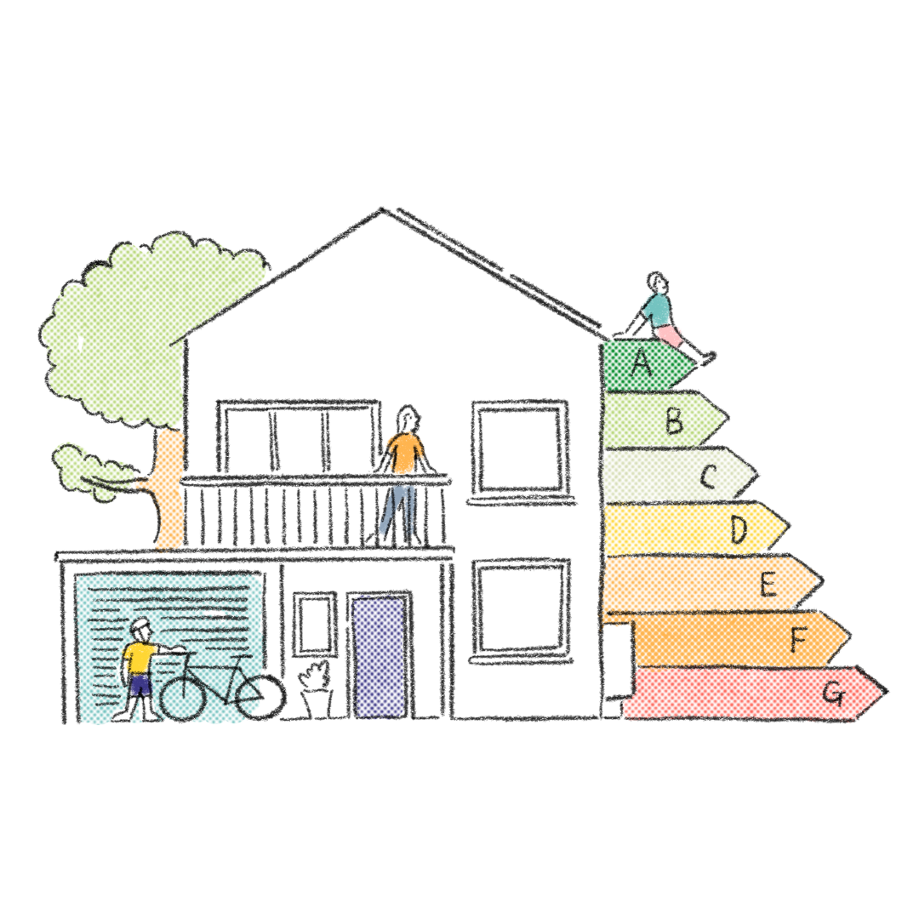
Messaging – what works
Telling a positive story
Linking to emotion, identity and personal values
Connecting the planet’s health with our own
Normalising action and change
The narrative of WE not I
Linking to psychological motivations that drive behaviour
Conversation over information
Confident, clear, exciting messaging
Stories of ‘re-world building’ can be epic. It’s a journey... sell the journey!

Slide 9
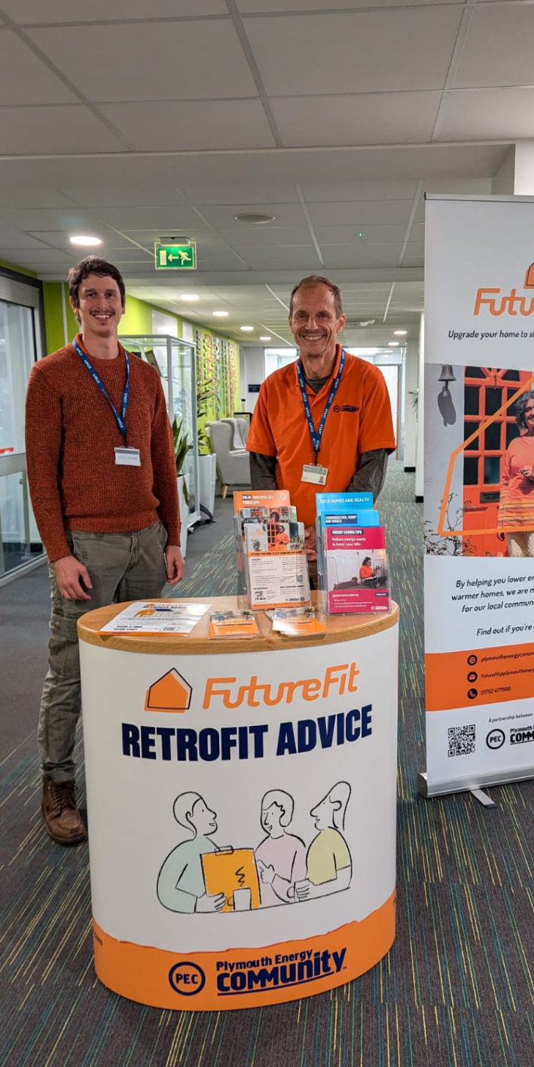
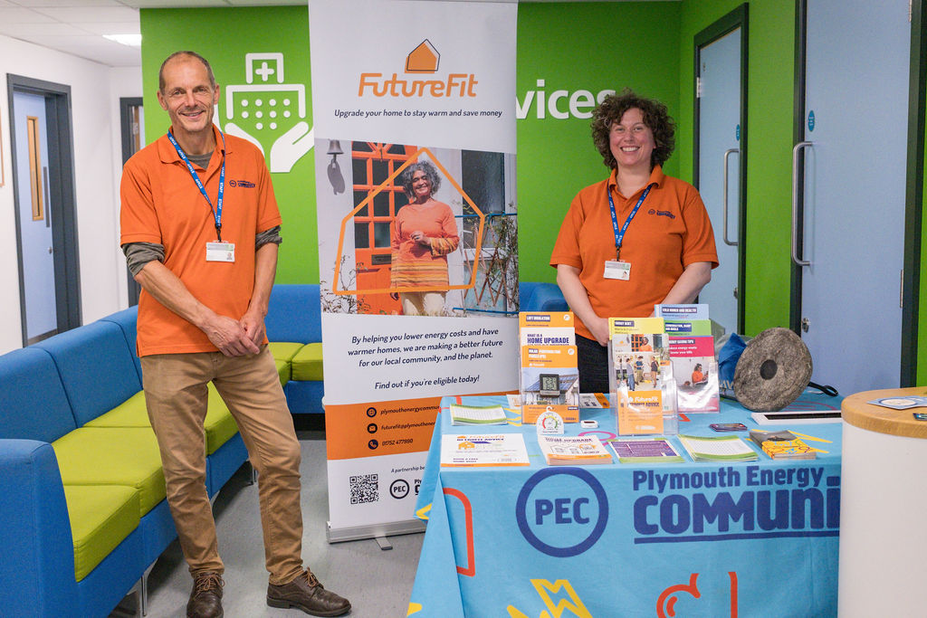
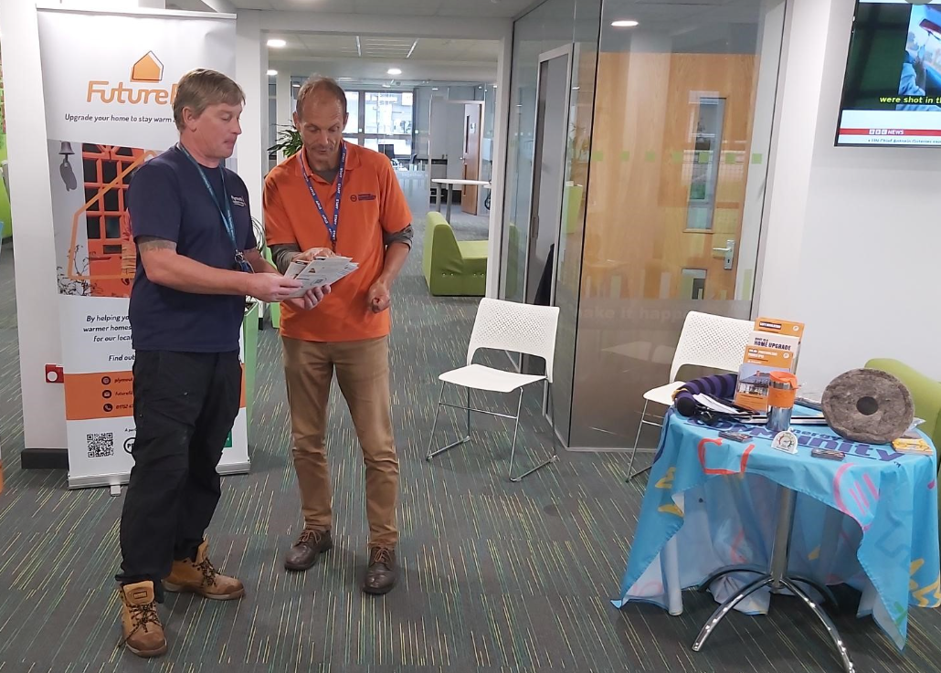
Engagement - Employer drop ins
8 Drop-ins so far at large Employers
Including:
Plymouth Community Homes
Derriford Hospital
Plymouth City Council
DELT
200+ employees engaged
Engaging people at a convenient time

Slide 10
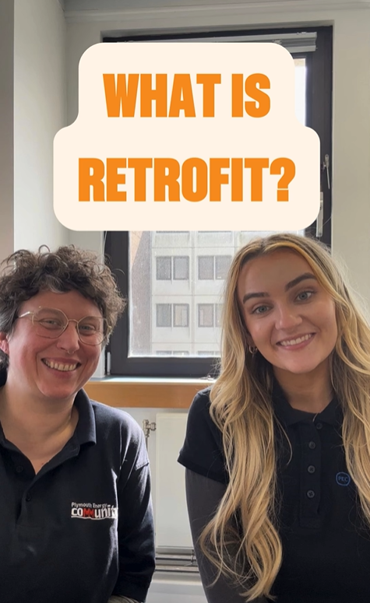
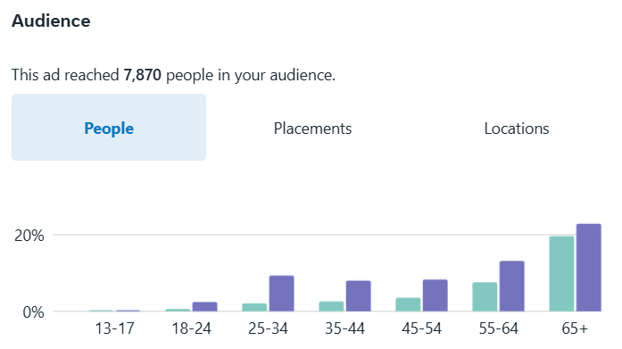
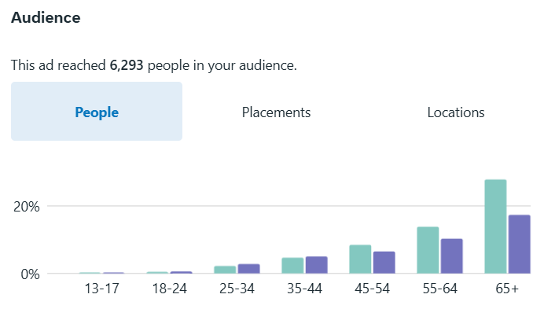
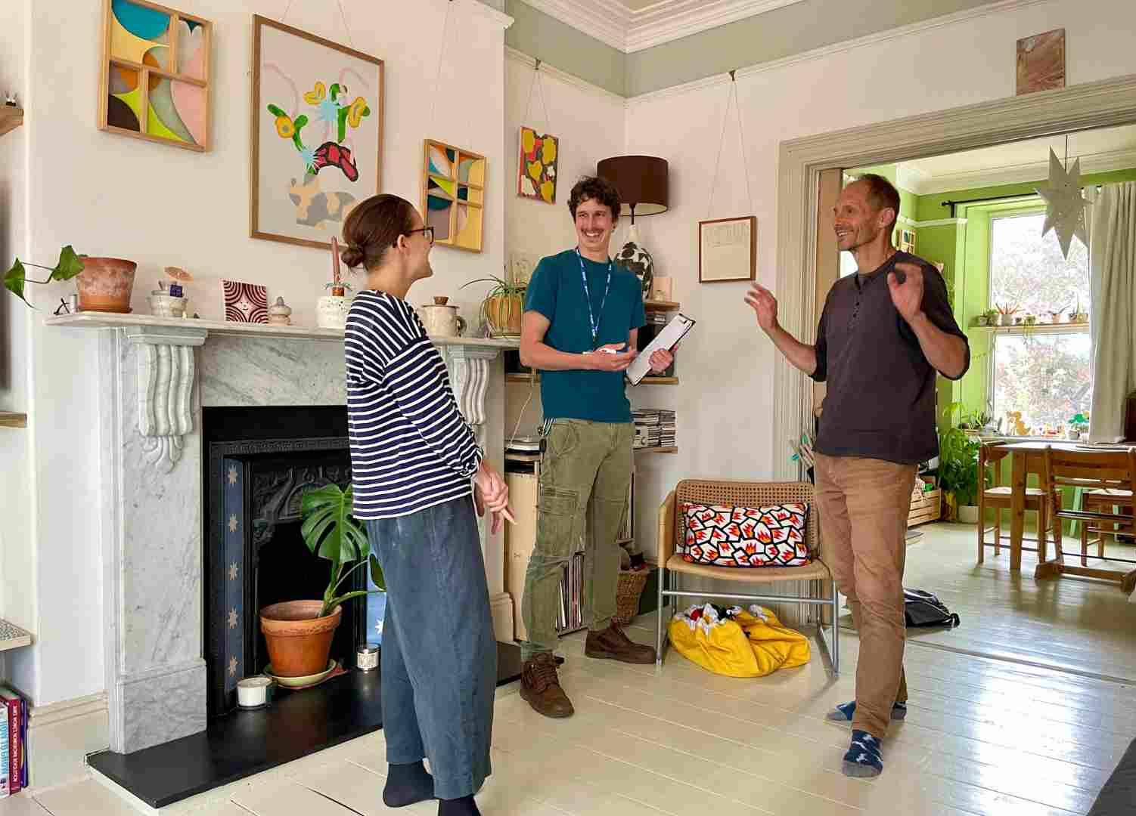
Engagement - socials
Video Reel:
Video based content – reels on Facebook and Instagram, engaging a younger audience. But work to do here!
Photo post:

Slide 11
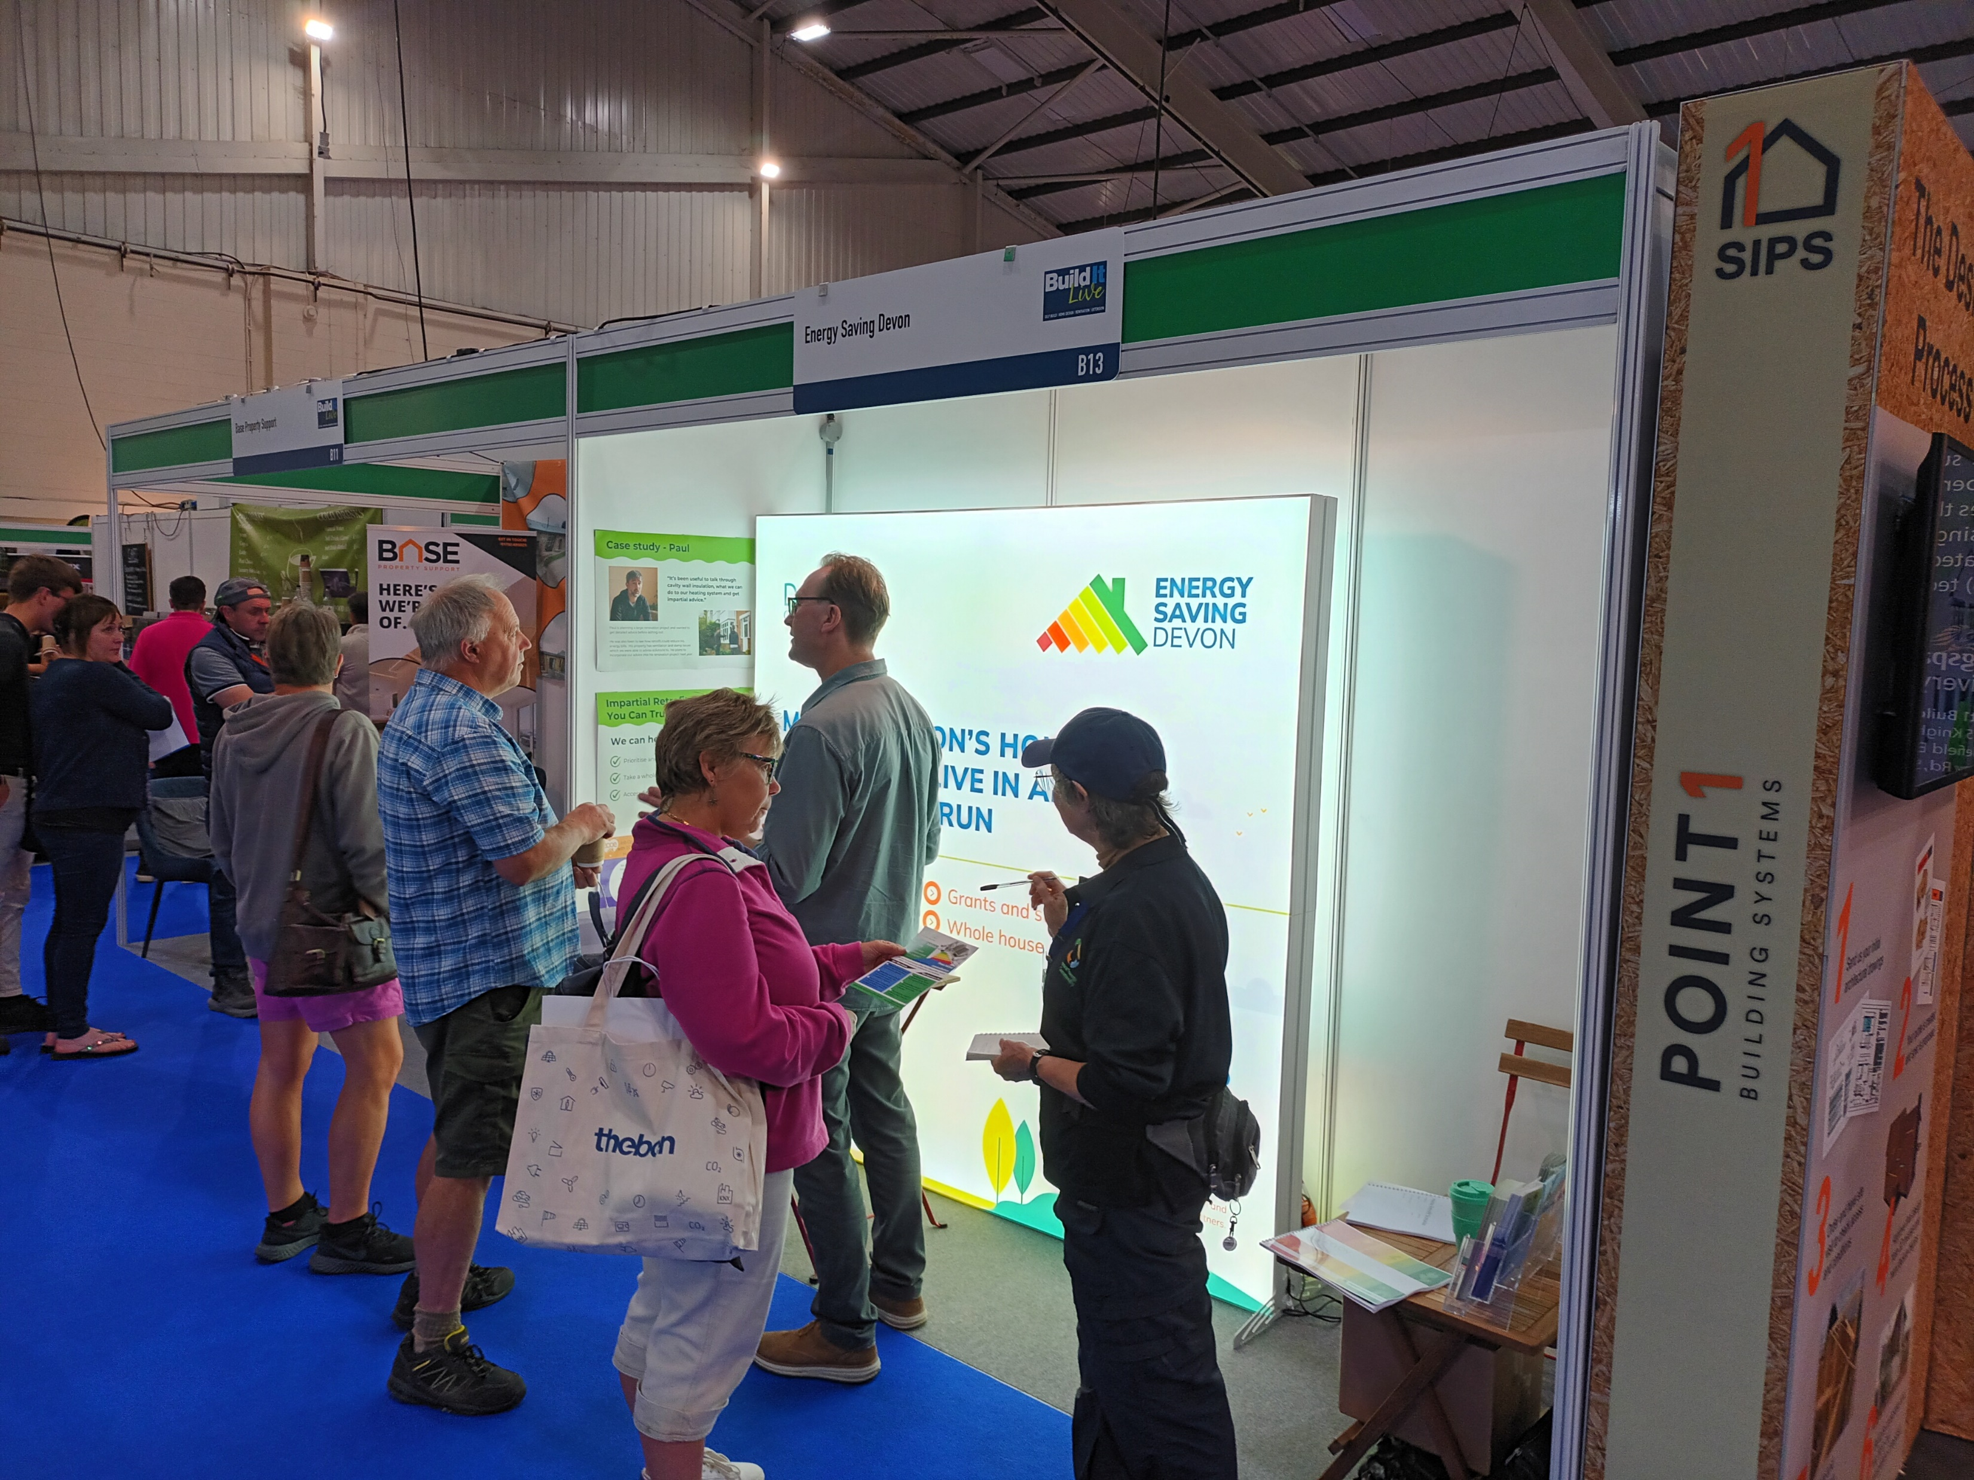
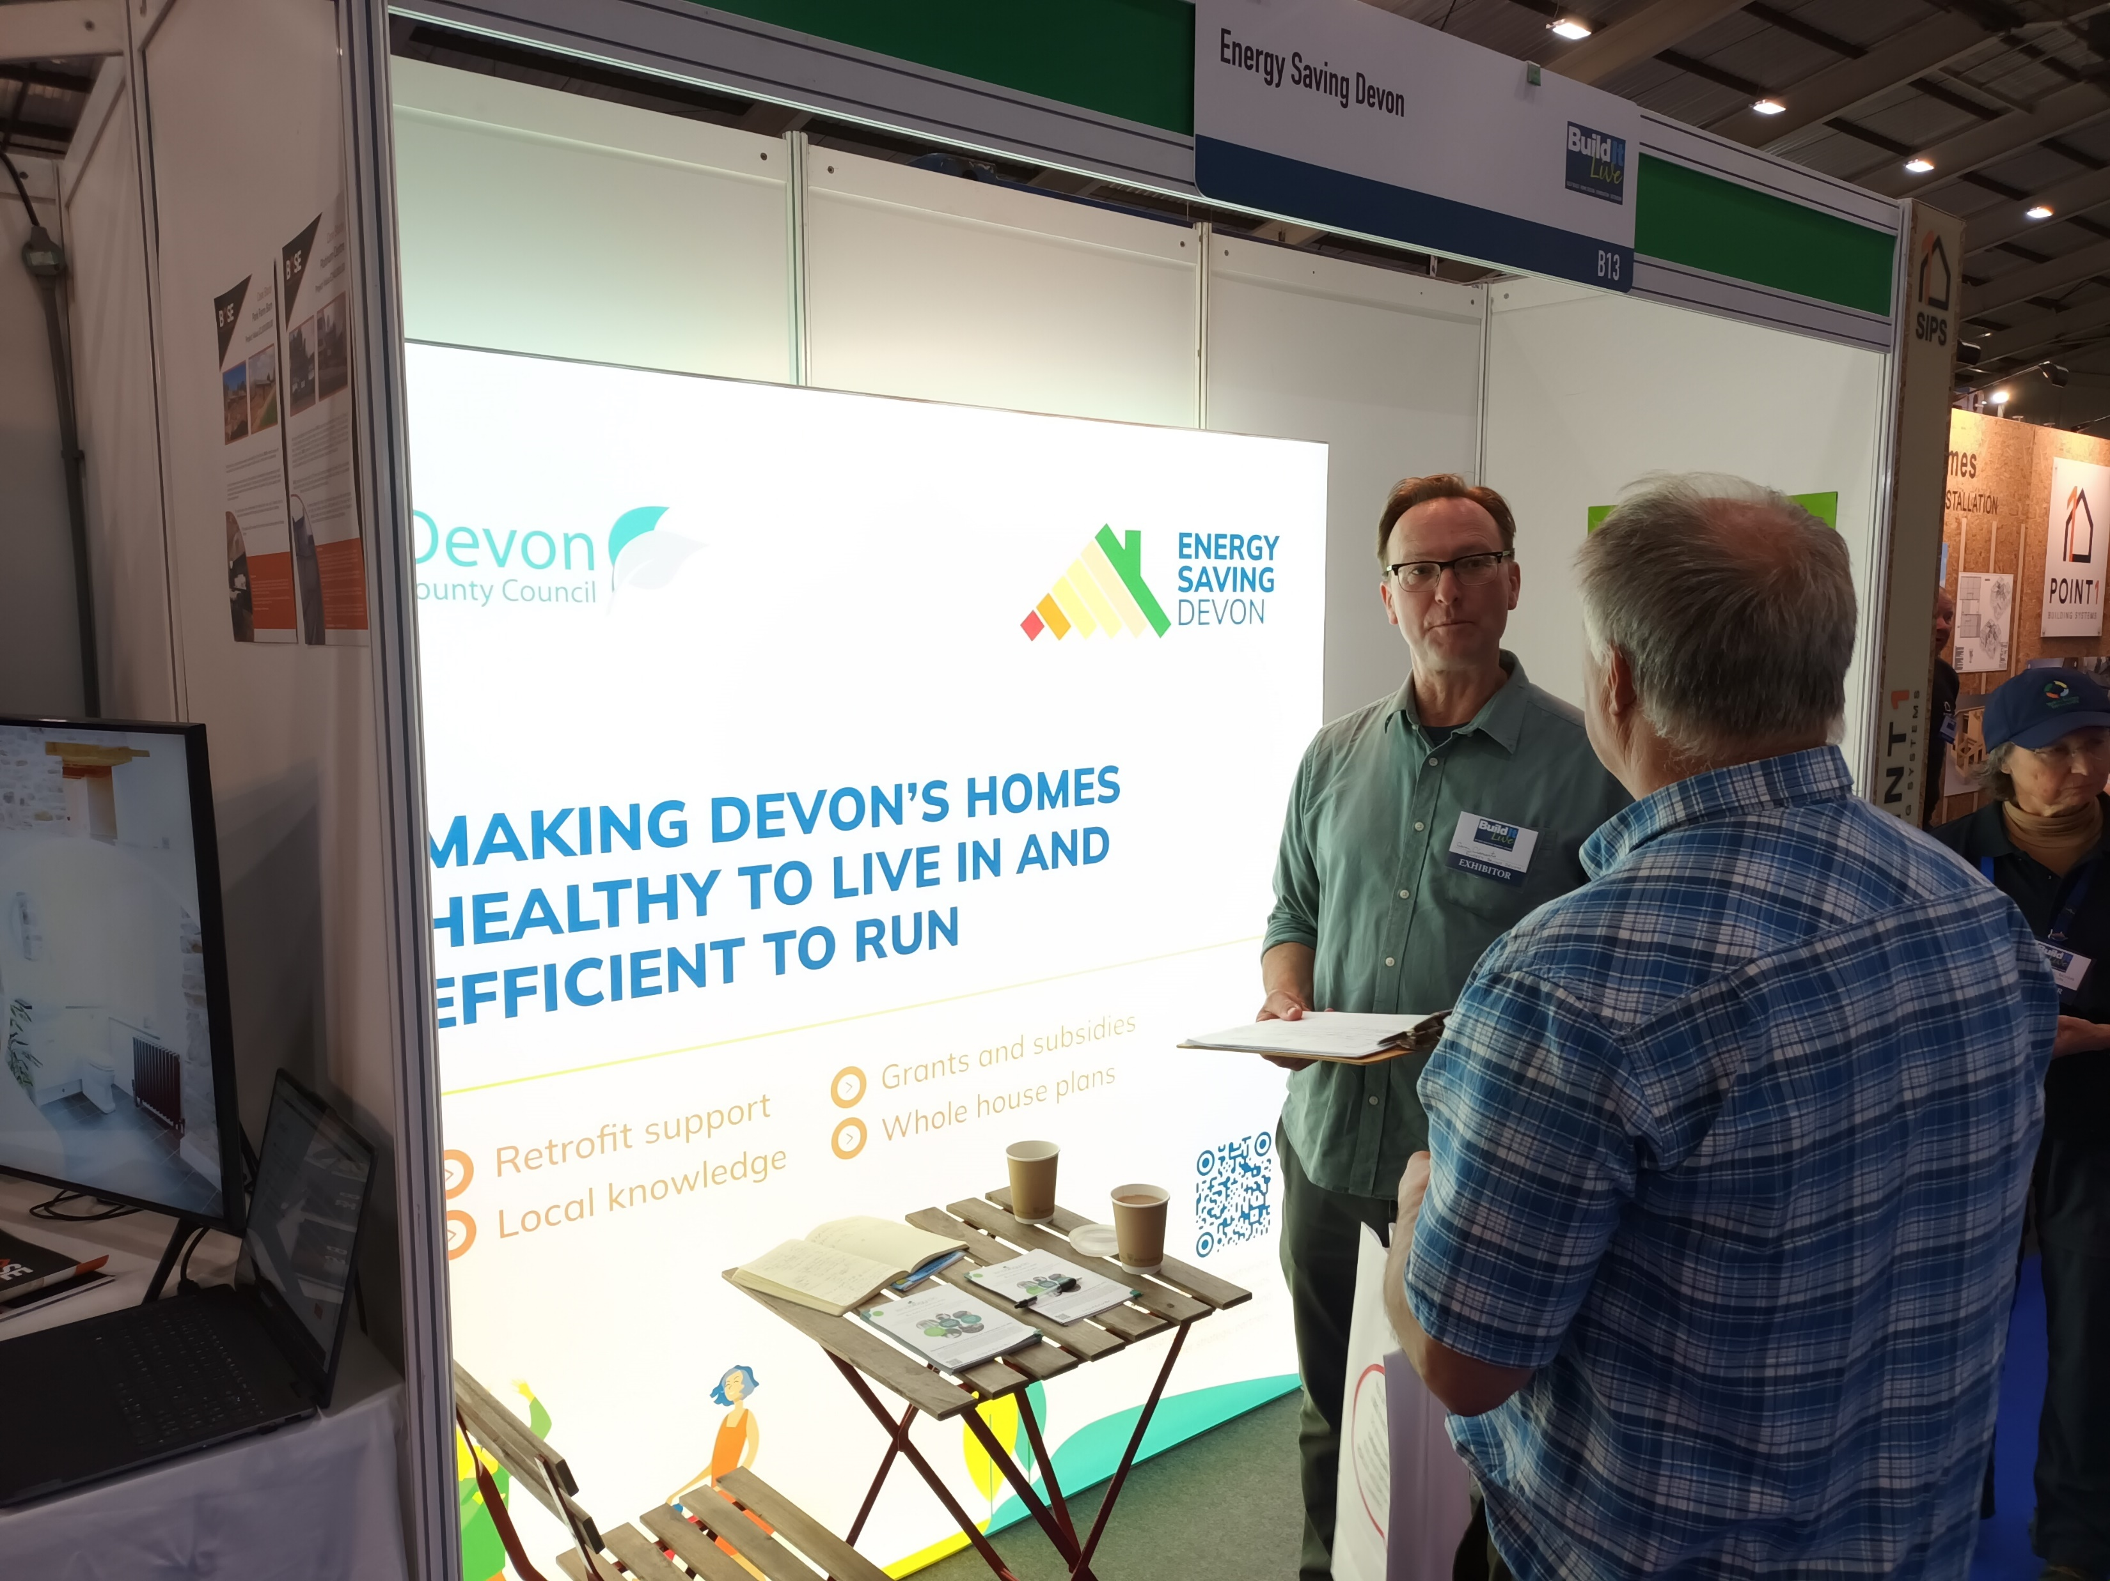
Engagement - events
Build it Live - Exeter

Slide 12


Learning
Evaluating the process
What works well
What can we change and adapt to improve the service and uptake of retrofit services?

Slide 13
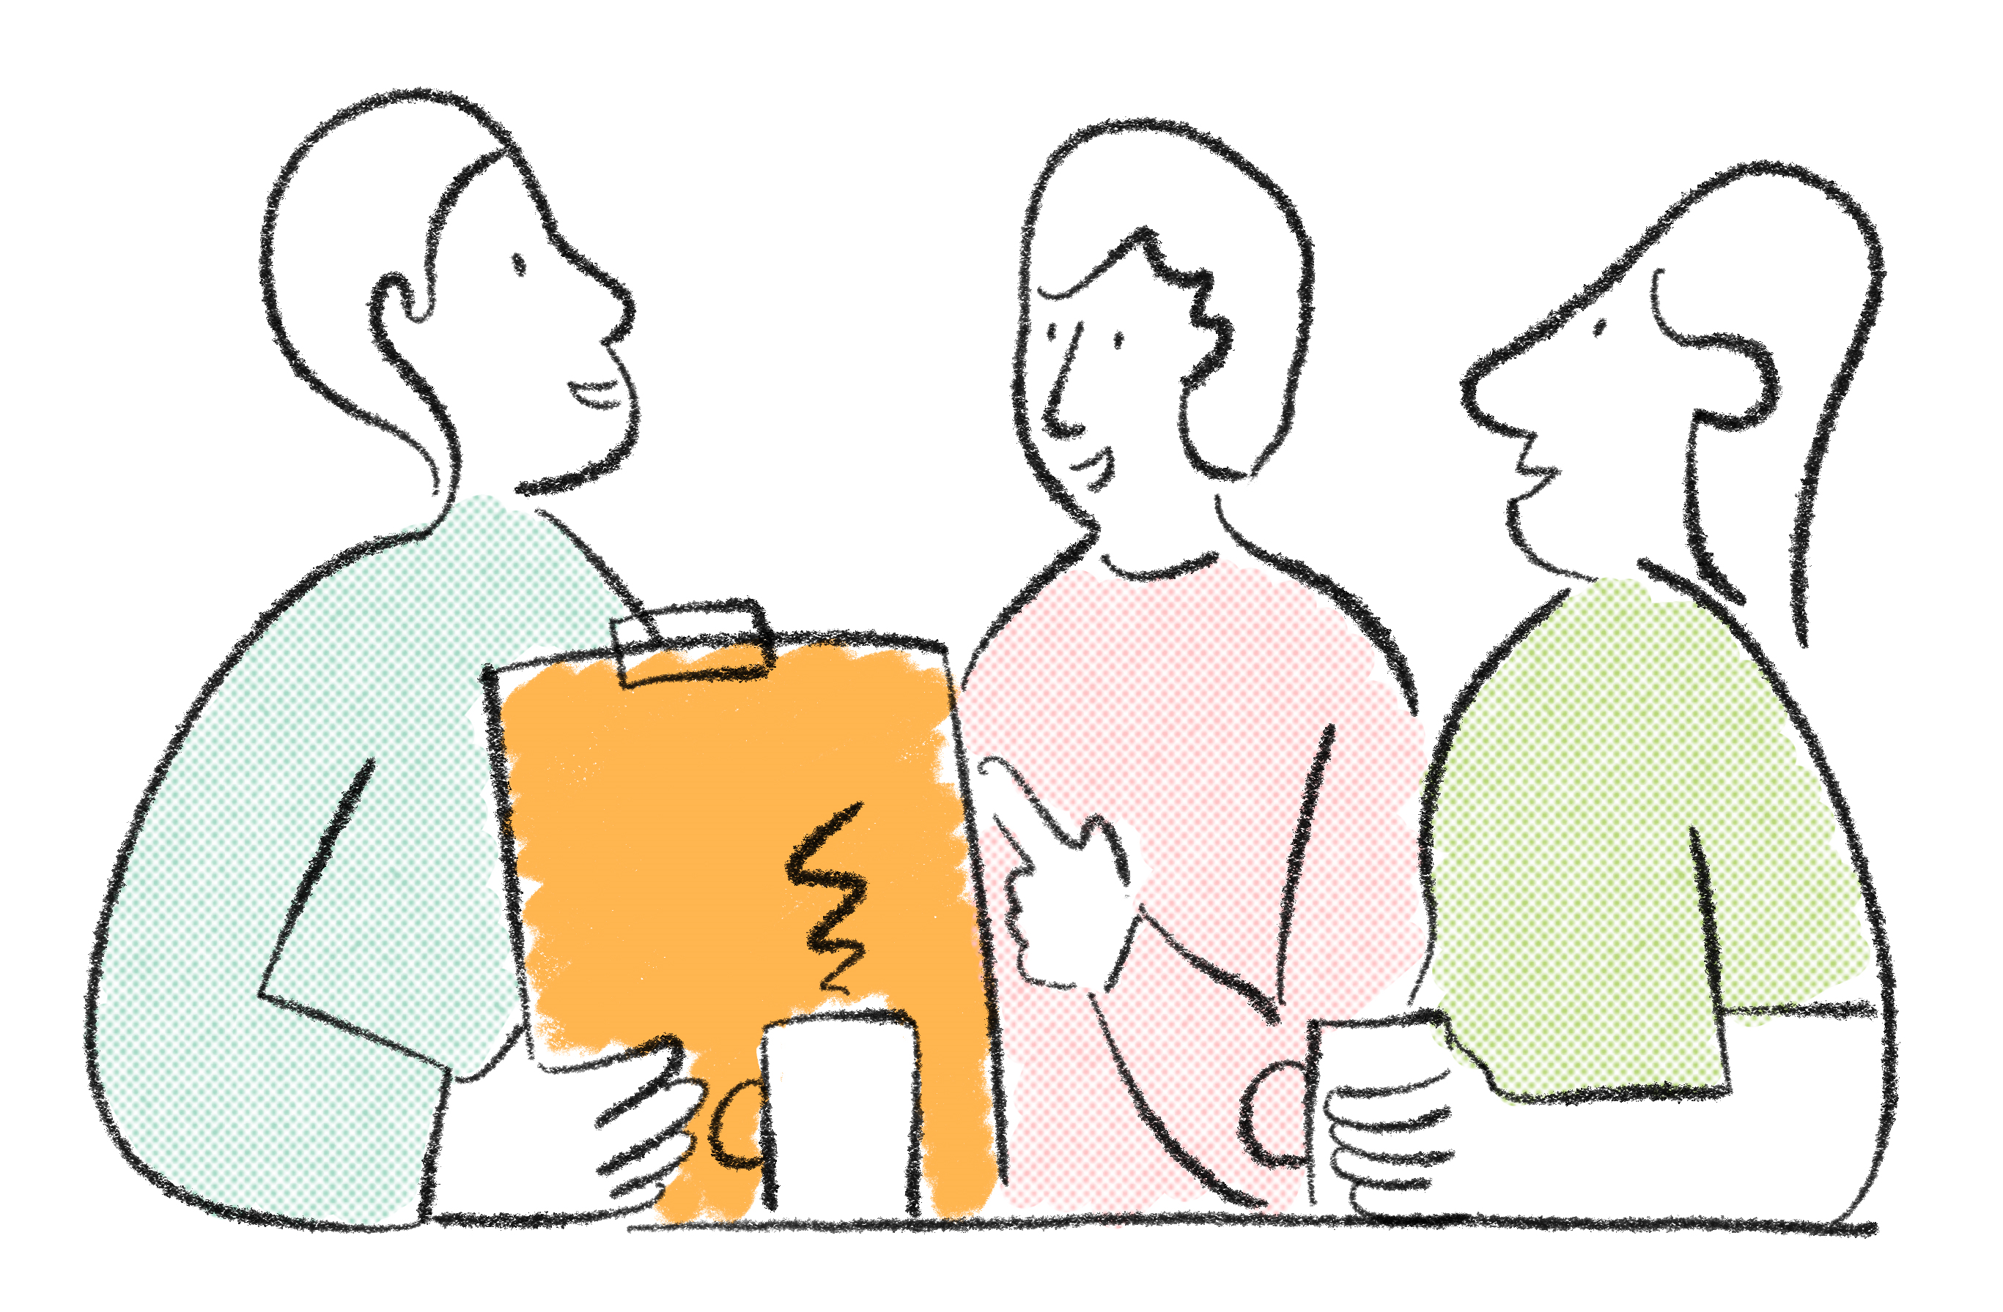
Barriers in the retrofit market
The majority of homeowners were lacking information on what to do and where to start
Transparency in what is being offered and how to go about it.

Slide 14
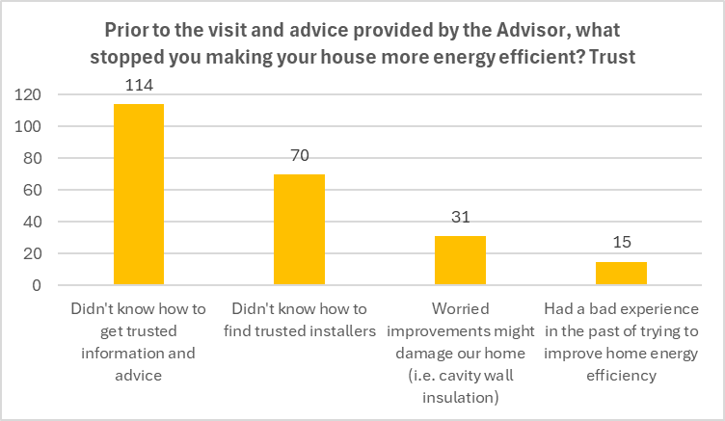
Why aren't people retrofitting their homes

Slide 15
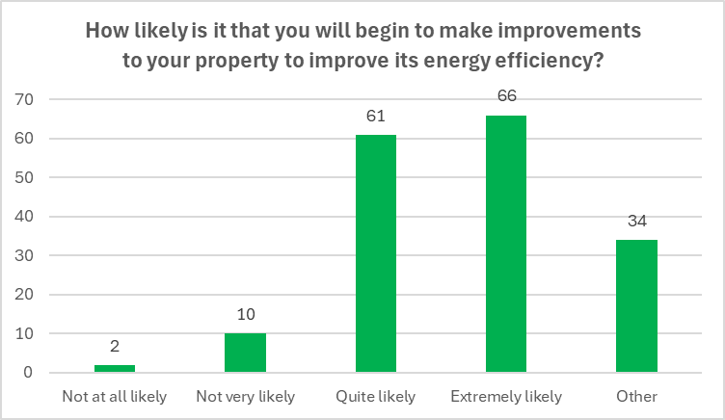
Positive Impact of a Retrofit Visit

Slide 16

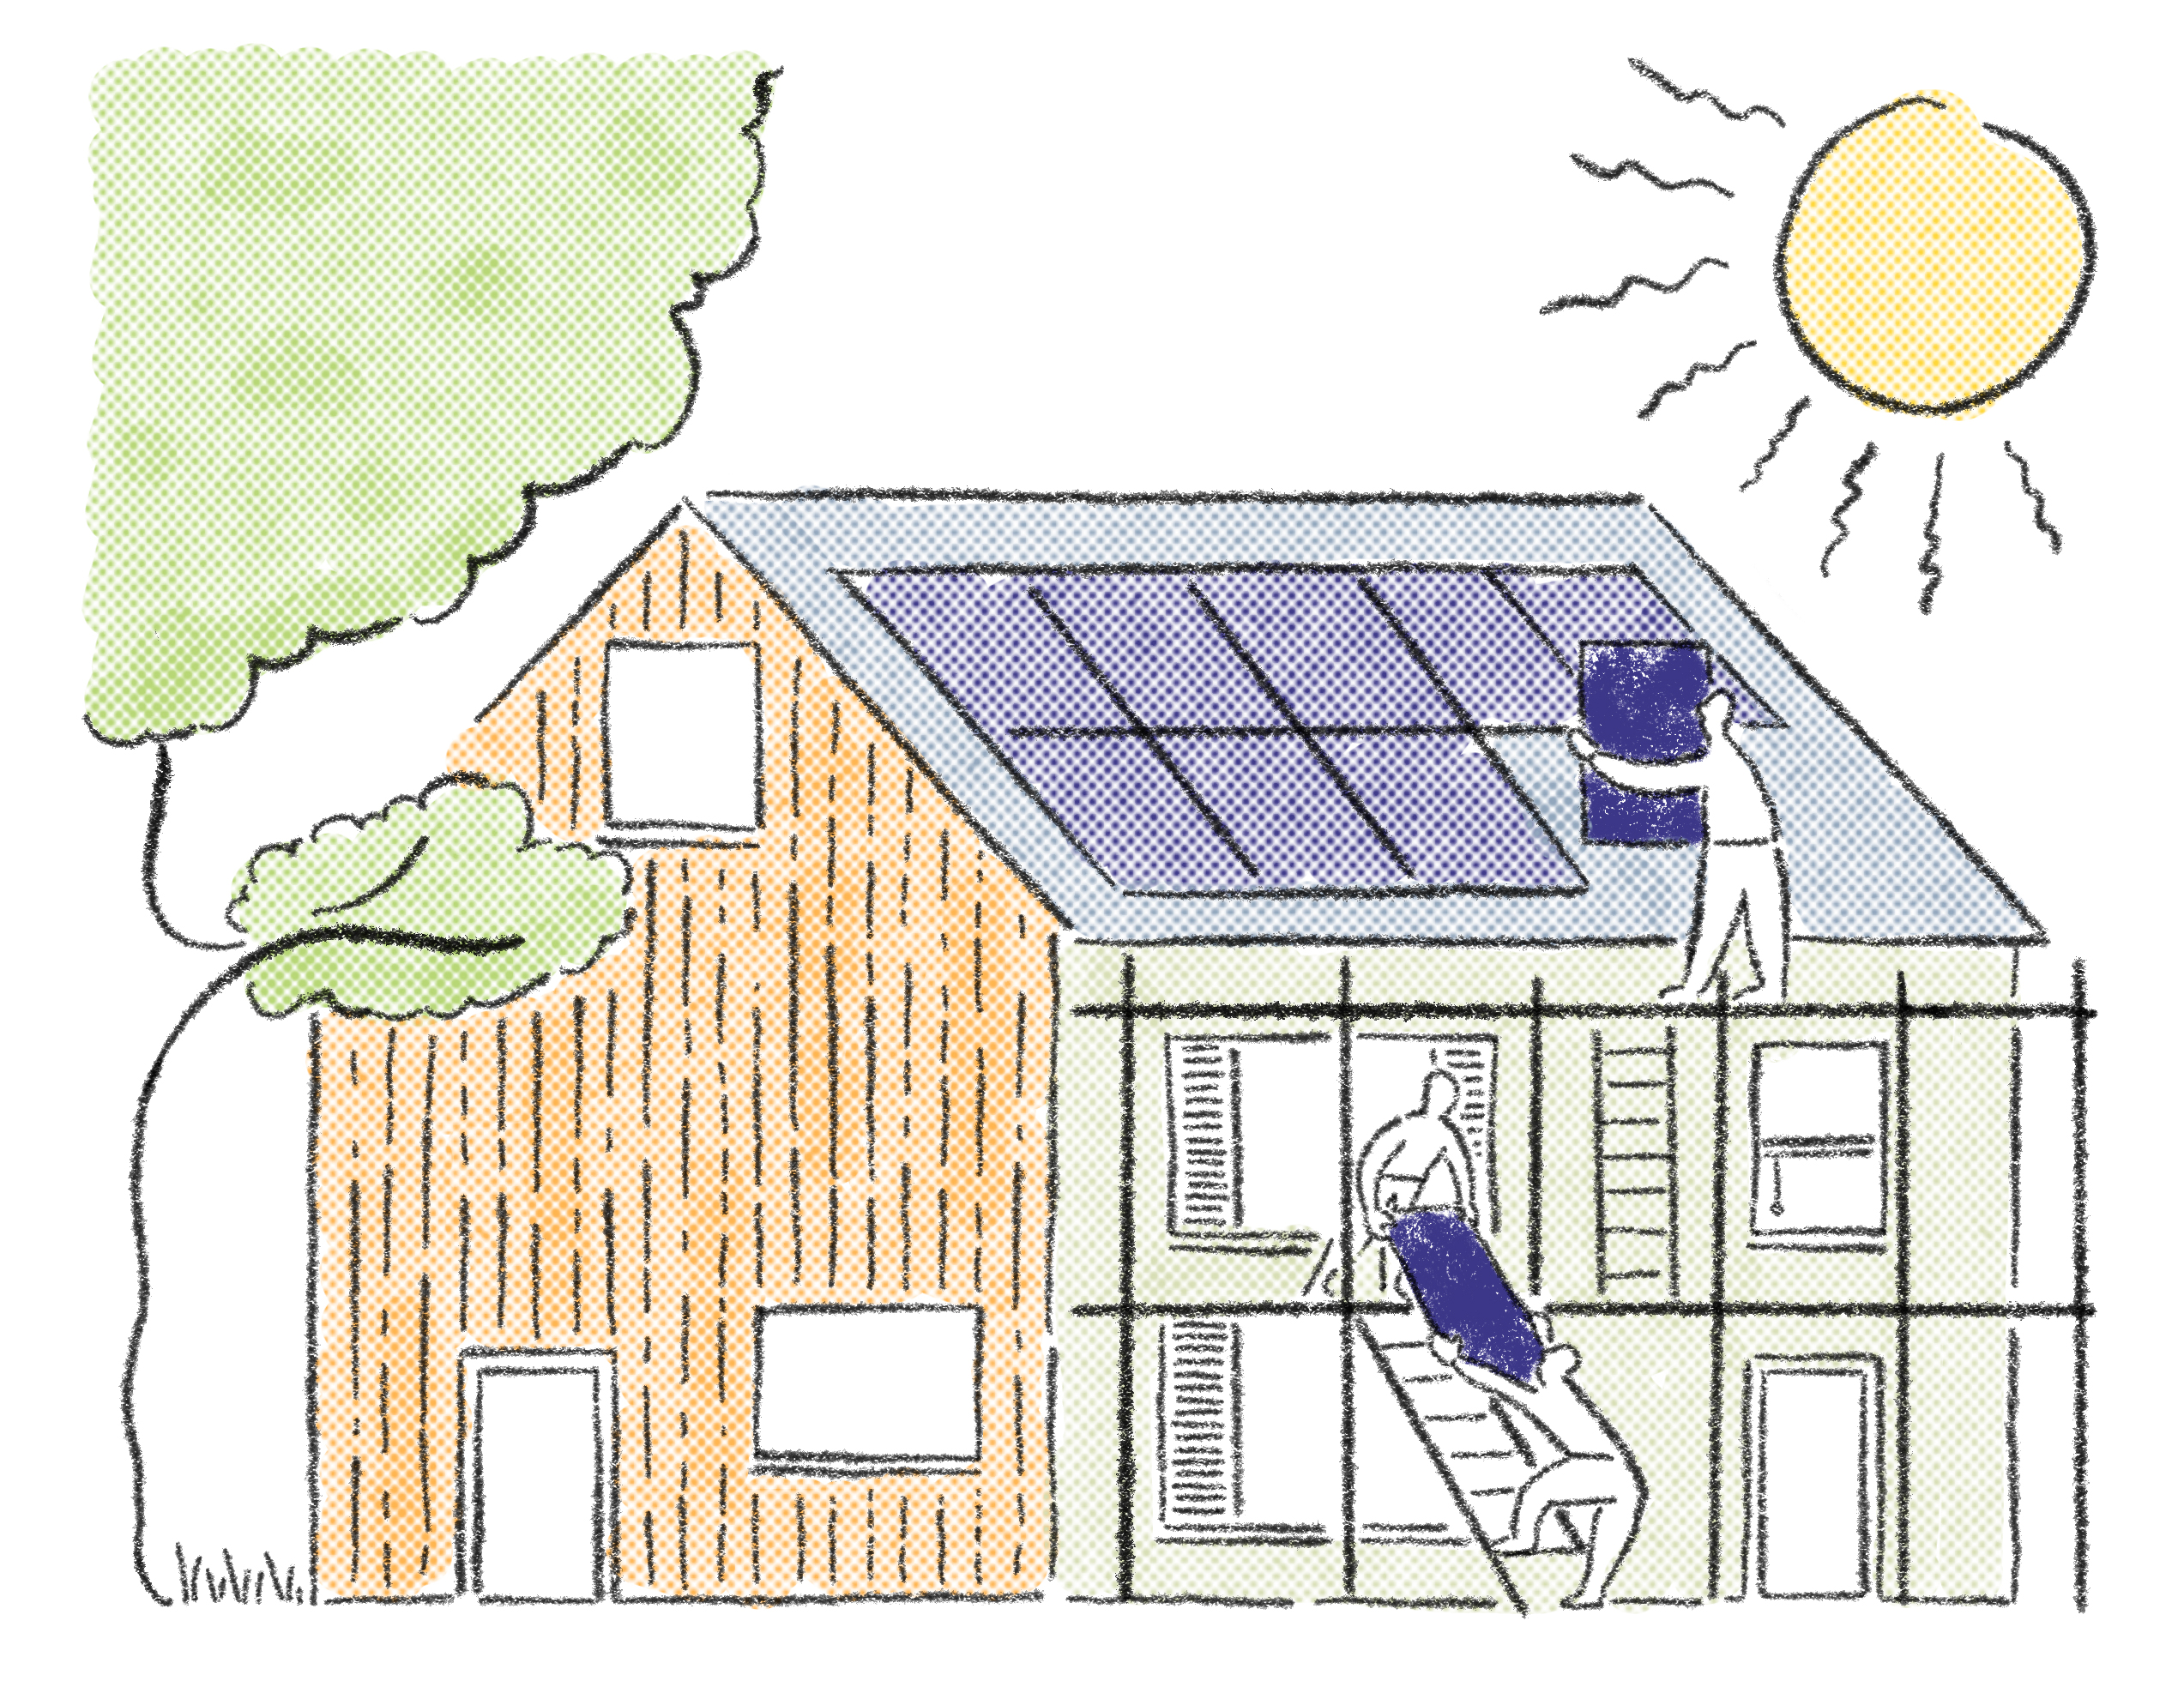
Information key
On having the information on the potential retrofit energy efficiency improvements that their home can achieve, 73% of people were likely to make the improvements.
Having skilled and knowledgeable advisors left homeowners feeling very satisfied with the service

Slide 17
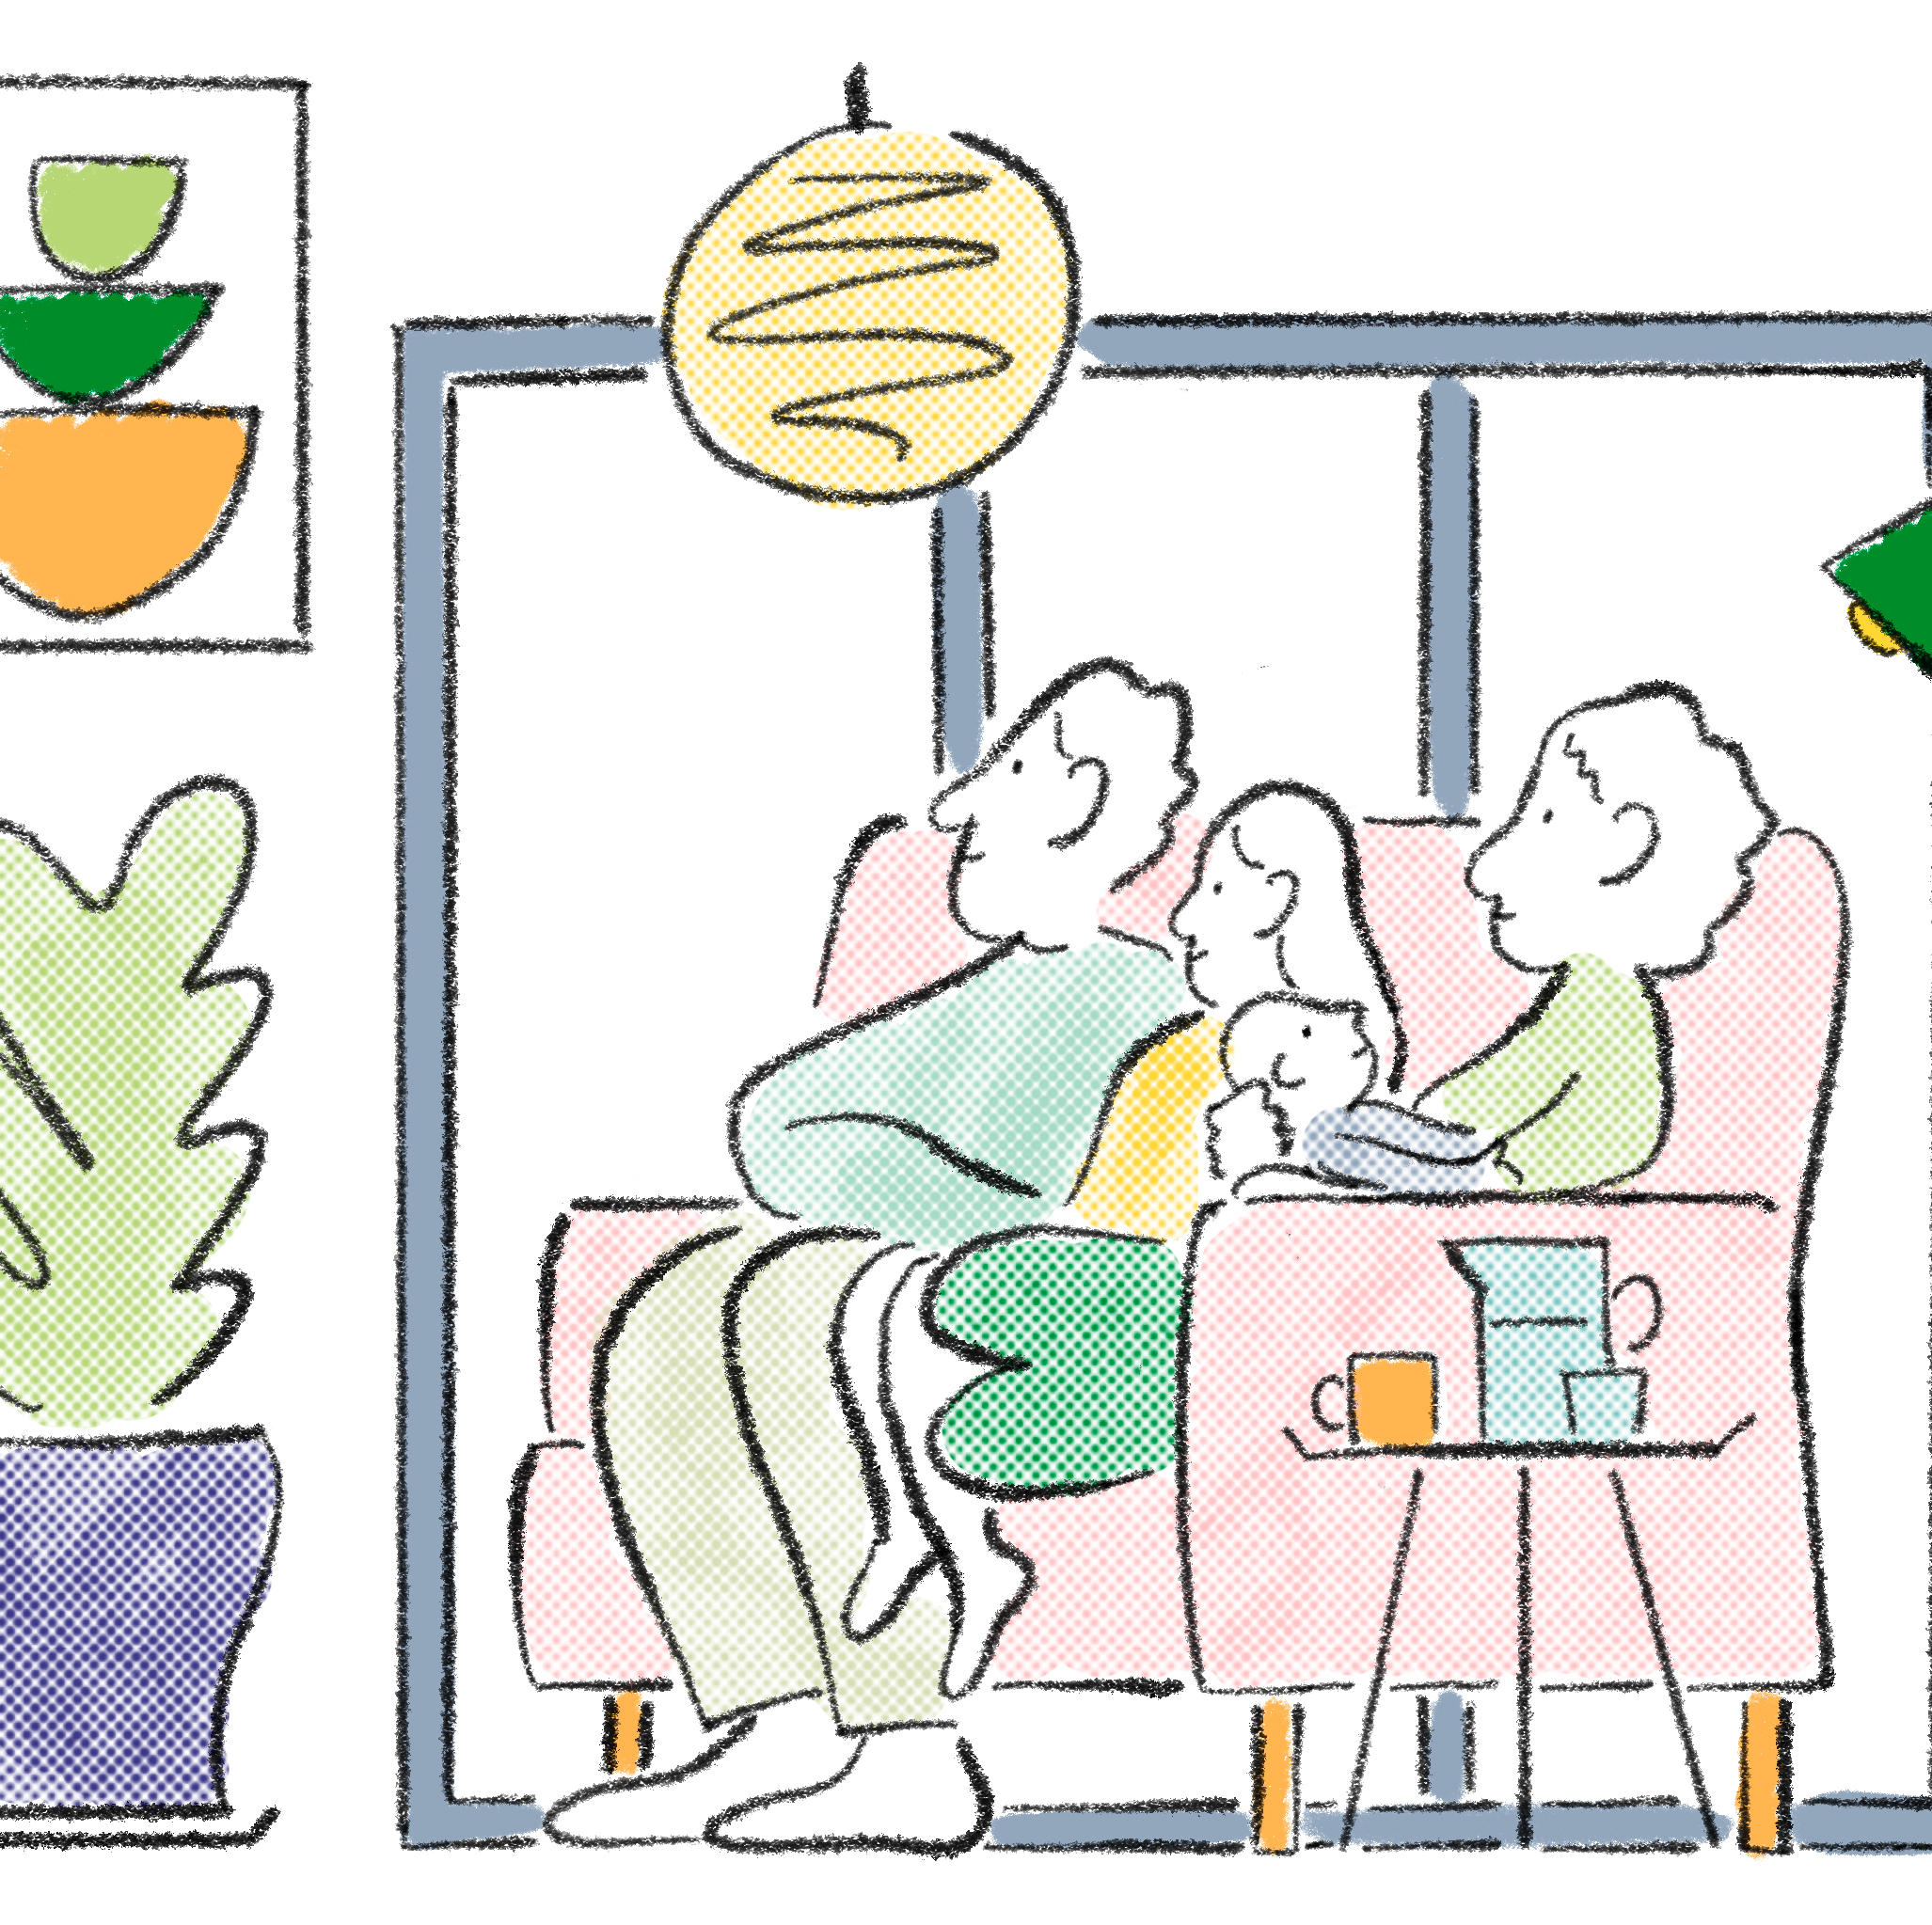
Who to market and where
Varying customers
Grant funded retrofit opportunities
Able to pay market
Low interest finance opportunities
Attending different events and networking with different partners to enable all homes the possibility to get their homes ready for the future.

Slide 18
Jess Atherton
Severn Wye

Slide 19


Local Energy
Advice Demonstrator
Jess Atherton – LEAD Project Manager
Notes:
Projects will provide detail on basic offer (duration, targets), aims of project, methods, personnel, partners, pen-pic/ case study and go through referral routes

Slide 20
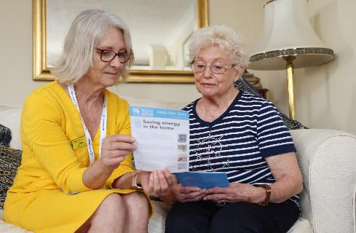
Overview – What's the challenge?
Domestic properties to be made more energy efficient in Gloucester and South Gloucester
This includes tenanted properties
Notes:
Aims:
- Equip and incentivise small/medium enterprises across Wilts and into Swindon to make carbon-saving improvements to their sites
Increase activity in the Wiltshire ‘green sector’ among energy efficiency contractors and those installing renewable technologies
Improve the quality of Wilts business premises
Make businesses more profitable
Contribute towards Wilts carbon neutral objectives: https://www.wiltshire.gov.uk/green-economy-climate-emergency (2030)
…and the LEP’s Local Industrial Strategy in terms of decarbonising the economy

Slide 21
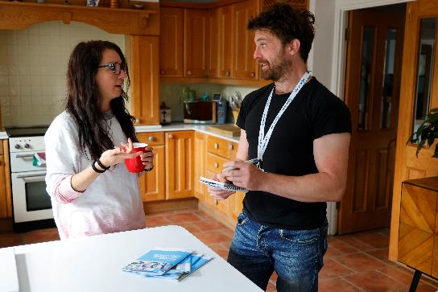
What are we doing?
We are doing this by providing Bespoke Energy Efficiency Reports (BEERs) which provide consumers with the knowledge to implement retrofit recommendations through private investment
EPC energy assessments
A simple and easy to understand report
A personal energy advisor to advise on priorities for measures based on customer needs
Help to identify and procure installers

Slide 22
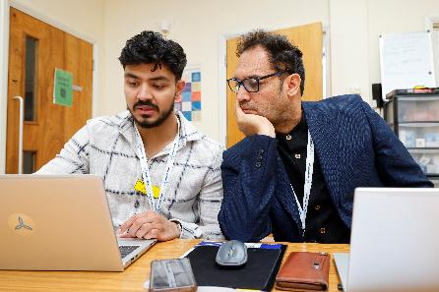
Who are 'landlords' and why are they hard to target?
Why such a difficult group to target
'Test and Learn' Strategy
Getting the messaging right
Research found that 1/3 of private landlords in the West of England were not fully aware of the Minimum Energy Efficiency Standards (MEES)
Notes:
Aims:
- Equip and incentivise small/medium enterprises across Wilts and into Swindon to make carbon-saving improvements to their sites
Increase activity in the Wiltshire ‘green sector’ among energy efficiency contractors and those installing renewable technologies
Improve the quality of Wilts business premises
Make businesses more profitable
Contribute towards Wilts carbon neutral objectives: https://www.wiltshire.gov.uk/green-economy-climate-emergency (2030)
…and the LEP’s Local Industrial Strategy in terms of decarbonising the economy

Slide 23
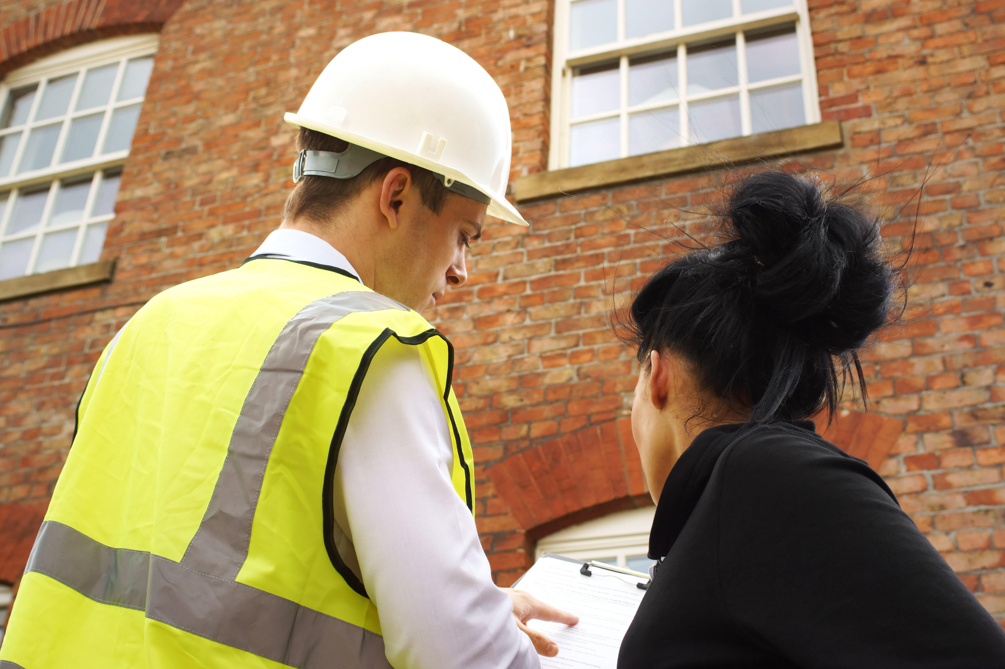
What we have learnt
Successes
Failures
What's round the corner for MEES

Slide 24
Local Energy
Advice Demonstrator
Jess Atherton – LEAD Project Manager
Notes:
Projects will provide detail on basic offer (duration, targets), aims of project, methods, personnel, partners, pen-pic/ case study and go through referral routes

Slide 25
Steven Cole and Amy Staff
Centre for Sustainable Energy

Slide 26


Hyper Local Approaches to Retrofit

Slide 27


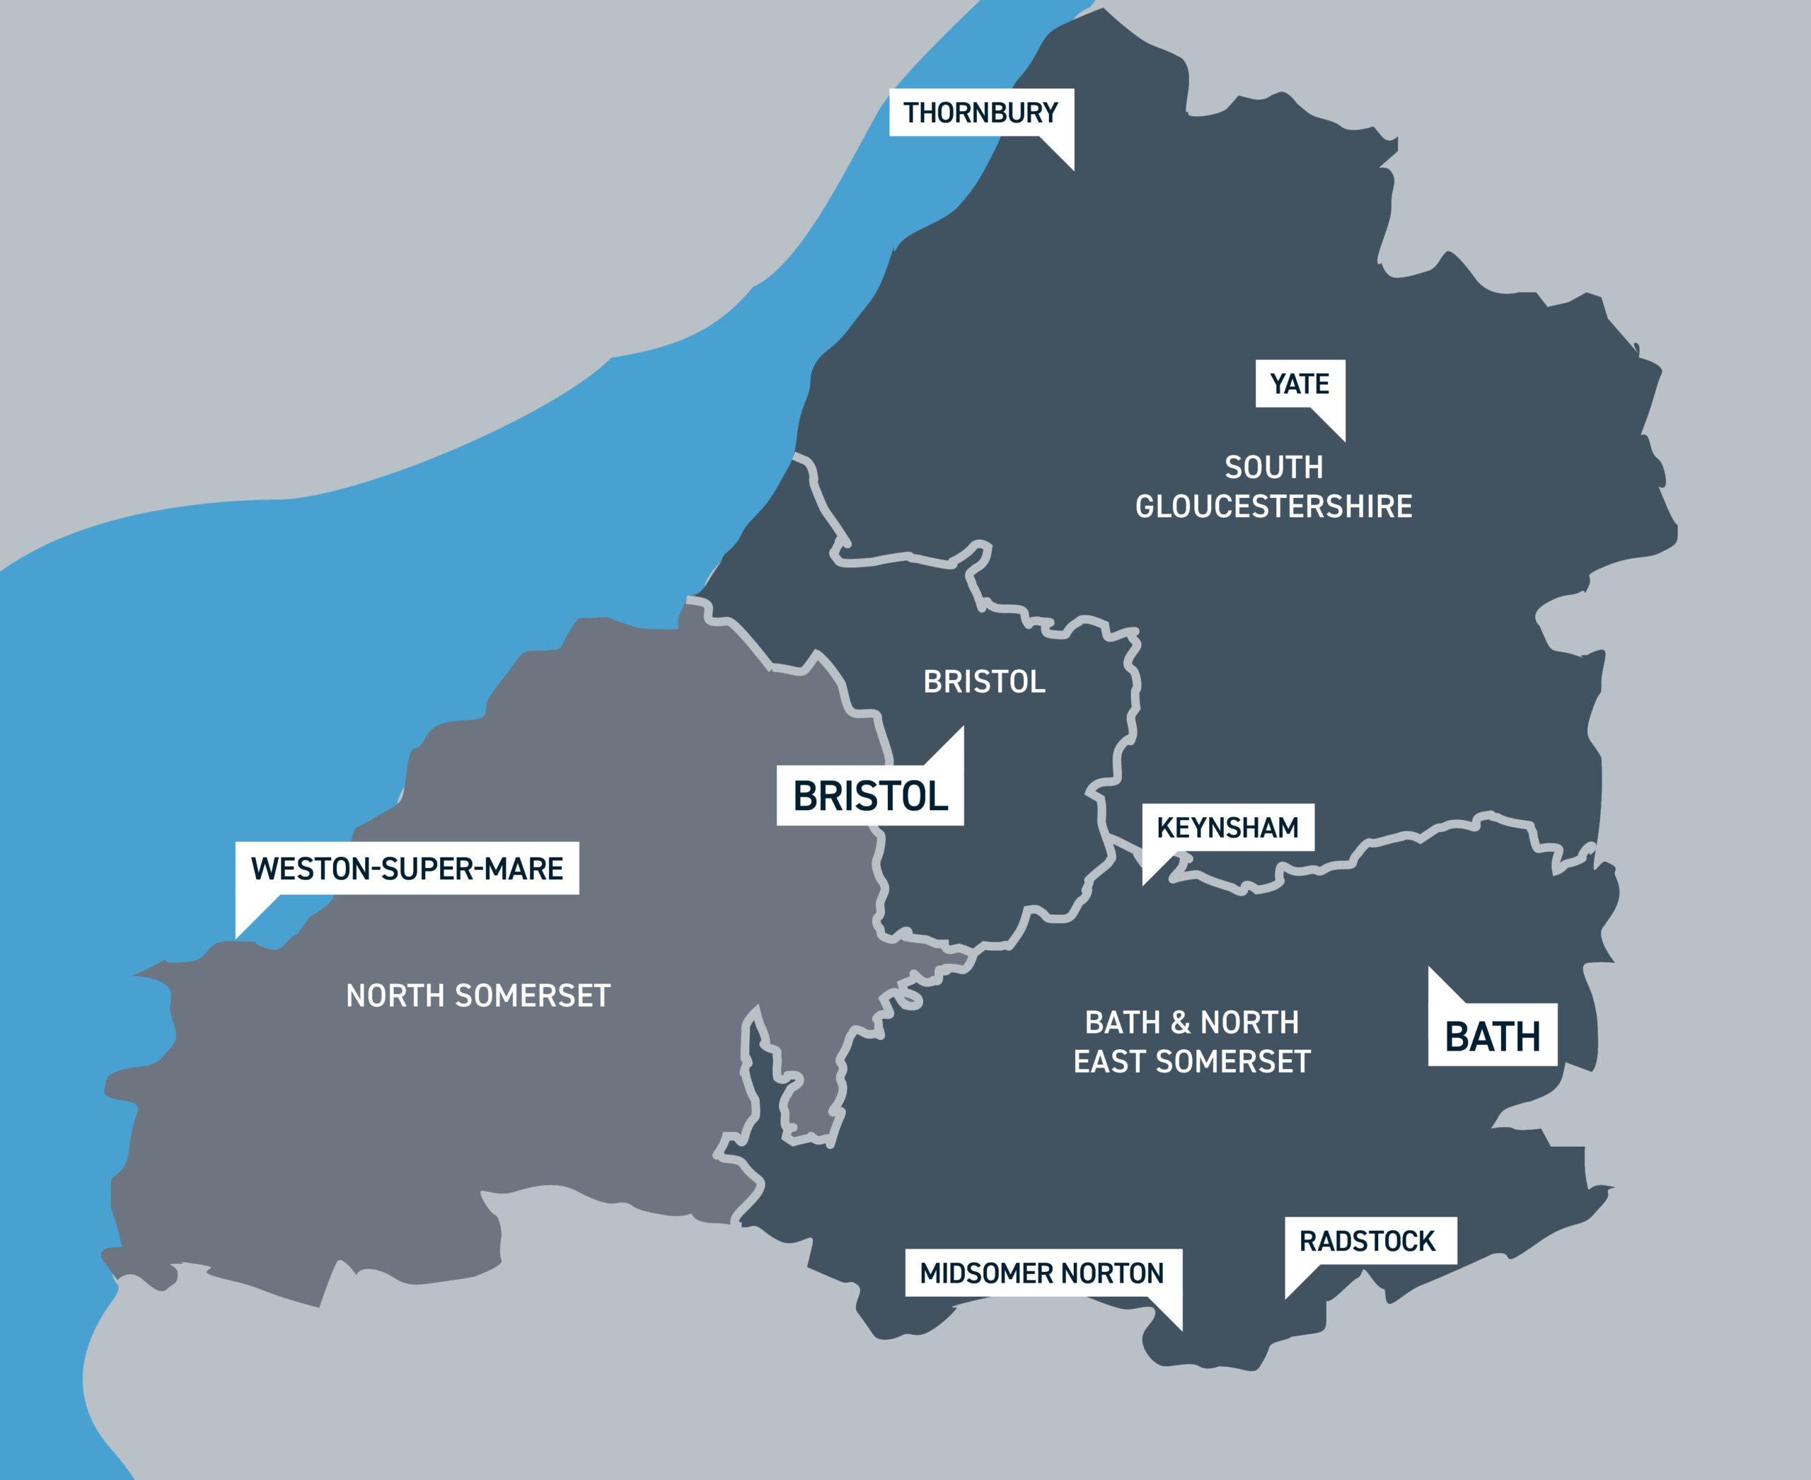
WoE LEAD: North Somerset
Aim: empower communities to act around retrofit
How? Grants for ‘Open Homes’ events
Why? Hear real accounts and experiences from homeowners
Foci: Hard-to-reach & hard-to-treat homes
Notes:
Our West of England Local Energy Advice Demonstrator project – or WoE LEAD approach was centred around ‘open homes’ events.
Aim: We want to get citizens and communities in North Somerset clued up about retrofit measures, and also address people’s concerns about where to start, costs, where to find reputable installers, disruption and energy bill savings.
How: Green open homes started in 2013, as a platform for people that have had home improvements done (e.g. solar panels) to share their stories. The worlds changed significantly since then, realised that lots of groups wanted to educate people on where to start. So not all homes we’re going to open are going to be ‘green’
Why: Sharing stories and hearing people's real accounts of their experiences is important. Things to consider might not crop up until you’re in the thick of it! For people getting started, there’s lots of information out there, and not all of it correct for your house, so we wanted to support people to start asking the right questions about their homes first, and avoid blanket advice.
Foci: We didn’t just want shiny (green) homes, we want old buildings, park homes, homes in rural areas, any homes, we wanted to demonstrate that retrofit can come in all shapes and sizes (and reach beyond the typical ‘greens’.

Slide 28




Limited/confused retrofit knowledge
Limited/no capacity of volunteers
Barriers
Rural vs Urban
No community group in area
Notes:
Naturally, we faced some barriers to engagement in the beginning.
Limited retrofit knowledge – people don’t know what they don’t know, so there was an element of training that needed to happen (more on this later!)
Limited capacity volunteers – some groups we contacted had 3 volunteers, so even with grant money, just didn’t have the time to dedicate to the project.
Some areas – Portishead/WSM didn’t have community groups – so we had to change tack there too!
Which brings on to how we adapted..

Slide 29


Hyper Local Events

Slide 30

Classic
Adapted
Green Open Homes
Not Yet Green Open Homes
Portishead Energy Expo
‘Sherlock Homes’ – House Investigation
Coffee Mornings
Energy/Buildings Climate Action Planning
Notes:
Of course, green open homes was our classic option, but this evolved into all these different events, which I’m going to delve into why they worked in each area!
Luckily through this project we were able to host ‘Other events’ – which good for attracting people that wouldn’t necessarily go to a specific ‘green’ event, and to meet people where they are, and recognise that everyone’s in different places.

Slide 31

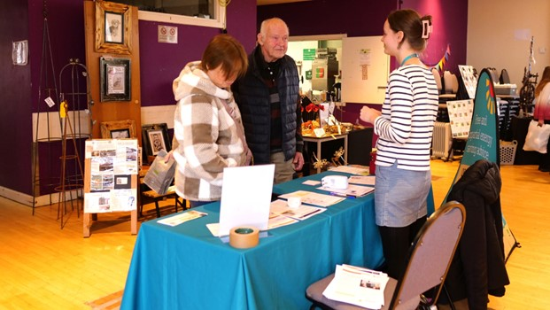
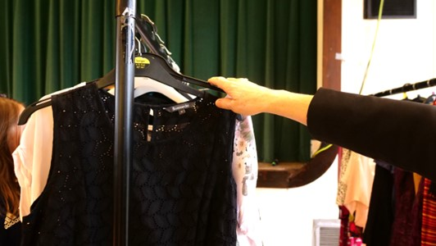
Portishead: Energy Expo
‘Market-place style’ event
5 Energy-related stalls
Mini retrofit training and kids workshops
Other types of stall (e.g. clothes swap) brought in extra numbers
Notes:
Didn’t think the homes approach would work for them, nor would an energy focused day! So it developed into this:
5 energy related stalls (thermal imaging camera loan service, energy advice/SMEAPs, retrofit storytellers, children’s activities (colouring, pin the retrofit on the house, Whats the Deal?, make a draughtproofing snake), retrofit basics training, childrens workshop

Slide 32
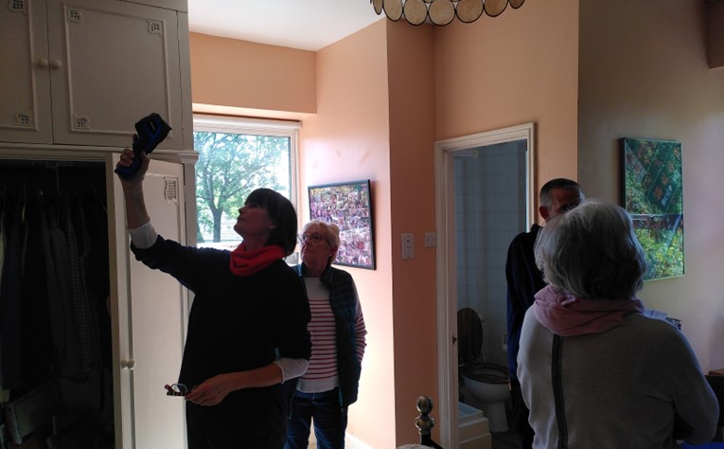
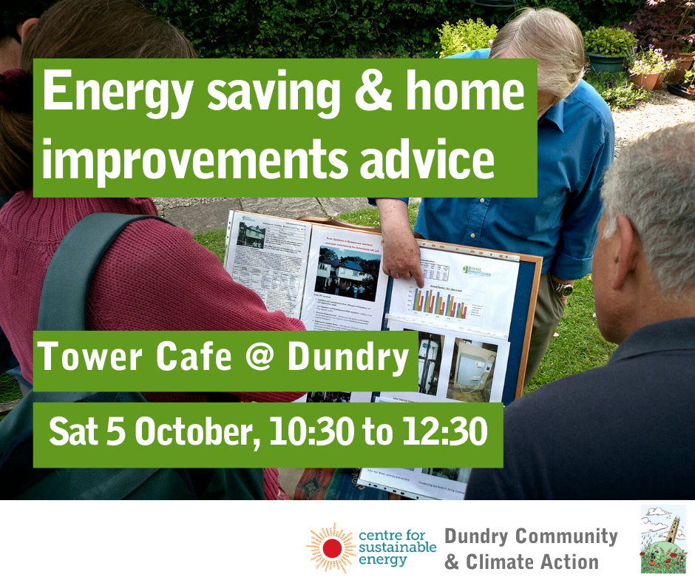
Dundry
Not Yet Green Open Home
Tours of 2 open homes (1 traditional with extension, 1 modern)
DIY Building Survey
15 people attended
Coffee morning
Thermal imaging service
Energy advice
20 people attended
Notes:
Not Yet Green Open Homes – wanted to know where to start – recognition that there weren’t ‘shiny’ show homes in the area. Particularly interested in thermal imaging cameras. Not necessarily old part of the house that’s the issue (it’s the extension).
Led on to a coffee morning, N Somerset do have a free thermal imaging camera loan service, but it’s over subscribed, and the nearest library is a 20-minute drive. Funding used to purchase cameras, worked with a councillor who regularly visits the rural wards in the area. The idea is that she will take them around with her to loan out when visiting areas. This was launched at one of their monthly coffee mornings, alongside an advice stall and camera demonstration.

Slide 33
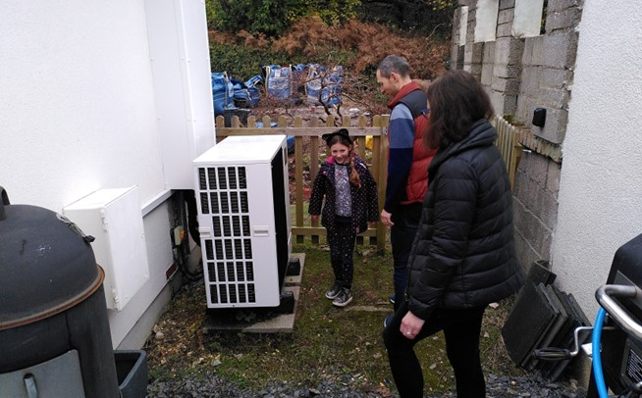
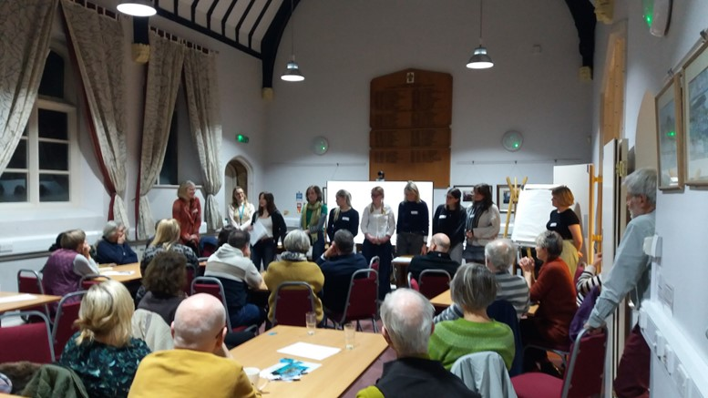
Clevedon
Green Open Homes
6 homes opened over 2 weekends
96 visitors
Action Planning
Clevedon Climate & Nature Partnership
Plan for energy/buildings in Clevedon
Notes:
After doing their own not yet green home event (spoken about in a previous webinar!), Sustainable Clevedon felt the next natural step was to host GOH events – our classic approach! They did 2 different events over 2 weekends, with 6 homes opening in total, and demonstrating solar panels, solar thermal, heat pumps, and even thermal wallpaper!
Beyond that, Clevedon were keen to do some climate action planning for their area. To build on the work they’d already done, we led a 2-part session specifically around energy/buildings, the first of which (engaging community/inspiring speakers from community energy projects/retrofit basics), second session will be around coming up with ideas for space/water heating/building fabric/energy generation and energy saving behaviours and planning what the next 6-12 months will look like for that. Notably at the first session we had an enthusiastic group of young people from Clevedon School that came to the session to speak about their climate action work, and they’ll be coming back to input into the plan for their area.

Slide 34
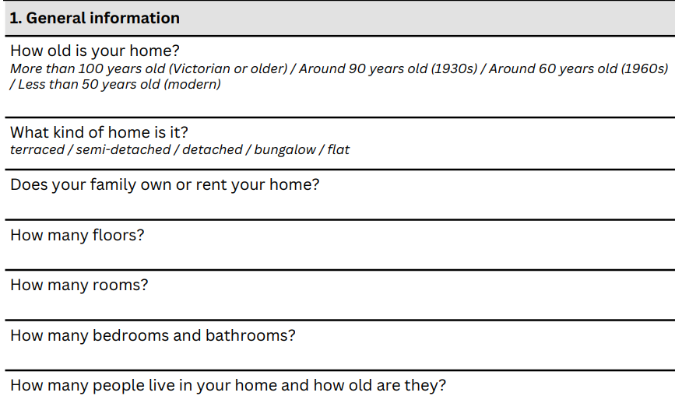
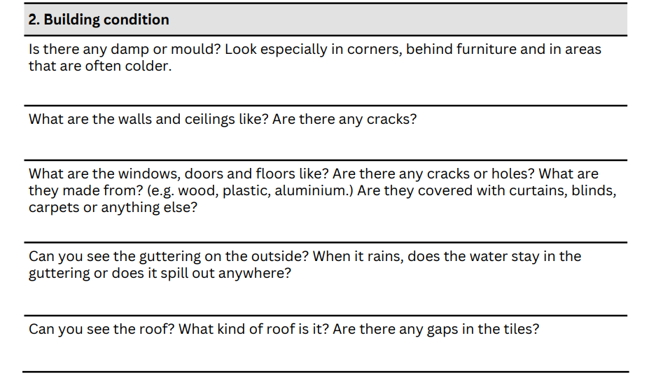
Weston Super Mare: Sherlock ‘Homes’
DIY Building survey for KS2
Workshop taking place in January
And….
Ventilation and draughts
Heating
Lighting
Water use
Notes:
Lastly, Weston Super Mare demographic is primarily renters, many of which are suffering from fuel poverty (community group in the area). The open homes approach was therefore not quite right for this area. We did however have Axe Scout District get in touch about hosting an event with us, and were interested in the energy efficiency of their scout hut. As this project was aimed at domestic level, we worked with our Future Generations team to edit our DIY building survey to KS2 (7-11 year olds). The aim being that these young people start to think about the kinds of things to ask to understand how buildings work, and they’ll share their findings with other scouts at an event in January. We pitched it as a ‘house investigation, leading to the name ‘Sherlock Homes’.

Slide 35
Local Data

Slide 36
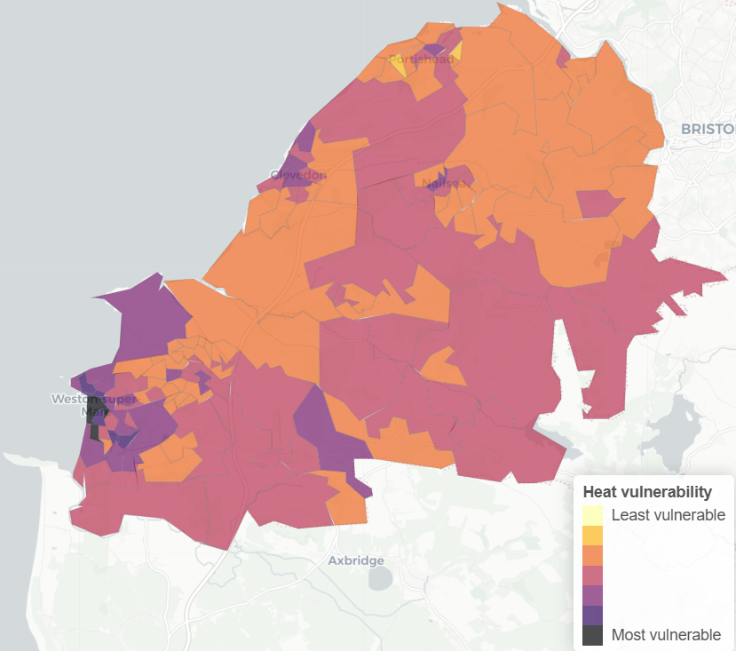
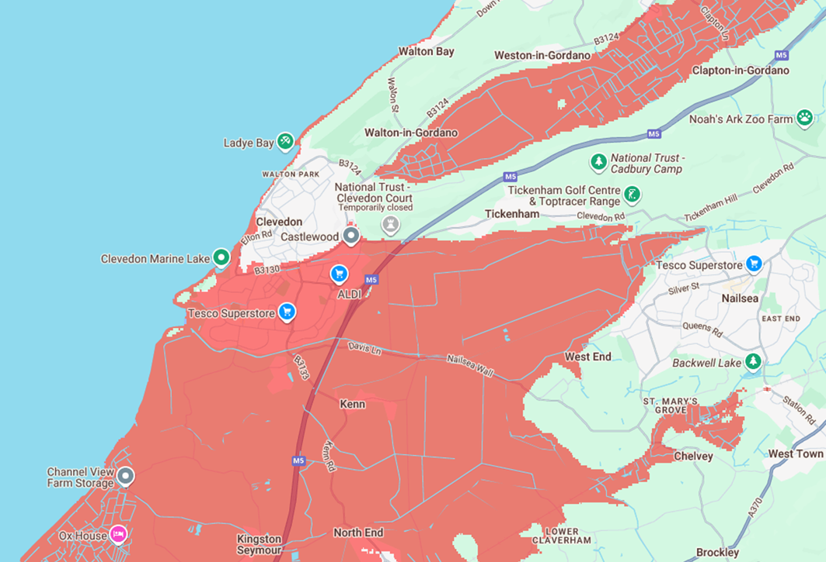
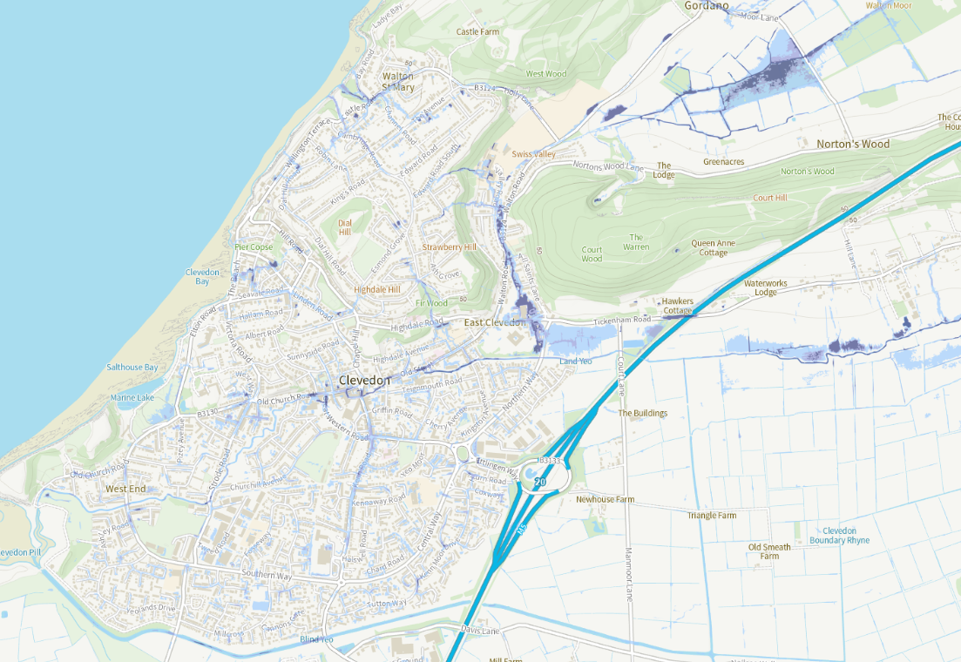
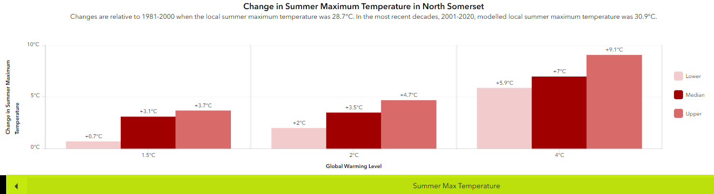
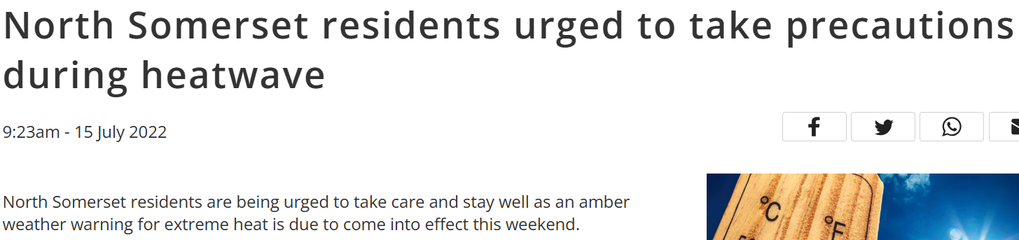
Using Local Data: Maps
Highlight local data to make issues locally relevant
Tailored retrofit advice
Example: Clevedon climate action planning
Notes:
Just a point about the importance of making sure we’re making issues locally relevant for people, and the advice that we give as a result (and that it’s not the same for everywhere!)
These maps are from Climate Central, Environment Agency – sea level rise by 2050 and surface water flooding risk. VCS Emergency Planning Tool – highlights vulnerable people exposed to frequent heat. This last one is a new met office Local Authority Climate Explorer tool, which shows you the local impacts of climate change under 1.5, 2 and 4 degrees of warming. In Clevedon – this means that in our events we’ve not recommend cavity wall insulation, and want to make sure residents are aware that overheating will become an increasingly prevalent issue.

Slide 37
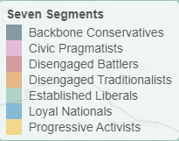
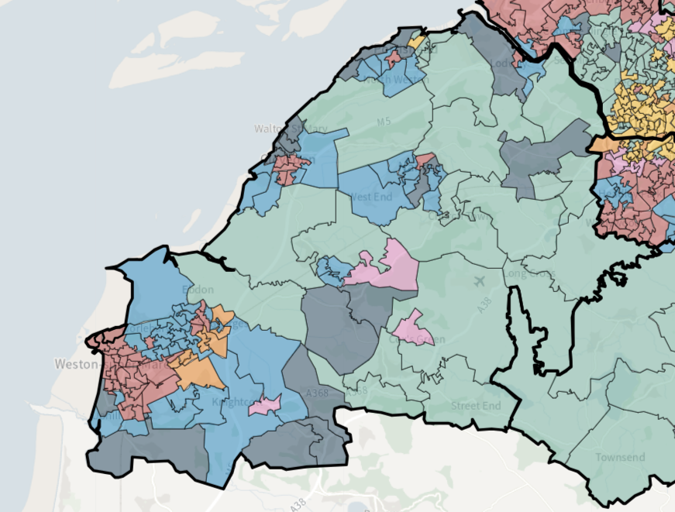
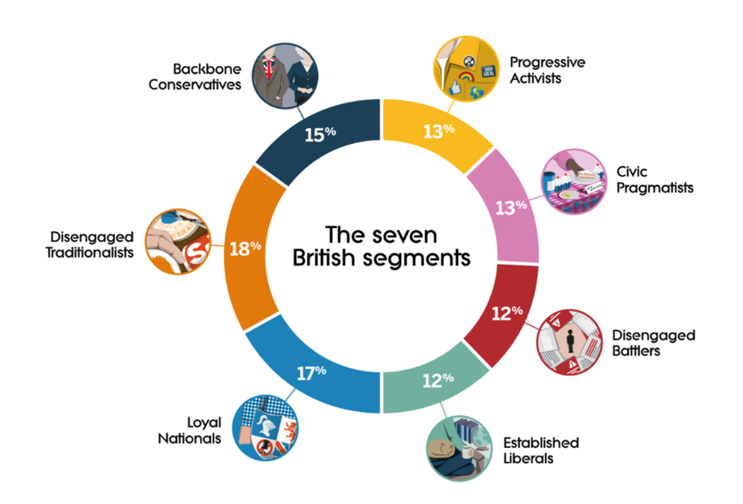
Using Local Data: Britain Talks Climate
Common agreements on benefits of taking climate action:
Protect future generations
Create a healthier society
Preserve the countryside
Values like fairness, avoiding waste, unity and pride go across all segments.
Example:
Portishead Energy Expo – tailored messaging
Britain Talks Climate toolkit
Britain Talks Climate - WECA
Notes:
The most prevalent segments in Portishead specifically are ‘loyal nationalists’, and ‘backbone conservatives’ so taking a ‘local action (both), saving money (LN), improving health (both) and preserving heritage (BC)’ approach might be better, as these are the topics that are most important to these groups.
Energy Expo poster text:
“Discover: home maintenance tips to benefit your health and save you money
Learn: how to preserve your traditional build home
Hear: energy efficiency improvement stories from local people
Meet: local installers
Support: North Somerset businesses. “
Clothes Swap text:
“UK citizens spend up to £400 every year on new clothes
By joining our clothes swap and fashion show, you can help:
Keep clothes in use locally
Learn how to mend your favourite pieces
Save money”

Slide 38
Training

Slide 39
An Introduction to Repair, Maintenance and Energy Efficiency in Old Buildings
(Tywi Centre)
Home Improvements: The Basics (CSE)
3-part series (evenings)
Live webinars & recorded
Mini:
Recruitment event
Portishead Energy Expo
Action Planning
Full day
In-person (across WECA)
Notes:
When you do things changes your audience:
Full day – part of work (e.g. local community orgs, CHEESE people, retired people)
Evening – people with jobs (spare time)

Slide 40
Learnings & Impact

Slide 41
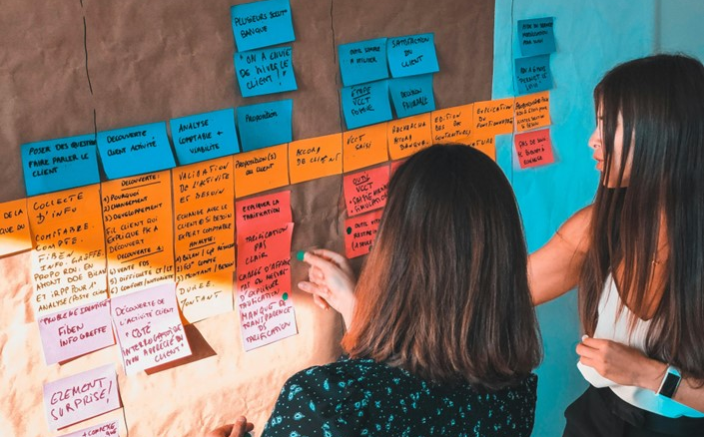
Capacity Building – Learnings
Think long term - no boom and bust
Build on previous work – no wheel inventing
Staff – pay people for their time
Collaboration (installers, community groups, similar organisations)
Notes:
Collaboration: Not a competition

Slide 42
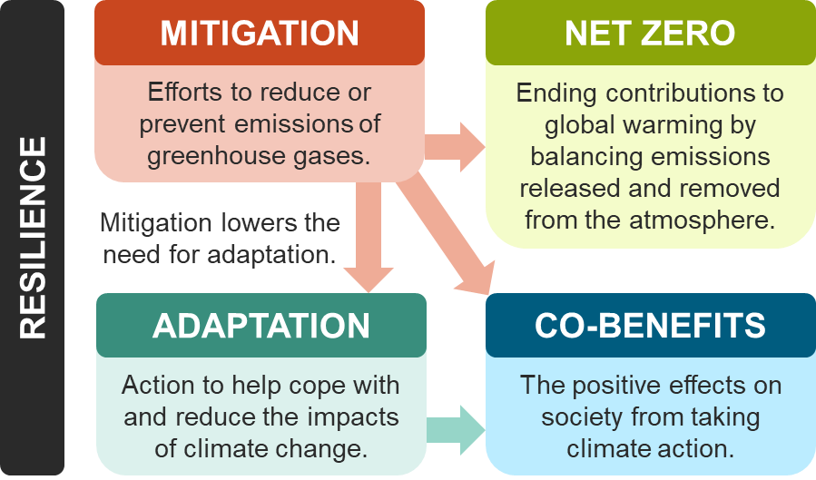
Community Resilience
Notes:
Collaboration: Not a competition

Slide 43

Capturing Engagement Impact
How do you value it? Is it captured by KPIs?
How much work is it? Building trust takes time
No one size fits all!
Notes:
Building trust takes time – recruitment → starting from scratch → cold emailing → community events

Slide 44
Thank You!
Keep in touch: WoE-EnergyDemo@cse.org.uk
We’re a charity supporting people and organisations across the UK to tackle the climate emergency and end the suffering caused by cold homes.
cse.org.uk

Slide 45
Thanks for listening
Questions?

Slide 46
Contact us and sign up to our newsletter
www.swnetzerohub.org.uk
swnetzerohub@westofengland-ca.gov.uk
South-West-Net-Zero-hub
Sign up to the rest of the webinar series https://www.swnetzerohub.org.uk/knowledge/events/lead-webinars/

