Slide 1
How to attract the finance necessary to deliver a decarbonised local energy ecosystem in the South West
Laurence Diment
Assistant Director, Local Authority Advisory & Lending
25th April 2024

Slide 2
Contents
Introduction to the UK Infrastructure Bank
Local Authority Advisory and Lending
Developing a bankable proposition
How UKIB can help

Slide 3
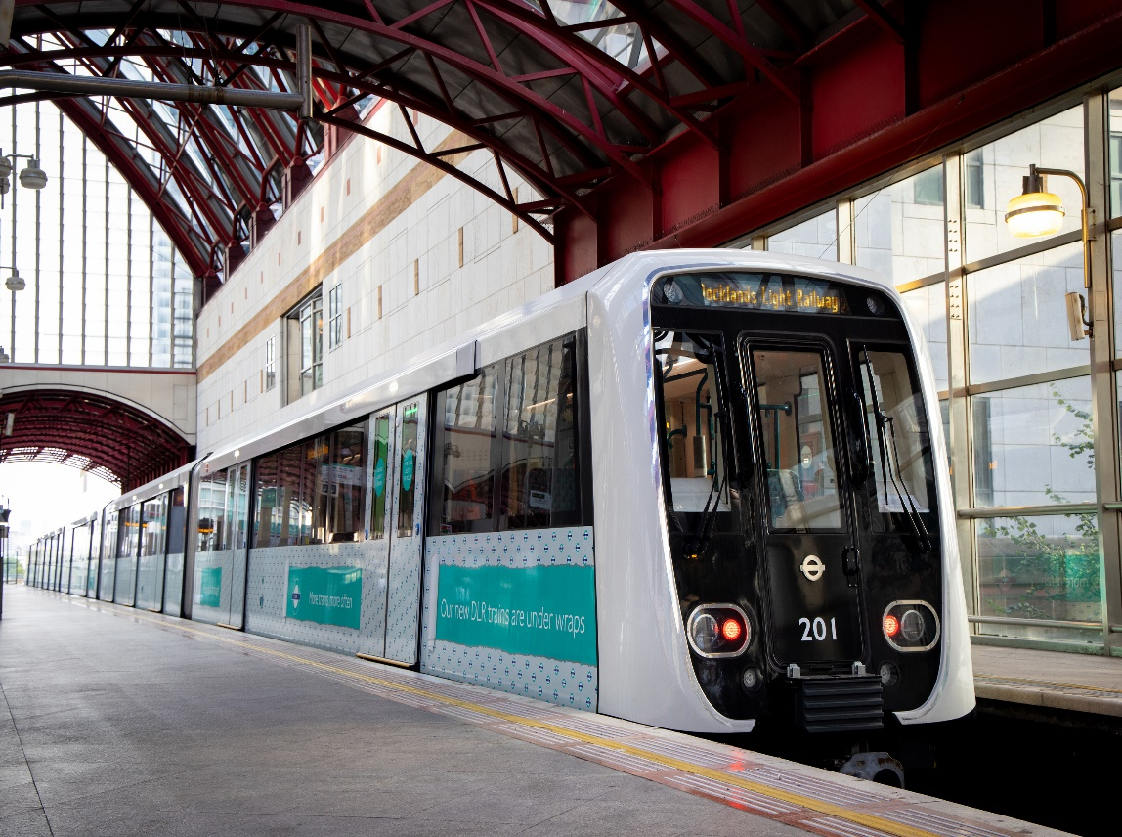
Introduction to UKIB
Two core objectives:
    Help tackle climate change; and
    Support regional and local economic growth.
  Four Investment Principles:
    Supporting the Bank’s objectives;
    Investing in infrastructure assets or networks, or in new infrastructure technology;
    Delivering a positive financial return, in line with the Bank’s financial framework; and
    Crowd-in significant private capital over time¹
©Transport for London
¹ Not a requirement for local authority lending

Slide 4
Local Authority Advisory and Lending
£22 billion financing capacity
£8bn debt & equity
£10bn guarantees
£4bn local authority debt
Local Authority Advisory Service
UKIB Priority Sectors
Clean energy
Transport
Waste
Water
Digital
Building decarbonisation
Mass Transit
Mixed infrastructure
LA Focus
Heat networks
Electric Vehicles
Solar

Slide 5
Developing a bankable proposition
Identify project cashflows
Understand funding / financing requirements
Assess funding / financing options
Strategic alignment
Delivery strategy
Risk management / mitigation
Evidence of project maturity

Slide 6
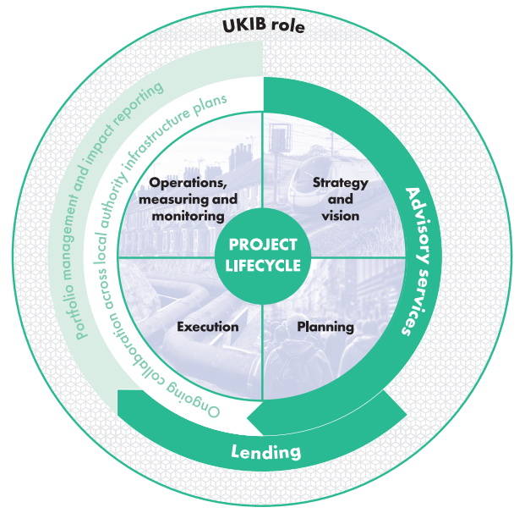
How UKIB can help
Advisory
Funding and financing options
Commercial delivery options
Business case review
Lending
Low cost, flexible debt finance
Project review process

Slide 7
Contacts
Laurence.Diment@ukib.org.uk

