Slide 1
Decarbonisation of Heat
Session Chair
Liz Warren, Director, SE2

Slide 2
Liz Warren
Director
SE2

Slide 3

The role and interdependency of heat in a thriving, decarbonised Local Energy System
Liz Warren, SE² Ltd
25 April 2024
Notes:
Intro Liz
Now this title may make you think about having a post lunchtime nap, so let’s jazz it up a little…

Slide 4
Five things to think about when you think about heat
Liz Warren, SE² Ltd
25 April 2024
Notes:
That’s better! Some of this is going back to basics, but I wanted to build you into thinking about heat before we go into the presentations from Naomi, Mark and Sam.

Slide 5
1. What’s it for?
And these relate to:
Householder need/preference
Householder comfort/ affordability
Organisational need
Demand patterns (time/day/ season)
Infrastructure
Space heating
Hot water
Process heat
Steam
Cooling
Power generation
Storage
Nothing at all
Notes:
LOCAL – all those relationships are LOCALLY SPECIFIC

Slide 6
2. What resources do you have / need?
Fuel resources
Ground
Water
Air
Waste
Electricity
Wood
Oil
LPG
Sun
Which need
Availability
Price
Supply chain
Location
Sustainability
Physical space
Time
To meet demand
Types of heating
Quality of heat
Density of demand
Demand reduction
Using systems
Emitters
Controls
Secondary heating
People!
At different scales
Individual
Communal
Network / district
Notes:
Resources – are locally specific
Scale is locally specific
These are the things that will create your heat economy within your energy economy.

Slide 7
3. What else is important?
Energy efficiency
Grid availability and capacity
Energy prices, particularly electricity
Shifting the default
A changing climate
Control
Notes:
Some of these are not so local:
Energy efficiency – the cheapest unit of energy is the one you don’t use. Still a local thing
Grid availability and capacity – very competitive, very costly, long delays in planning for things like heat pumps on new developments. Getting more regional.
Energy prices change the nature of the game, bringing different techs in and out of favour
Default – we have to shift our counterfactual away from gas boilers. Most people don’t remember what it was like before gas boilers. Actually you may have a local advantage here if you have people on non gas systems who get extra benefit from moving to something like a heat pump because it’s just so much easier to run.
Temperatures / seasonality / climate change / cooling
Control – you can have the best heating system in the world but it means nothing if it can’t be controlled by the user

Slide 8
4. What else does it take?
Money stuff:
Commercial models
Ownership of buildings, infrastructure, resources
Funding and incentives
Capital costs
Running costs
People stuff:
Willpower
Knowledge
Supply chain
Marketing
A plan
And policy…
Notes:
Money stuff: the good news is that a lot of this stuff has been thought about. Heat networks are rich at the moment and grants for heat pumps are high.
Willpower – and belligerence
Knowledge – or access to people with knowledge
Supply chain: scale, trust, quality

Slide 9
5. So what should I do?
Understand your community - people, organisations, buildings
Get to know your local supply chain
Map out demand for different types of heat
Make a plan (check out the session later today on LAEP!)
Work with partners
Learn from each other – practitioner networks, the Hub
Notes:
Don’t ignore it: heat is around 37% of UK emissions; 40% of households report they are using less energy because of price rises and struggling to pay their bills.
Knowledge is power: data sets about your local residents, local business population, major public sector organisations and all the types of buildings that they use will help you be both strategic and tactical
Supply chain: who are they? What can they do? What can’t they do? How are you going to make sure there are enough to go round?
Make a plan: there’s a whole session later about Local Area Energy Planning – which is a fantastic process. But also your Local Plan. Remember: this is not just about Heat Supply, it’s about Demand Reduction and Energy Efficiency too.
Work with partners – eg local housing associations, major energy users, consultants, DESNZ. You don’t have to do everything. You just need to put in place conditions which will be really supportive of change.
Learn from each other – District Heating Divas; The Heat Network; UKGBC LARF; the Hub

Slide 10
Thanks for listening!
Liz Warren, SE² Ltd
www.se-2.co.uk / www.districtheatingdivas.com 25 April 2024
Notes:
You’ll note that I didn’t talk about specific technologies. That’s because the technology choice will depend on a whole range of other factors that you have to think about first: who and what the heat is for, what resources are available, your interdependencies, and some of those broader considerations around financing, supply chain and risk. The good news is that the technologies exist and they are already out there working. The tricky stuff is not around the technologies but around organising for change, understanding heat as part of a system, and coordinating local heat in ways that serve local needs.

Slide 11
Naomi Harnett
Delivery Manager
East Devon Council

Slide 12

A Council perspective on district heating
eedez.com

Slide 13
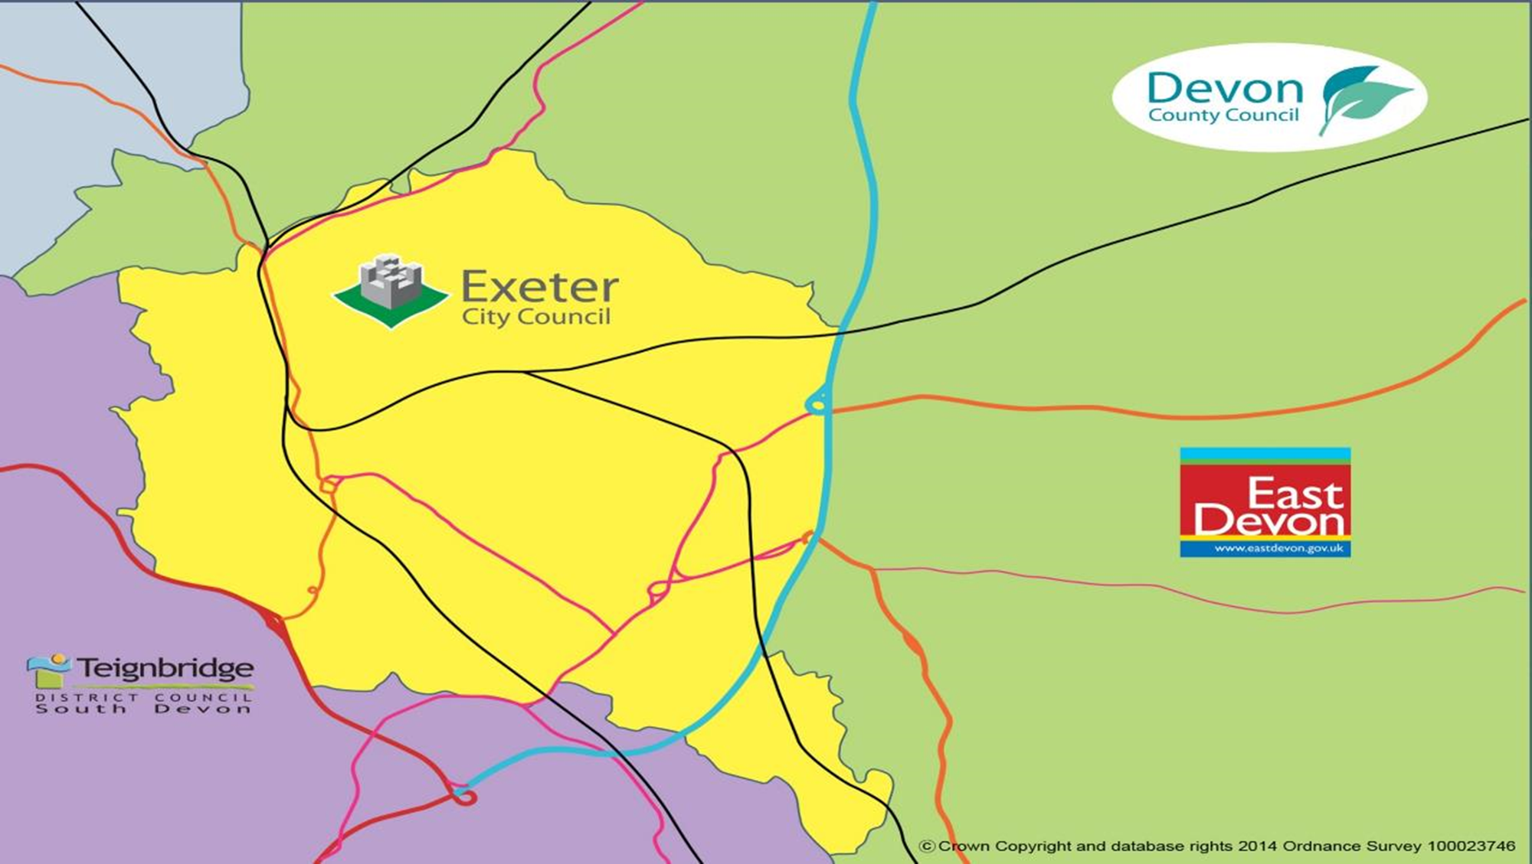

Slide 14
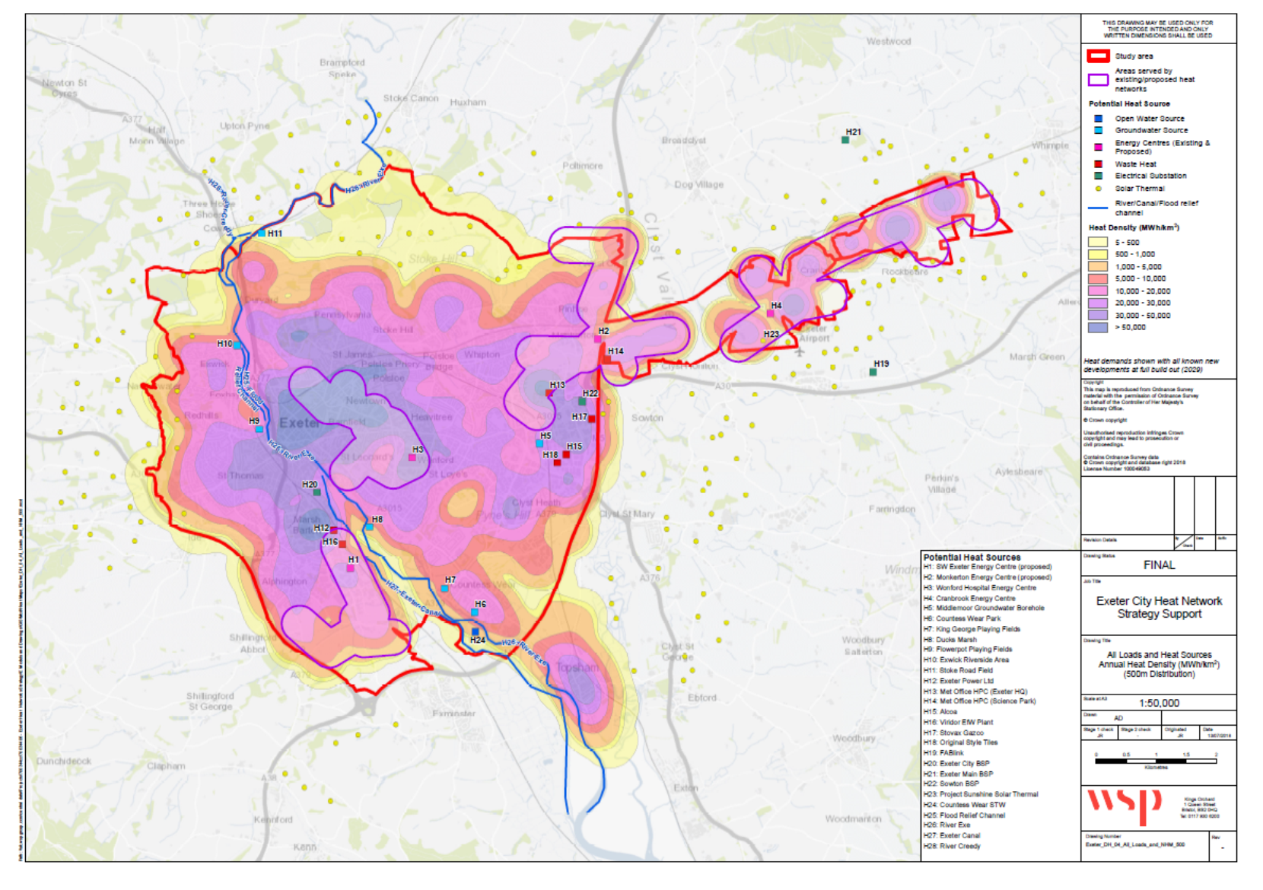

Slide 15
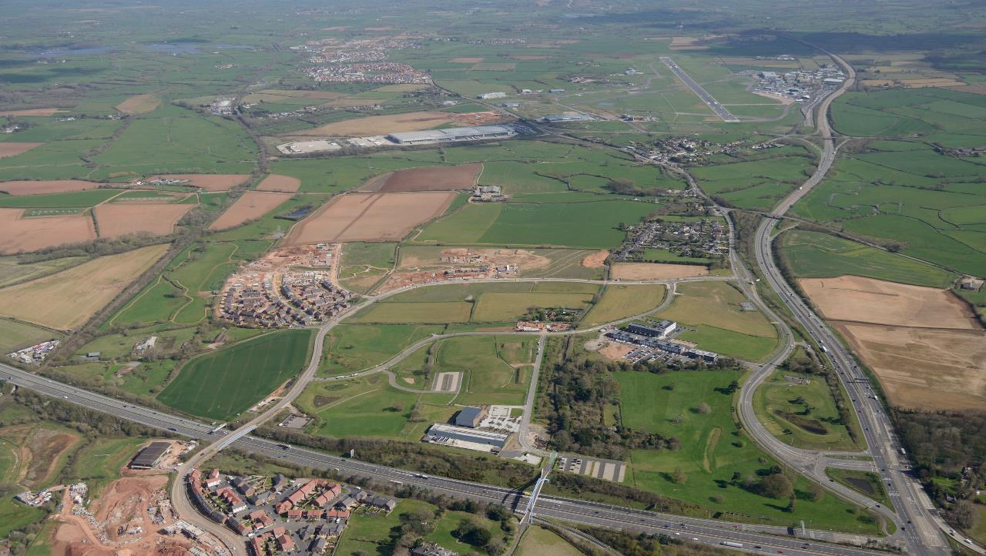
Key ingredients
Major growth corridor
Extending eastwards from Exeter
Strategic location at nexus of A30 & M5
Planned to accommodate 12,000 homes and circa 4m sq ft of commercial space
Substantial investment in enabling investment

Slide 16

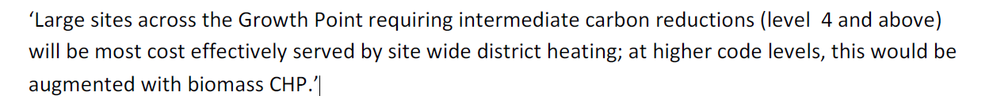
Why district heating?

Slide 17
Timeline
2008 - Element Energy Study
2010 - Cranbrook/SkyPark concession
Planning permission for Energy Centre
with biomass obligation
2012 - Heat on, first occupations
2015 - Monkerton/Tithebarn concession
2017 - Heat on
2019 - Biomass trigger reached
2020 - HNDU feasibility study
2021 - Heat Network Investment Programme bid
2022 – Green Heat Network Fund bid
Today - Cranbrook Plan
Live applications for 2,745 homes

Slide 18
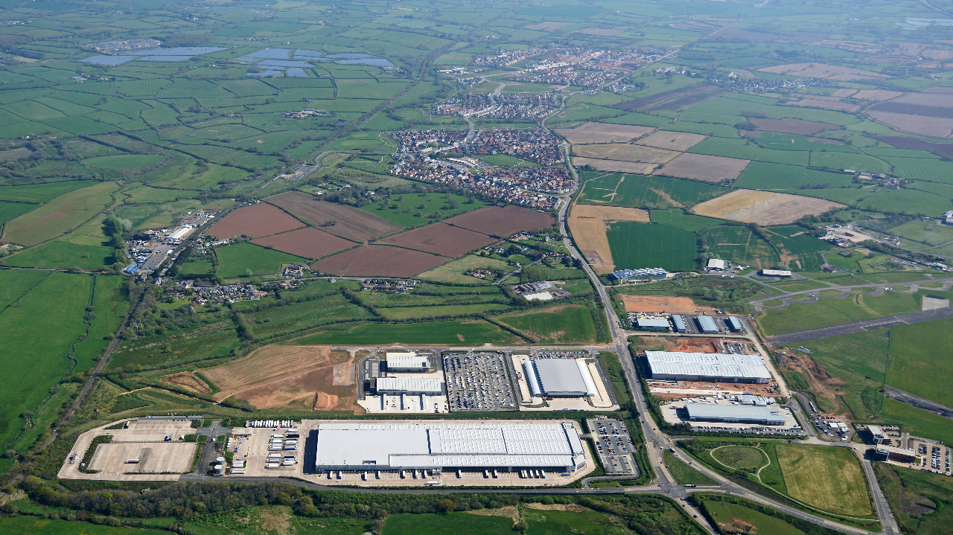

Cranbrook/SkyPark concession
80 years
3,500 homes
160,000m2 commercial

Slide 19
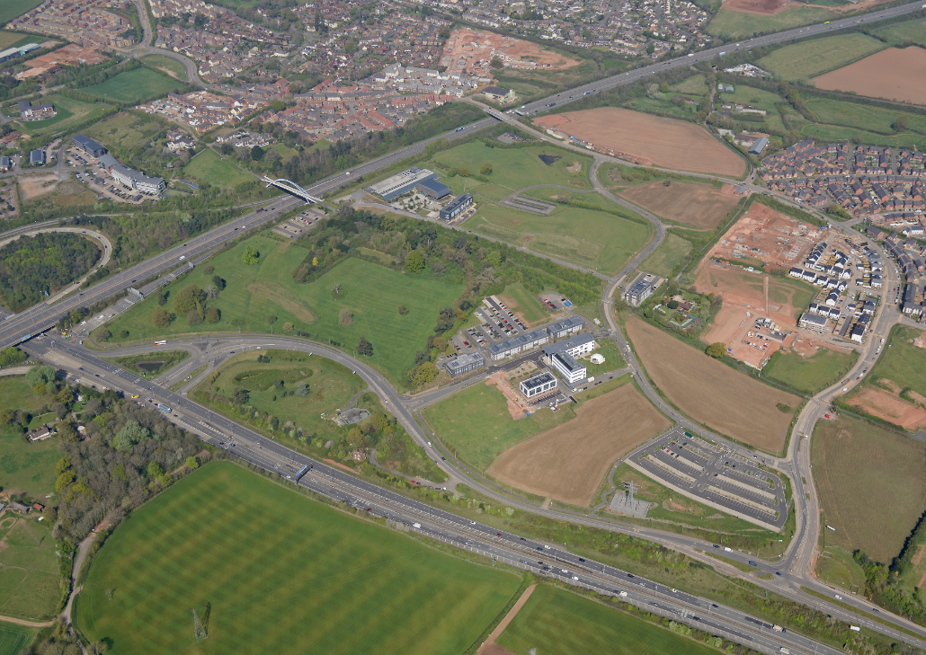

Monkerton/Tithebarn concession
End date of concession co-terminus with Cranbrook
4,264 homes + Exeter Science Park
Connection under M5

Slide 20
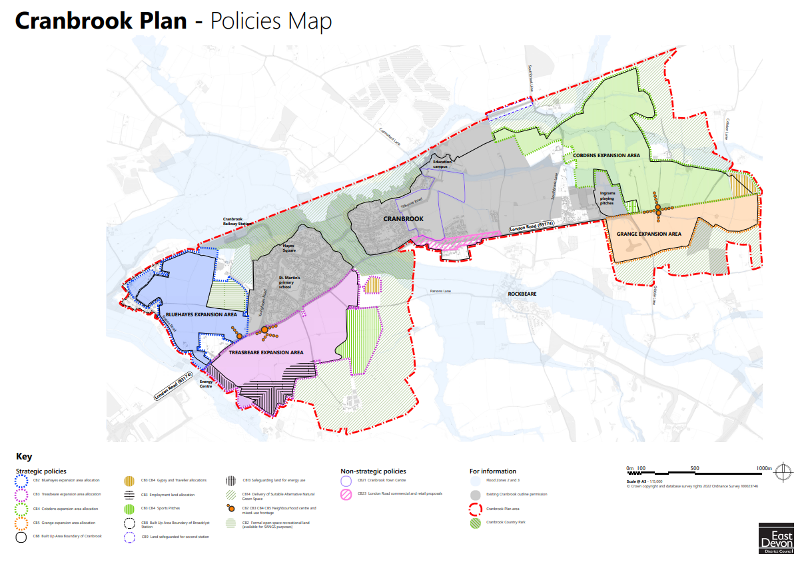

Slide 21
The Interconnector Project

Slide 22
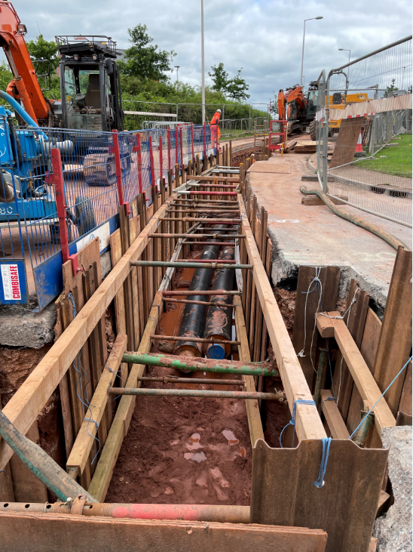
Rationale for District Council investment
Complete the journey
Decarbonise existing concessions including resolving s.106 obligation
Enable cost-effective, large-scale delivery of zero carbon development
Social purpose – avoid multiple tariffs, address fuel poverty
Could change this bullet to: Potential to deliver 17,200 tonnes of carbon savings per year.

Slide 23
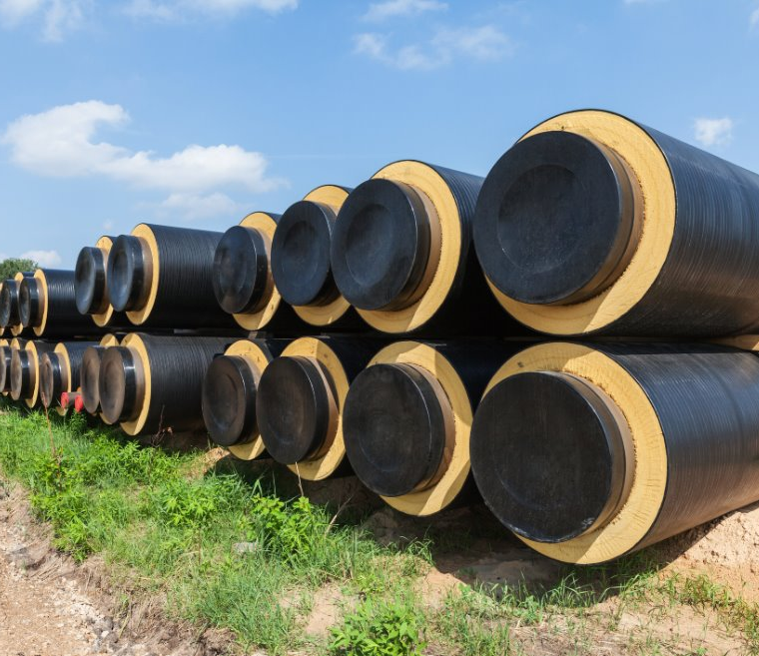
Project overview
Bulk supply of low carbon heat
Up to 37 MW(th) from three heat sources
7.5 km of transmission main (350/300/250DN)
Connect to Exeter Science Park sub-station and Skypark Energy Centre
Expected capex circa £31m
First heat to customers to begin in 2026

Slide 24
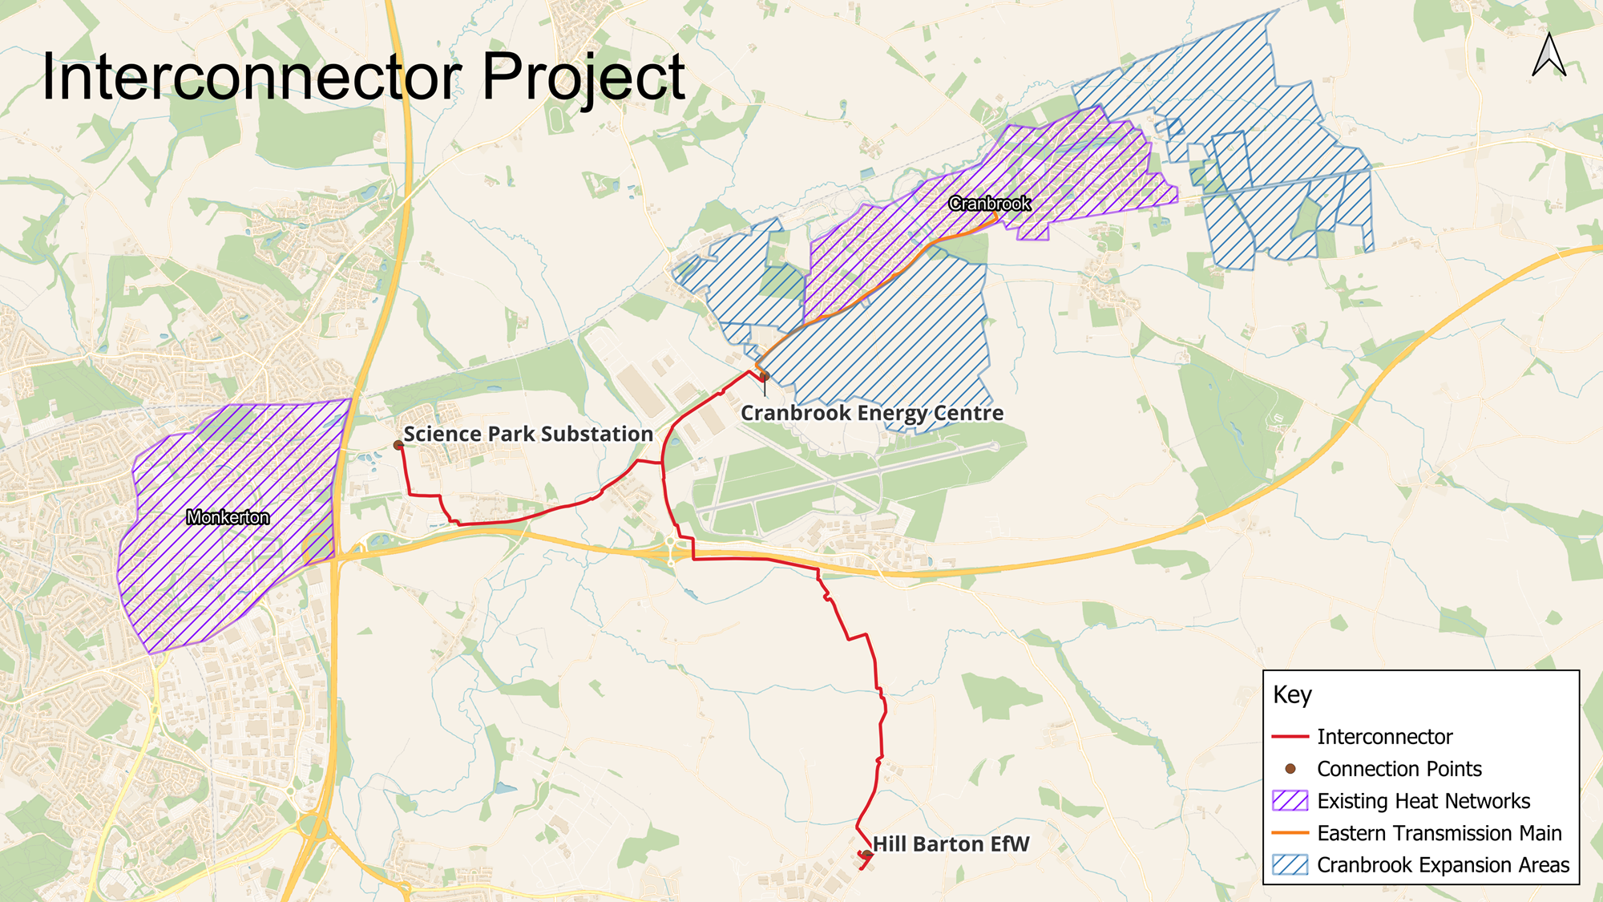

Slide 25
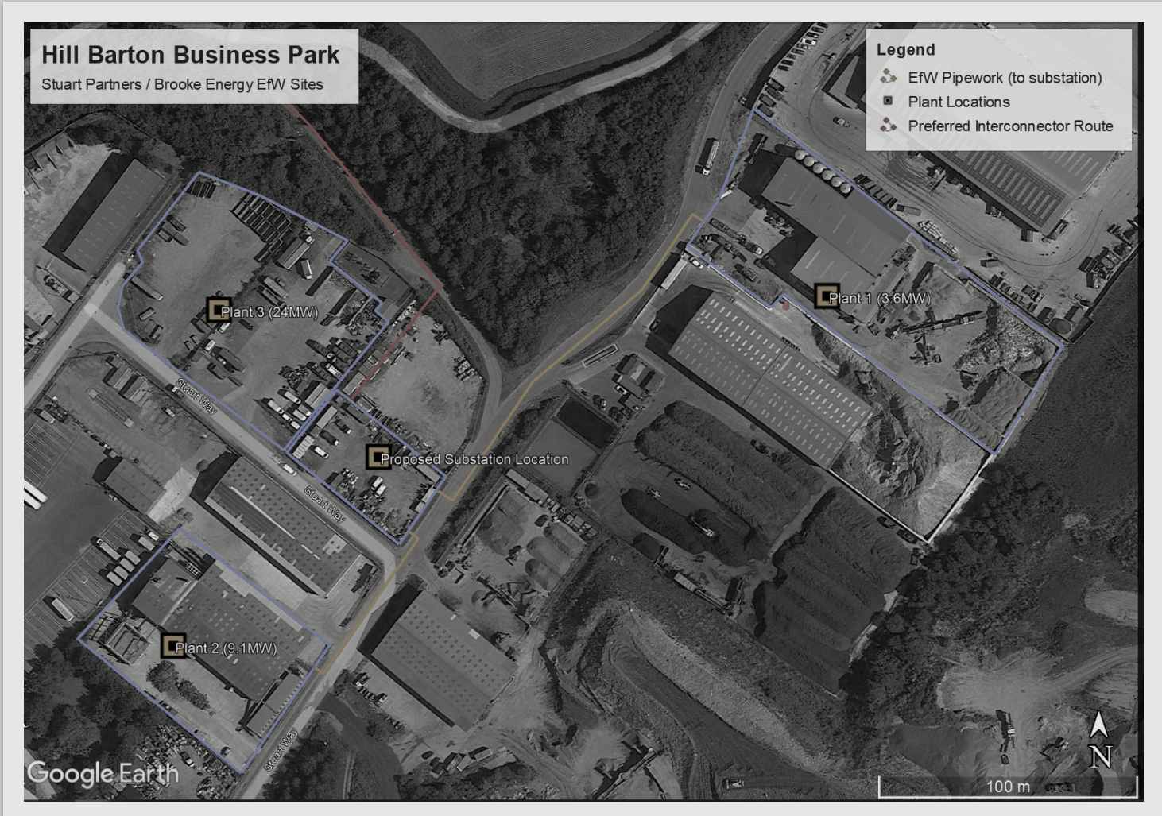
Hill Barton EfW Heat Sources
Plant 3
24 MW_{th}
Plant 1
3.6 MW_{th}
Plant 2
9.1 MW_{th}
Interconnector Pumping Station
eastdevon.gov.uk @eastdevon
Notes:
Project 1
Fully operational since March 2017.
Up to 3.6 MWth.
All year round.
85% availability after maintenance.
Project 2
Full operation by end of 2023.
Up to 9.1 MWth.
All year round.
85% availability after maintenance.
Once project 2 is up and running this will provide enough heat to reach capacity on the interconnector
Reached full financial close – fully funded.
In construction.
Commissioning in October 2023.
Project 3
Project 3 is in advanced development and currently is attractive commercially with no material reasons not to go ahead;
Heat provided by Project 3 would result in supply exceeding demand for Cranbrook expansion under current projections
In advanced development.
Planning and permitting secured.
Significant capital expenditure to date.
Grid connection in place.
Potentially full operation by end 2027.
Up to 24 MWth.
All year round.
85% availability after maintenance.

Slide 26







Commercial Structure
Monkerton
Heat offtake agreement
Interconnector Agreement
Cranbrook
Use of System Agreement
Future Cranbrook ESCo for expansion areas
£4.5m S106 contribution
£3.2m grant
£7.1m loan
£8.2m loan
£8m loan
eastdevon.gov.uk @eastdevon

Slide 27





Contractual Structure
Bulk heat purchase agreement
Bulk heat supply agreement
Design and Build Contract
Operate and Maintain Contract
eastdevon.gov.uk @eastdevon

Slide 28
Milestone Programme
Contract Award
Detailed Design
Start on Site
Commissioning
June 2024
Q3 – Q4 2024
Q4 2024
Q4 2025
Heat on to first Customers
Q1 2026
Programme risk is transferred to Contractor
eastdevon.gov.uk @eastdevon

Slide 29

Next Steps
Cabinet to consider the Full Business Case (FBC)
Final Investment Decision
Project Team to appoint Preferred Bidder(s)
De-risking continues in collaboration with Supplier

Slide 30
Supporting the journey
District Heating Divas https://www.districtheatingdivas.com/
Centre for Energy and the Environment, University of Exeter https://www.exeter.ac.uk/research/centres/cee/

Slide 31
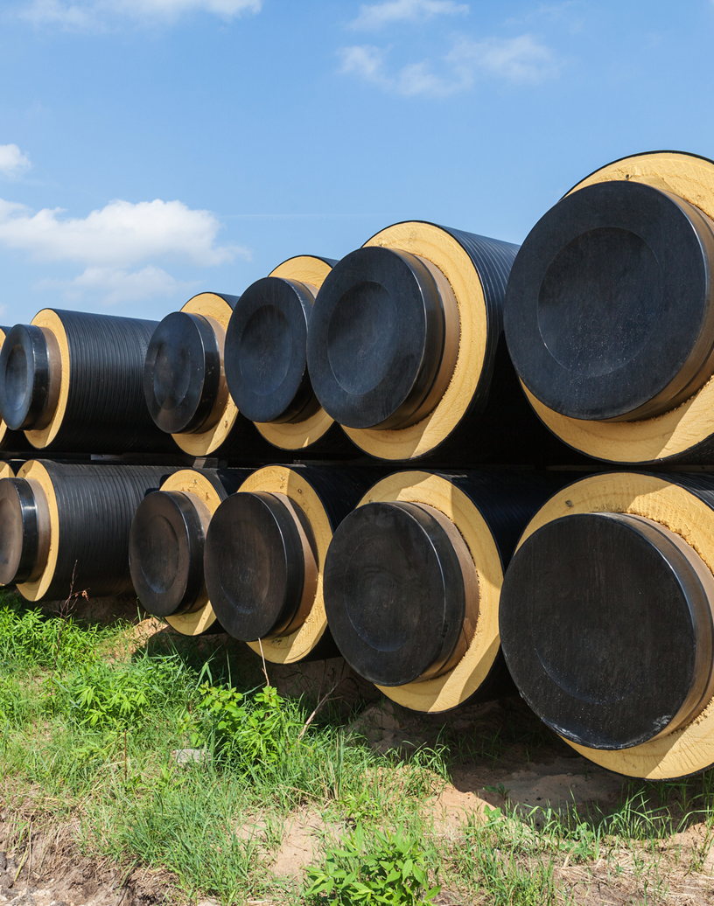
Thanks for listening

Slide 32
Mark Howard
Heat Networks Specialist
Department for Energy Security and Net Zero

Slide 33
Heat Network Zones and how they fit with smart local energy planning
April 25 2024
Mark Howard – Heat Networks Delivery Unit

Slide 34
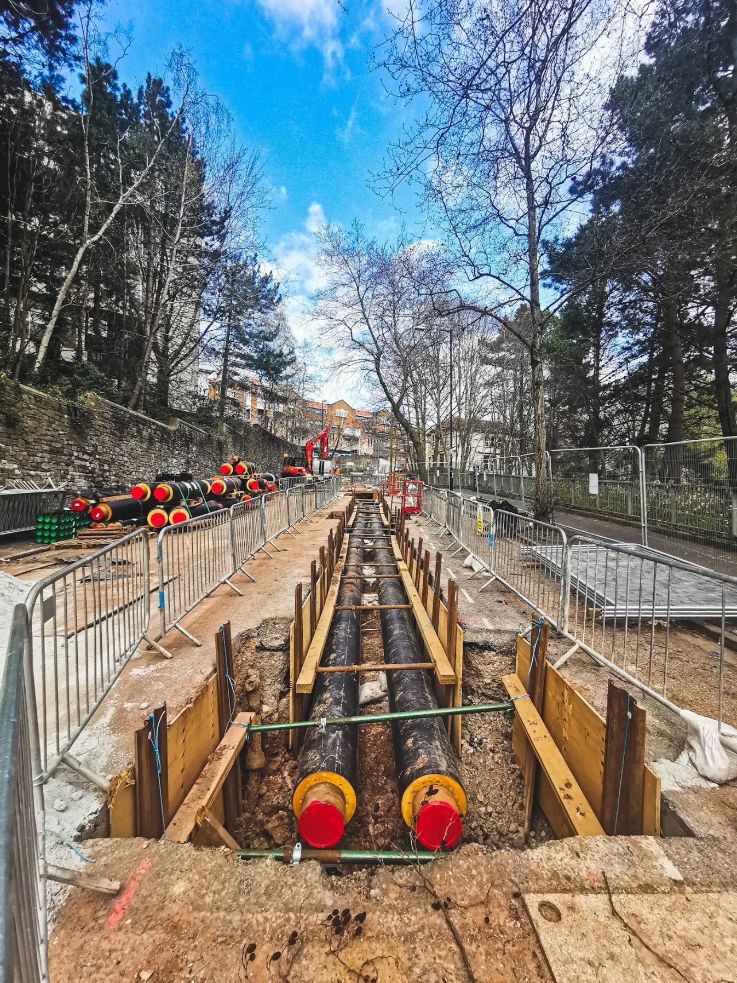
What is a heat network?
Heat networks use highly-insulated underground pipes to distribute heat from centralised sources to a variety of different customers, such as public buildings, shops, offices, hospitals, universities and homes.
This could be across entire cities or to a selection of neighbouring buildings.
In high density urban areas, they are often the lowest cost, low carbon heating option. Those currently powered by gas can be converted to other heat sources in the future.

Slide 35
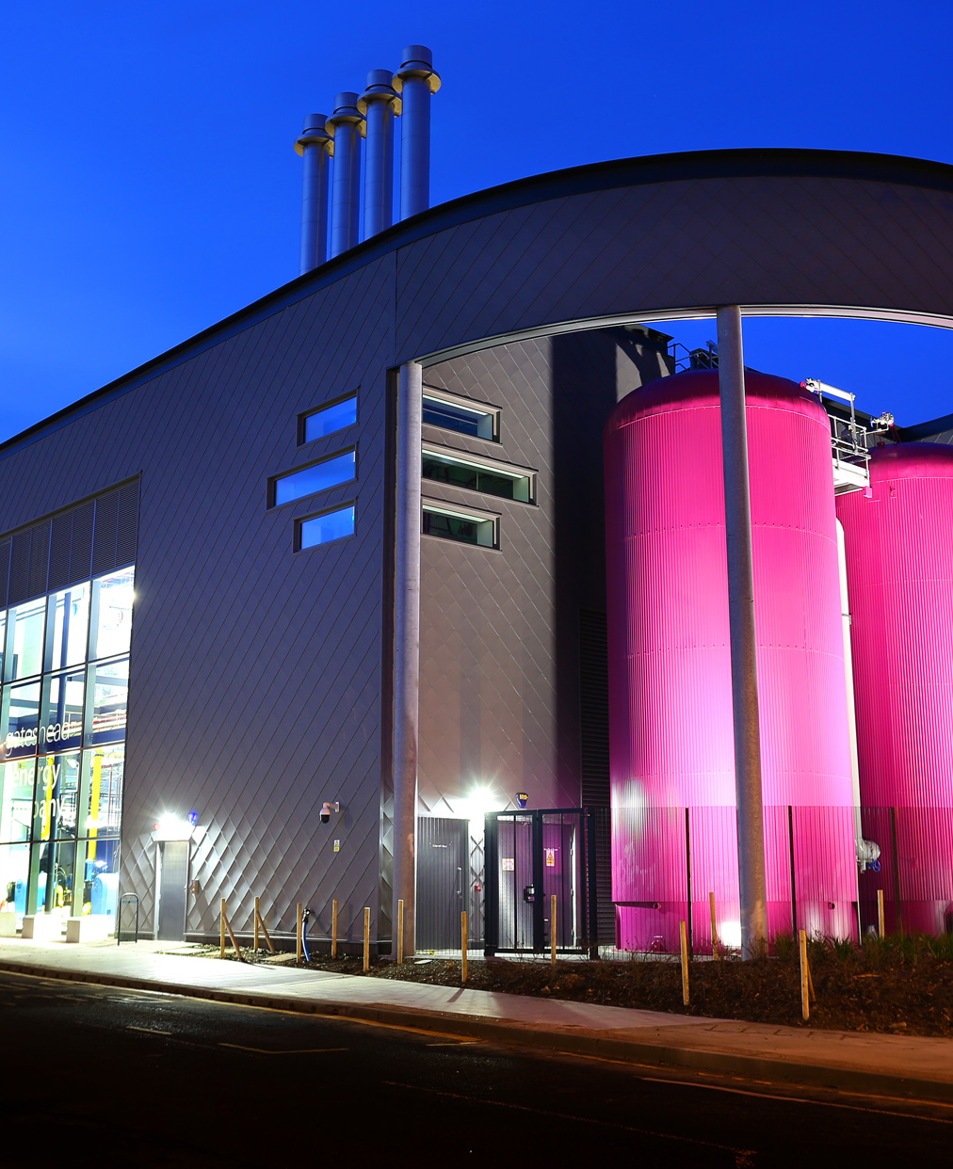
What is a heat network?
Heat networks currently provide almost 3% of UK heat demand and could provide 20% of heat demand by 2050.
They can unlock otherwise inaccessible large-scale renewable and recovered heat sources such as waste heat from industry and heat from rivers and redundant mines.
They deliver broader system benefits as they can run during times of lower grid demand and can take advantage of lower carbon electricity and reduce the investment needed in local energy grids.

Slide 36

Transform the market
Introduce heat network zoning
Attract and enable private investment
Collaborate with UK Infrastructure Bank
Publish heat network strategy
Strengthen supply chain and skills base

Slide 37
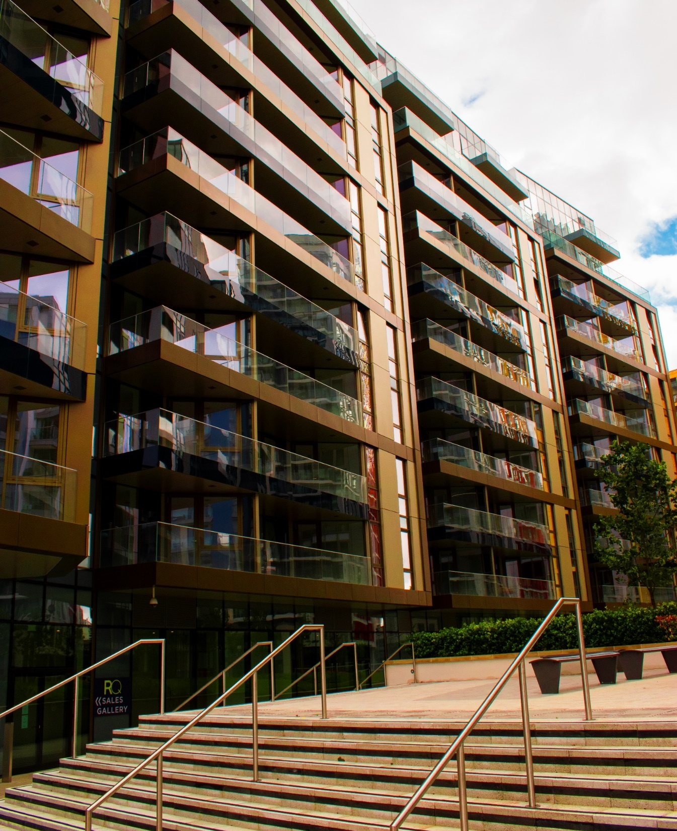
Protect consumers
Introduce Ofgem as new regulator
Deliver Energy Bills Discount Scheme
Finalise step-in arrangements
Support price rebalancing

Slide 38
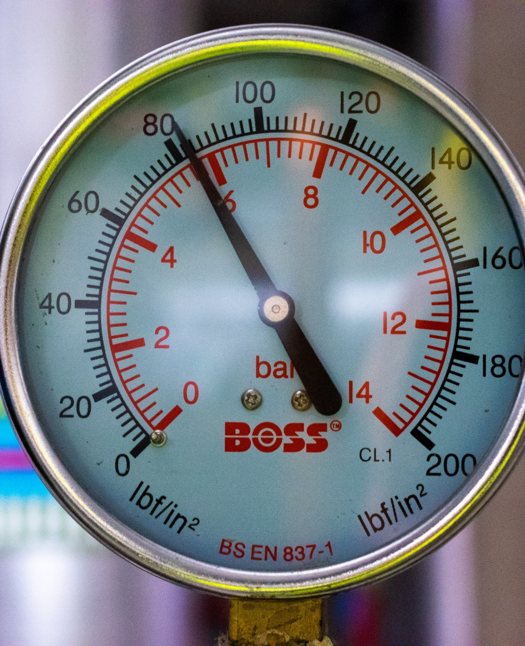
Improve and decarbonise
Deliver Heat Networks Efficiency Scheme
Introduce Technical Standards regime
Support decarbonisation and new low carbon heat sources
Streamline commercial and construction processes
£5m Heat Training Grant to upskill heat networks engineers

Slide 39
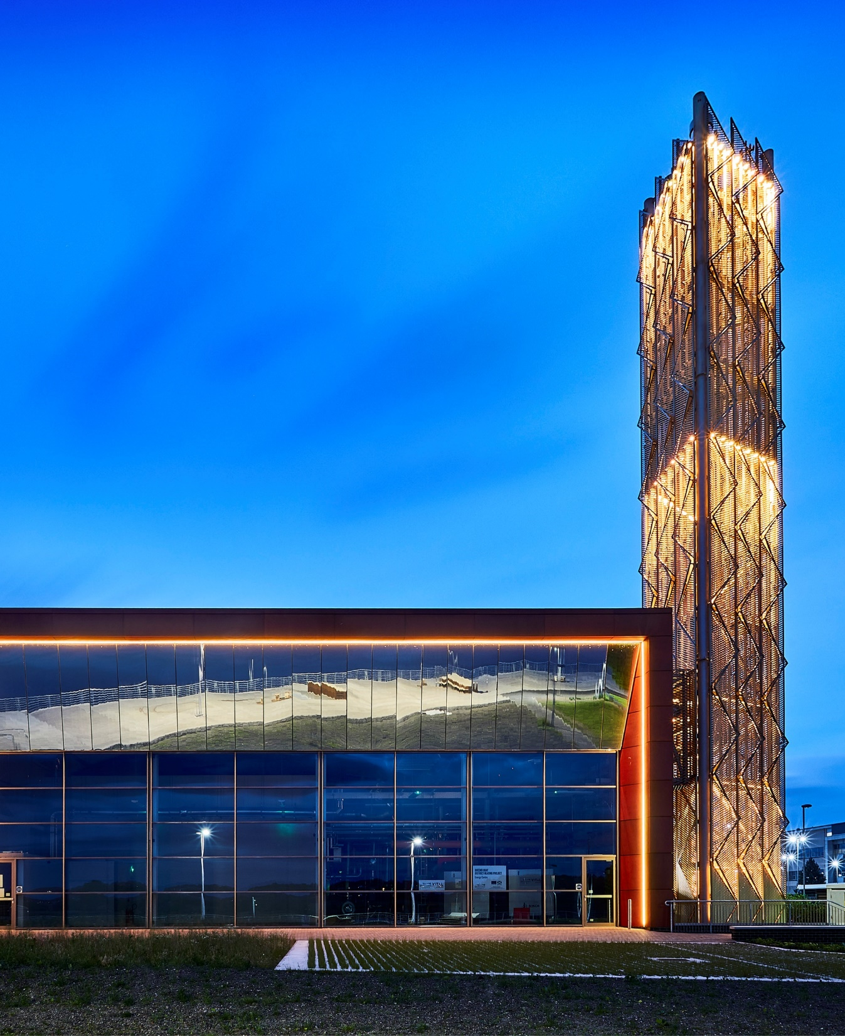
Build the pipeline
Deliver the Green Heat Network Fund
Introduce South Westminster Area Network
Collaborate with local authorities on Advanced Zoning Programme
Continue to provide Heat Network Delivery Unit support

Slide 40
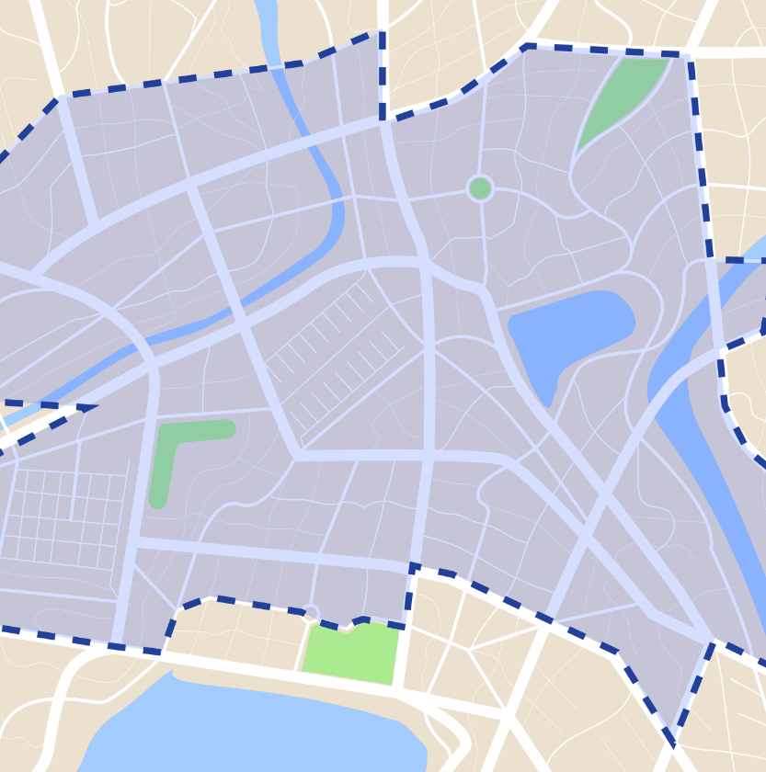
Heat network zoning will fundamentally transform the development of heat networks in towns and cities across England

Slide 41
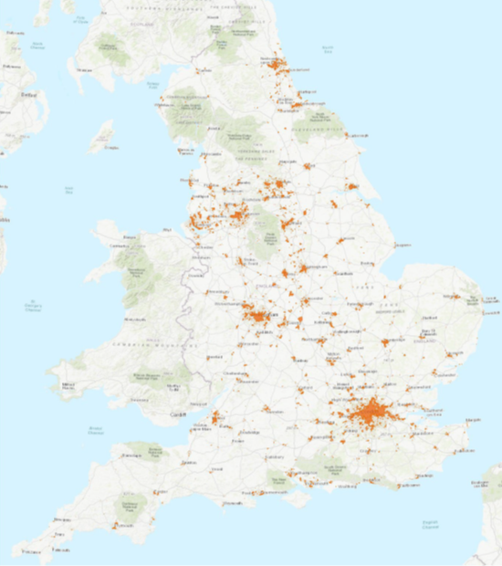
Heat network zoning will designate areas where heat networks are expected to provide the lowest-cost, low carbon heating.
It will give local communities the tools to accelerate the development of heat networks in their towns and cities.
We want to give developers and investors more certainty about the number of likely connections to networks to help unlock the investment needed to build them.
This will remove the barriers to greener, cheaper heat that currently limit the scale and pace of developing heat networks and encourage investment.
This will allow for large-scale strategic heat networks to be built in towns and cities across the country.

Slide 42
How will zoning be delivered?
Enabling legislation in the Energy Act 2023
Consultation on heat network zoning – closed 26 Feb
Establish zoning co-ordinators and a national authority to oversee the process and support local zoning co-ordinators
Where will zones be and how will this be communicated?
Potential zones identified throughout England via a national methodology
Local refinement before zones designated
Zone information available via a digital portal
What is the process via which zones will be built?
Standardised routes for identifying heat networks developer in each zone
What lessons can we learn from early pilots and activity?
Advanced work to ensure initial batch of zones are in construction by end 2025

Slide 43
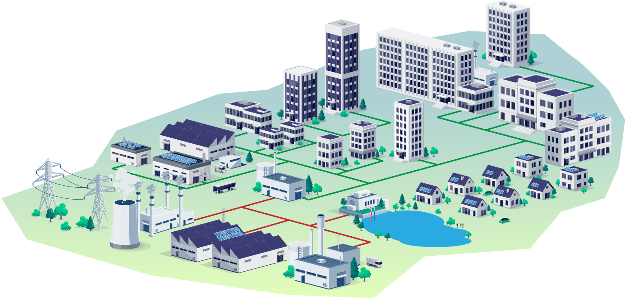
Heat consumers connecting to heat networks could include …
Schools and colleges
Hospitals
Hotels and leisure
Public buildings
Offices and commercial space
Industry
Communally-heated residential blocks

Slide 44
Producers of waste heat supplying heat networks could include…
Schools and colleges
Hospitals
Hotels and leisure
Public buildings
Offices and commercial space
Industry
Communally-heated residential blocks
Industry
Power generators
Data centres
Water and waste treatment sites

Slide 45
Thank you
OFFICIAL : SENSITIVE

Slide 46
Sam Moore
Project Manager
SWNZH

Slide 47
Heat Networks – a community of practice
Upcoming support from the SWNZH on heat networks
Sam Moore: Project Manager
Sam.Moore@WestofEngland-ca.gov.uk
Notes:
Objective:
To identify, support and seek investment for two new heat network projects in the South West by 2025

Slide 48

Heat Networks
Notes:
1 HNDU The Heat Networks Delivery Unit (HNDU) is a specialist unit of heat network experts in DESNZ. HNDU provides grant funding and guidance for early-stage heat network project development.
They share best practice and knowledge across the market, promote new guidance on technical standards, create standardised documentation and facilitate project development.
HNDU previously worked with local authorities. All bids for support are reviewed by a panel of engineering, financial and commercial experts with significant experience in heat network development.
2 The Green Heat Network Fund (GHNF) provides funding to develop new and existing low carbon heat networks across England.
Funding is available for a range of decarbonisation technologies such as large heat pumps, energy from waste, geothermal and recovered heat.
The fund opened for applications in March 2022 and will run until 2028. It originally launched with a budget of £288m and was intended to run until 2025. However, due to demand additional capital funding of £485m was announced in December 2023 and the scheme was extended until 2027/28.
Twenty funding awards totalling over £268m have been announced. Details of these awards can be found on the website of the GHNF delivery partner, Triple Point Heat Networks
The UK Infrastructure Bank (UKIB) also announced in 2022 that they would offer councils streamlined access to their £4 billion local authority lending product as part of the GHNF application process.
Applications are welcome from public, private and third sector organisations. Guidance is available at: https://www.gov.uk/government/publications/green-heat-network-fund-ghnf
3) The Heat Network Efficiency Scheme (HNES) opened in February 2023.
It is a programme providing funding to public, private and third sector applicants in England and Wales.
It supports improvements to existing district heating or communal heating projects that are operating sub-optimally, leading to poor outcomes for customers and operators.
It was initially launched with a budget of £32m. Due to strong demand a further £45m was announced for the scheme in December 2023.
Funding Round 6 is currently open, closing on 22 March 2024. To date, over £28.1m of funding has been announced publicly.
4) The £5m Heat Training Grant will support trainees in England taking short training courses relevant to either heat pumps or heat networks.
For the heat network courses, providers offering the grant will be able to provide trainees with a discount or rebate of up to £500. This will cover initial design of networks to building, operation, and maintenance and we expect approximately 4000 individuals will be supported over the two years.
The Midlands NetZero Hub has been appointed as the administrator, including to run the bidding process to select training providers. Heat networks training providers are being selected in two bidding rounds: one for delivery in 2023/24 and one for delivery in 2024/25

Slide 49

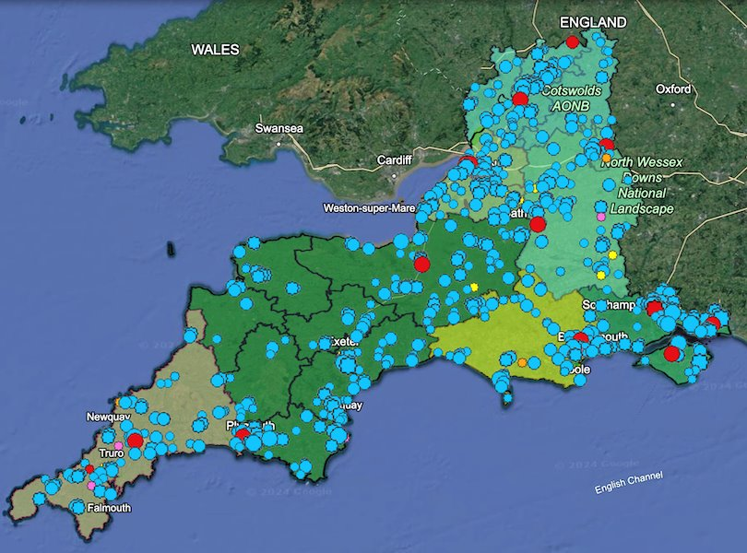
The Why….
Celebrate successes and share learning
Consider how we identify, support and seek investment for heat networks in the South West
Promote collaboration to develop and scale the solutions
Notes:
To identify, support and seek investment for two new heat network projects in the South West by 2025
Celebrate successes and share learning
Consider how we make heat networks the default choice for the early majority
Promote collaboration to develop and scale the solutions
Inflight SWNZH projects include:
Recoverable Heat Mapping Tool
Inter-Hub Heat Network Working Group
Interviewed 15+LAs and Officers
South West Heat Network Working Group
Heat from Mines project
Heat Training Grant
Heat Network Competition

Slide 50
The Local Context
Local Authority | Residential | Commercial | Industrial | Public | Other | Total
Bristol, City of | 3,413 | 376 | 0 | 2 | 5 | 3,796
Swindon | 2,149 | 223 | 5 | 3 | 0 | 2,380
BCP | 2,038 | 110 | 0 | 0 | 0 | 2,148
Wiltshire | 2,085 | 32 | 0 | 7 | 11 | 2,135
Bath and North East Somerset | 2,099 | 21 | 0 | 0 | 0 | 2,120
Exeter | 2,127 | 18 | 0 | 20 | 0 | 2,165
East Devon | 2,252 | 12 | 0 | 1 | 2 | 2,267
Dorset | 1,539 | 4 | 0 | 0 | 0 | 1,543
Sub total (top 8) | 17,702 | 796 | 5 | 33 | 18 | 18,554
South West | 24,248 | 1,384 | 15 | 54 | 25 | 25,726
In the SW circa 26,000 customers served by a registered heat network, c5,600 buildings (c600 of which are on a communal heat network) and a total of 765 registered heat networks by South West region (122 district networks, 643 communal networks).
Notes:
We have a long way to go…. the wider South West is recognised as having an outstanding natural environment, alongside other natural advantages such as the amount of solar, wind and geothermal resource and its marine environment.
The South West region has a population of around 5.6 million….that’s circa 1m people connected to a heat network by 2050…
This influences several factors which present challenges and opportunities for achieving net zero in the region
The table is a snapshot of SW, data is self-reported from heat network suppliers notifying under the Heat Network (Metering and Billing) Regulations. Data released 7 Nov 2023.
Shows number of customers served by a registered heat network by local authority and customer type, United Kingdom, January 2019 to December 2022

Slide 51





Overview of the 5i Programme
Influence
Implement
Innovation
Investment
Inter-disciplinary
Notes:
Creating a LA Heat Network Partnership to accelerate progress
The workshops are framed around the Five I’s to have a narrative structure for each of the workshops hang together (i.e. the story they tell collectively) with a clear purpose for each workshop.

Slide 52
5i Training Programme Summary
Influence
Implement
Inter-disciplinary
Innovation
Investment
Workshop Theme:
Decarbonising heat, Capacity and Resources.
Workshop Theme:
Learning and Knowledge, fostering collaborations.
Workshop Theme:
People and Organisations, Training.
Workshop Theme:
Finance,
Markets, Use and Risk.
Workshop Theme:
Policy and Regulation.
Resources: External Speakers, Net Zero Go, Peer to Peer learning and support, Case studies, Weblinks, SWNZH, Slide Decks and Collaborators
Notes:
Not a “binary” tax payers debate

Slide 53

Overview of each session
1500 – 1515: Welcome, introductions, Setting the Scene
1515 – 1535: External Speaker one
1535 – 1550: Q&A
1550 – 1555: Break
1600 – 1620: External speaker two
1620 – 1640: External speaker three
1640 – 1655: Q&A
1655– 1700: Wrap up discussion
Post event:
  Informal networking
  Community of Practice
Notes:
Five sessions
Two hours 15 minutes online
Part A – two 20-minute presentations – followed by 20 minutes facilitated Q&A with focused discussion areas where questions do not arise
15-minute break
Part B - a further two 20-minute presentations – followed by 20 minutes facilitated Q&A with focused discussion areas where questions do not arise
Aim for four expert organisations present per workshop, external to SWNZH.
The workshops are framed around the Five I’s to have a narrative structure for each of the workshops hang together (i.e. the story they tell collectively) with a clear purpose for each workshop.
Third Tuesday of every month – about 2 hr commitment.
Diff delegates attend diff sessions.

Slide 54
5i Learning Outcomes
By the end of each session, you will understand/have a good working knowledge of:
Influence | Implement | Innovation | Investment | Interdisciplinary
An introduction to District Heating Heat and Buildings Strategy Low carbon heat alternatives: Recoverable heat mapping LA Examples | Understanding Obstacles: eg physical connection barriers to heat networks Fostering Collaboration: eg Zoning - frameworks for co-operation Support tools available Anchor heat loads to catalyse a heat network Heat Sources | Training: heat network specialists and grants Internal Workforce and skillsets Engaging the Community Sector International and regional case studies models: scope for replication and implementation across the South West Code of Practice CP1 | Scheme viability with -and without -Local Authority finance? Is the Local Authority interested in making a return on investment? Has the local authority made a realistic assessment of the risks of funding the heat network? Best practice standards: Support for LAs | Ofgem and Heat Trusts role in regulation/ setting future standards Does the Local Authority have the capacity to undertake the role of regulation? Does the local authority have a political stake, or reputational interest in the long term success of the scheme? Does the local authority have the organisational resources to implement a Supplier role takeover?
21 May 24 (1500) | 18 June 2024 (1500) | 16 July 2024 (1500) | 17 Sept 2024 (1500) | 15 Oct 2024 (1500)
https://bit.ly/3SVtHCY | https://bit.ly/3SVtHCY | https://bit.ly/3SVtHCY | https://bit.ly/3SVtHCY | https://bit.ly/3SVtHCY
Notes:
3rd Tuesday of every month

