Slide 1
Workshop Session 1 - A thriving Local Energy Ecosystem for Community Energy

Slide 2
Emma Bridge Chief Executive Community Energy England

Slide 3
The potential for community energy and local authority collaboration
Emma Bridge
Chief Executive
Community Energy England

Slide 4
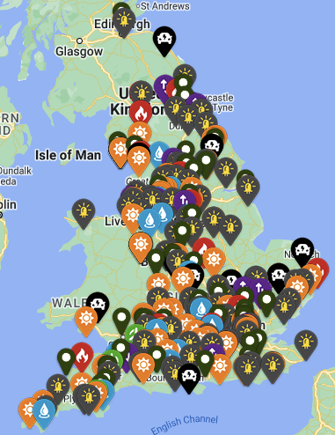
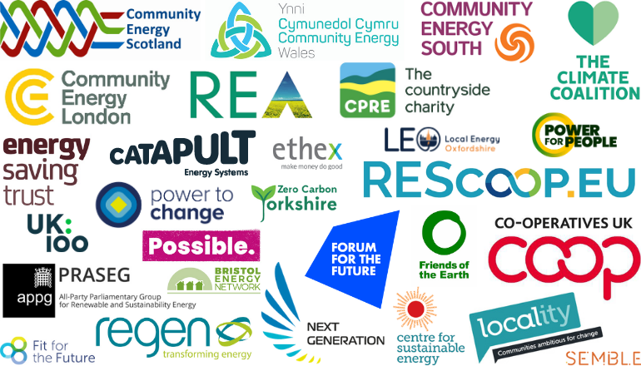
Community Energy England
Putting People at the Heart of Energy Transformation
Vision: A thriving community energy sector integrated into and truly powering a fair, zero-carbon energy system.
Mission: To create the conditions within which community energy is able to thrive and scale.
Support - Advocate - Collaborate
Our partners and networks
300+ members

Slide 5
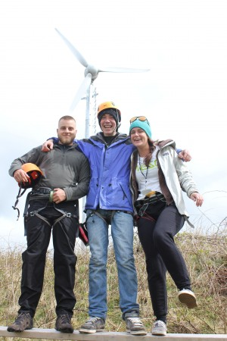
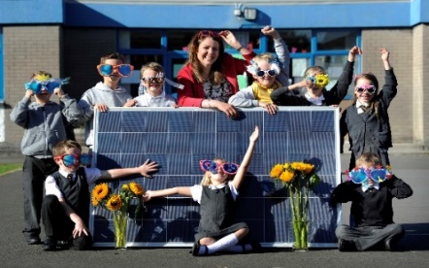
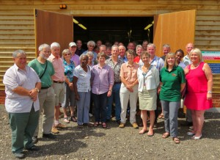
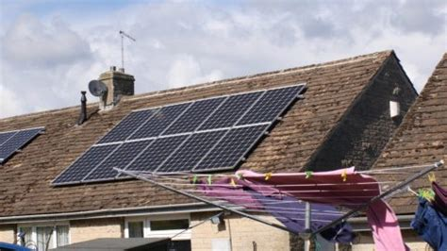
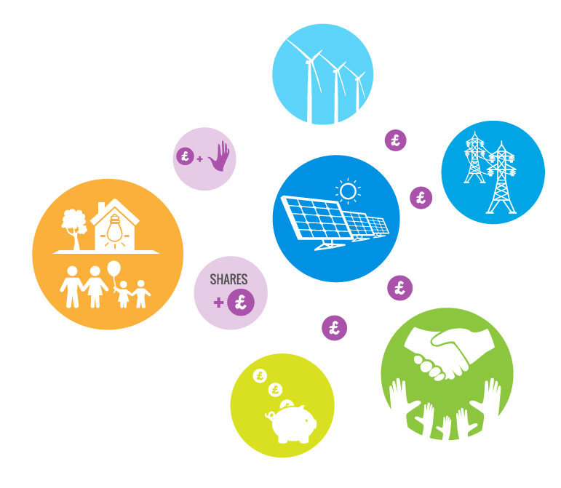
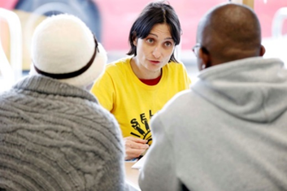
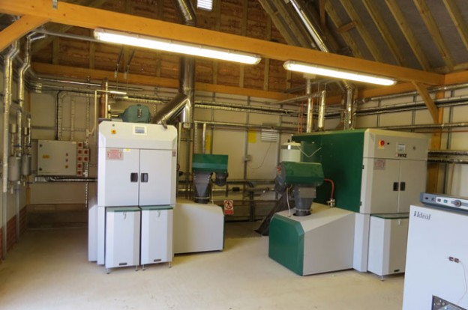
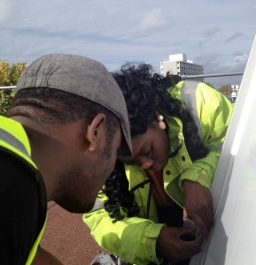
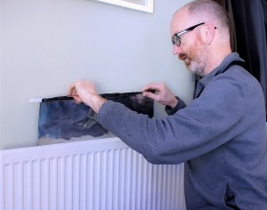
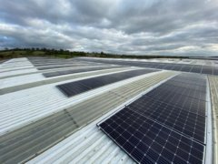
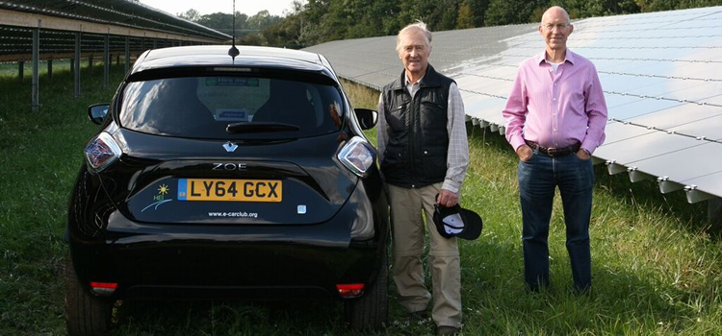
Community energy
Community
Leadership
Ownership
Accountability
Benefit

Slide 6
The value of LA and CE working together
Engagement and reach
Finance and funding
Enabling projects and services
Resources
Assets
Risk
Timescales
Innovation
Maximising community benefit and driving wider social, economic and environmental change…

Slide 7
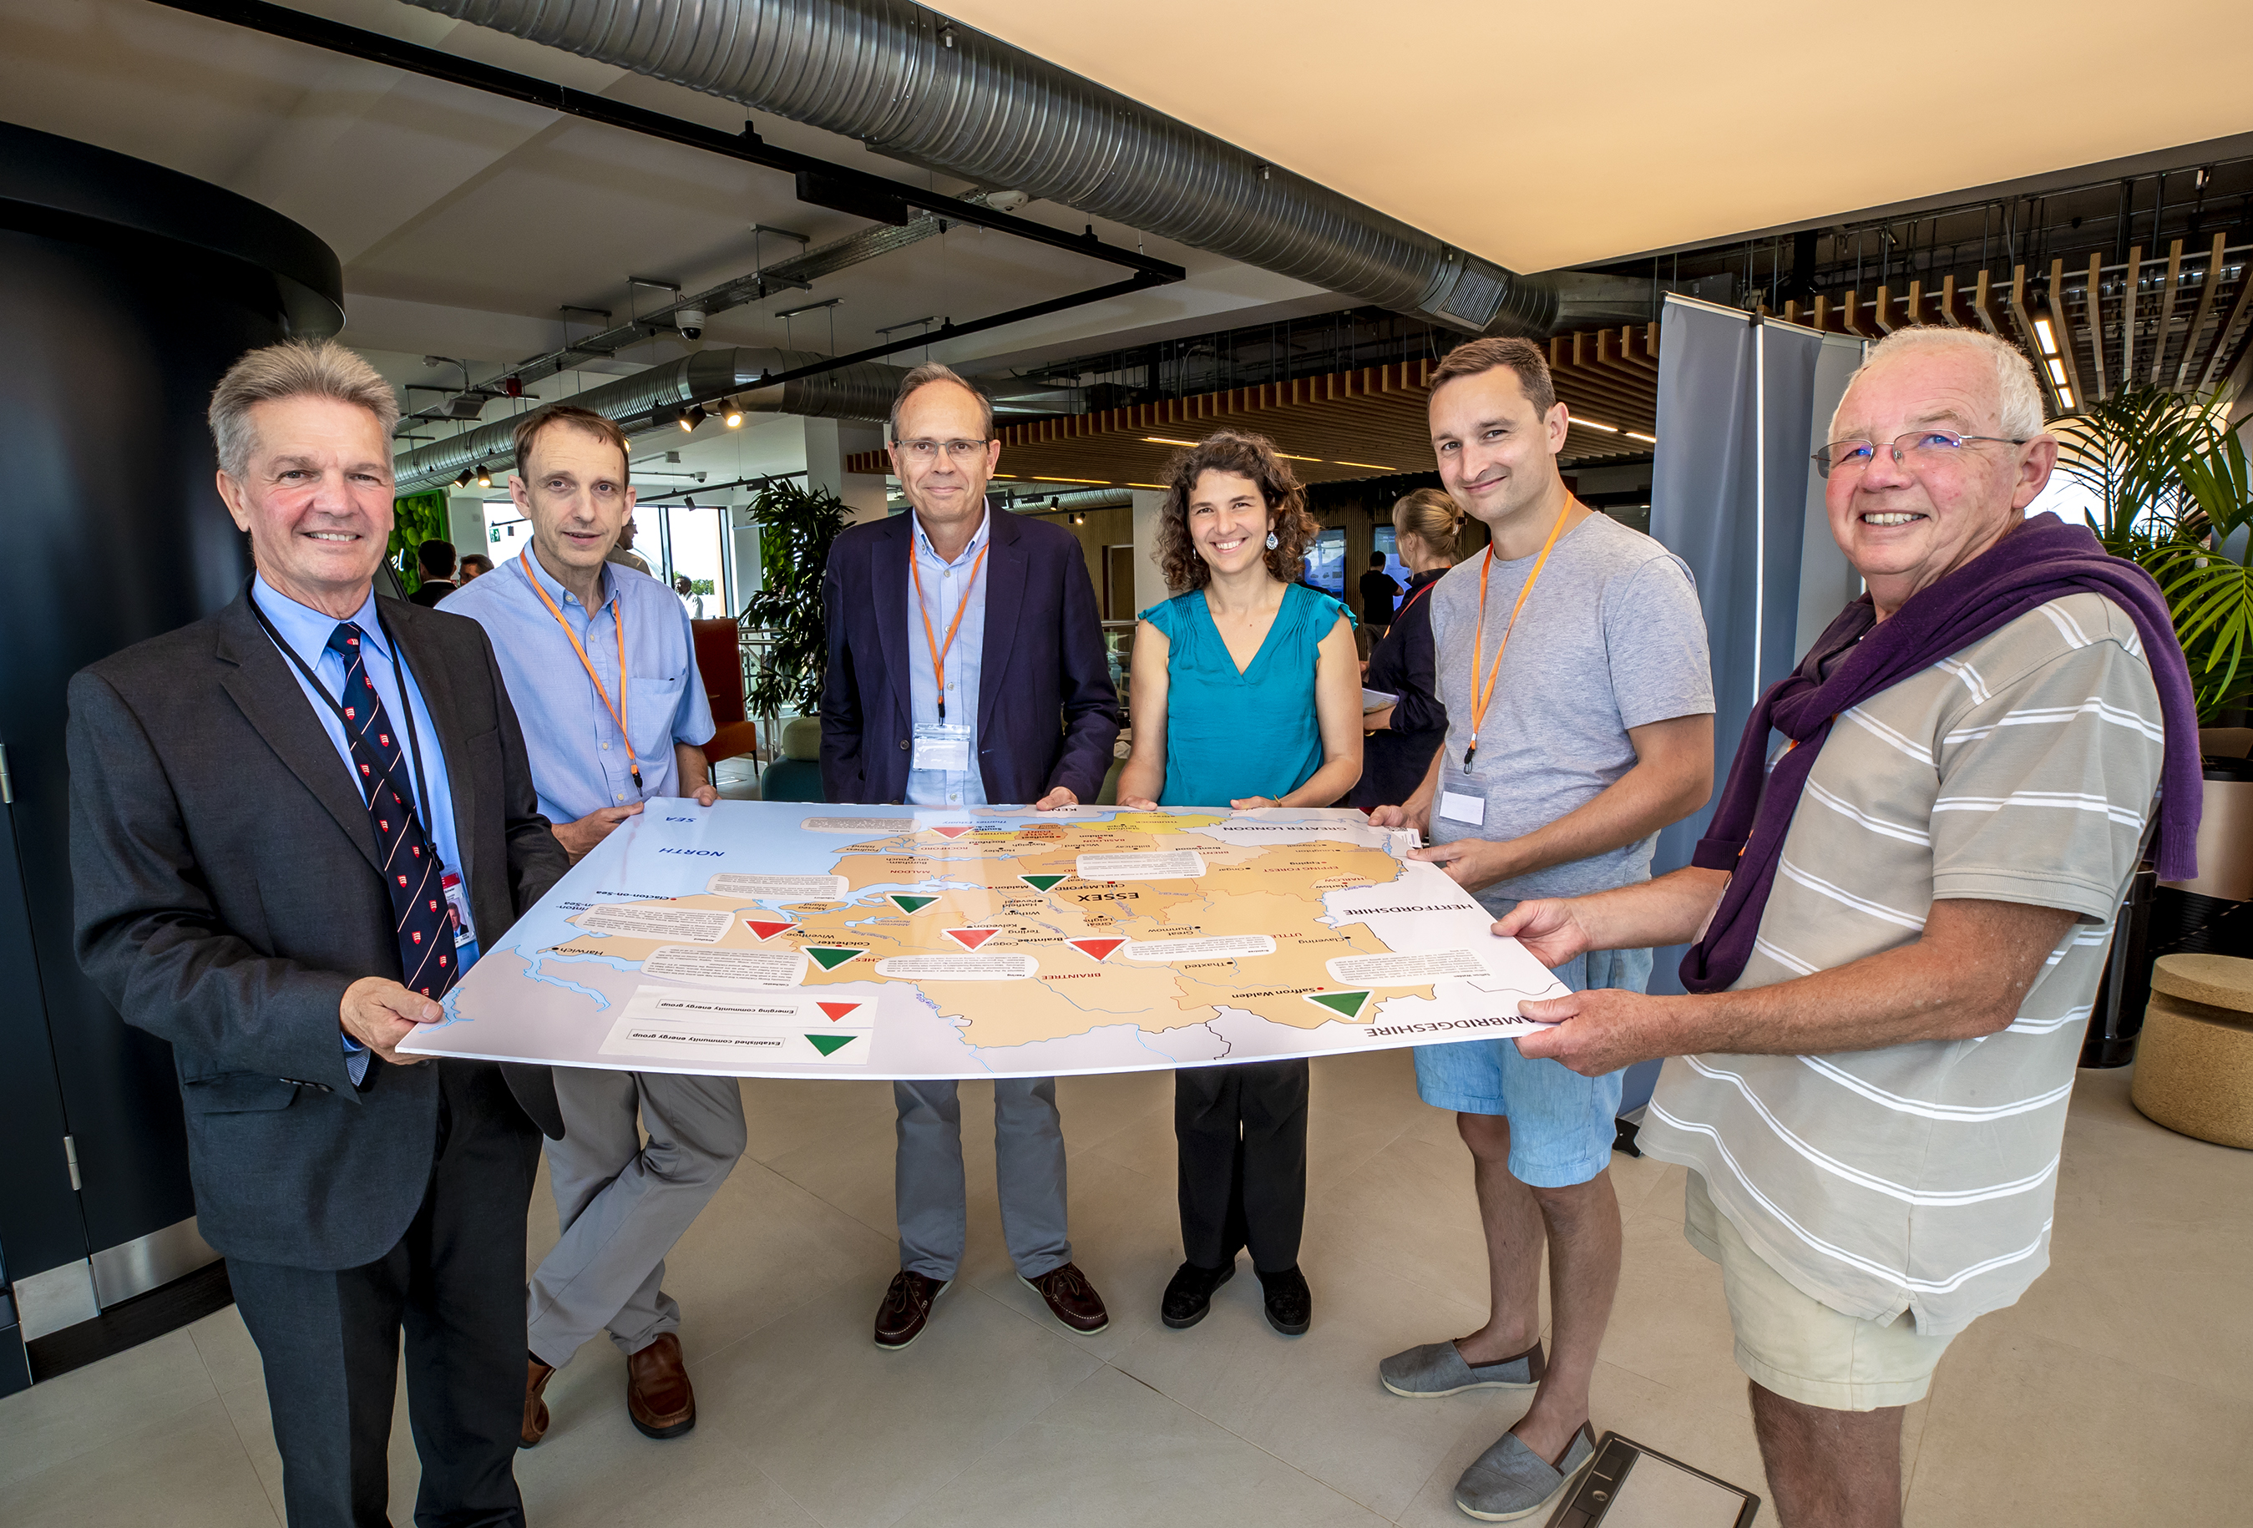
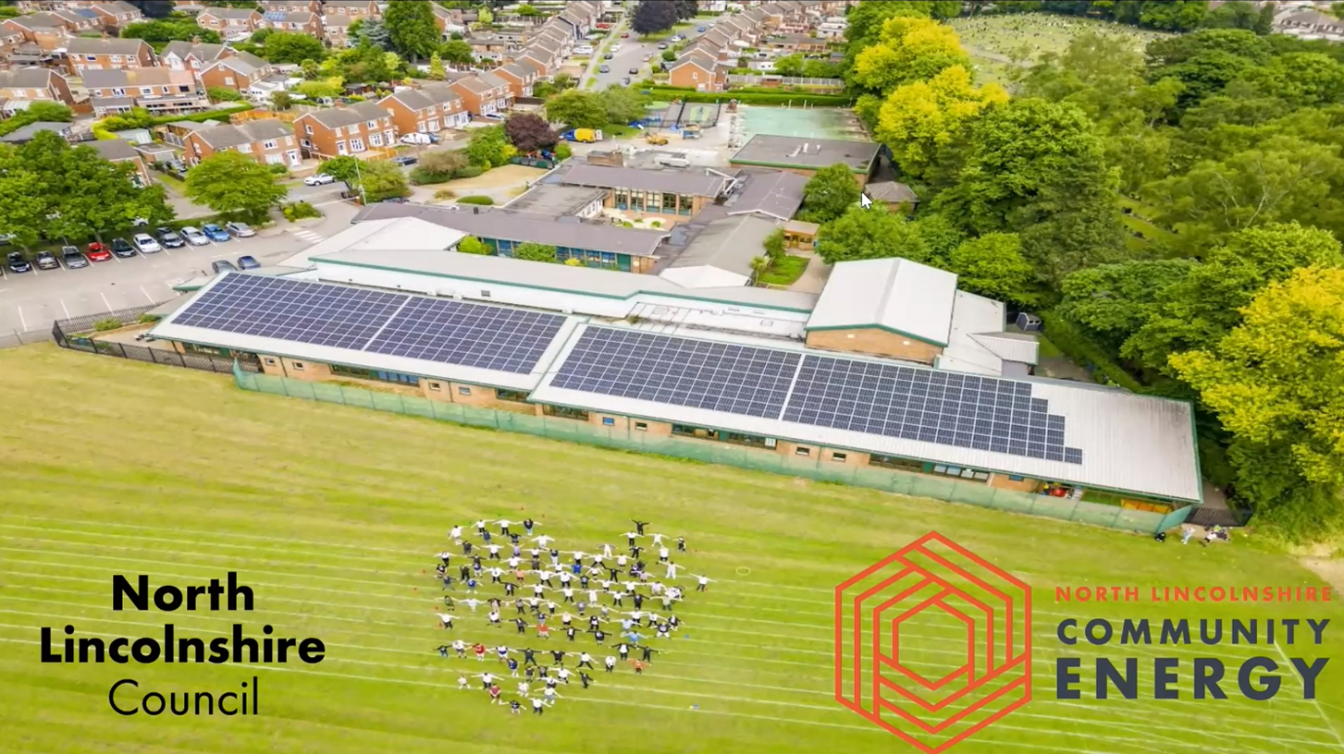
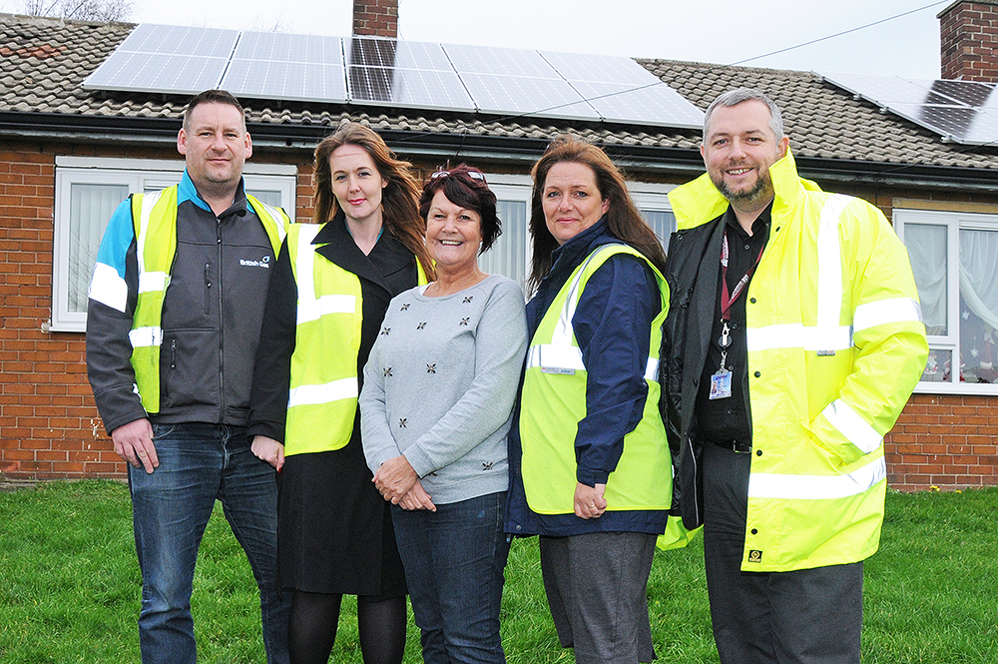
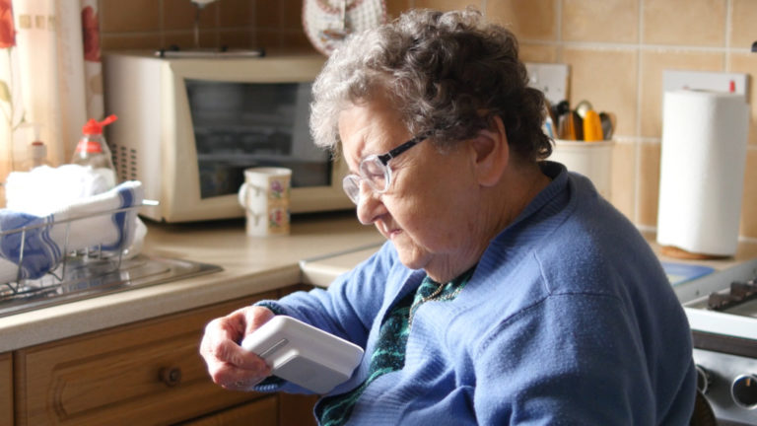
Examples of LA and community partnership working

Slide 8
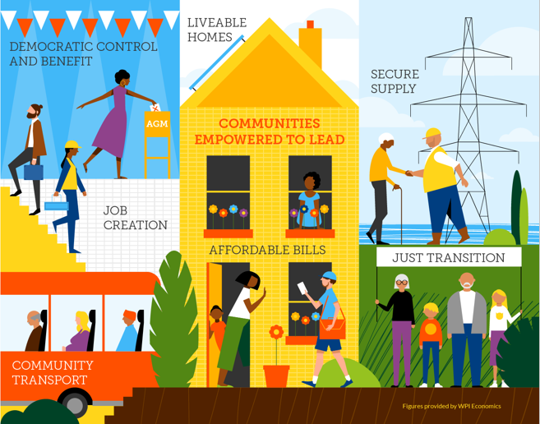
Barriers and opportunities
Many barriers but the opportunities are HUGE
Capacity
Budgets
Time
Scale
Motivation
Skills
Regional and national links
General election?!
We need to work together…

Slide 9
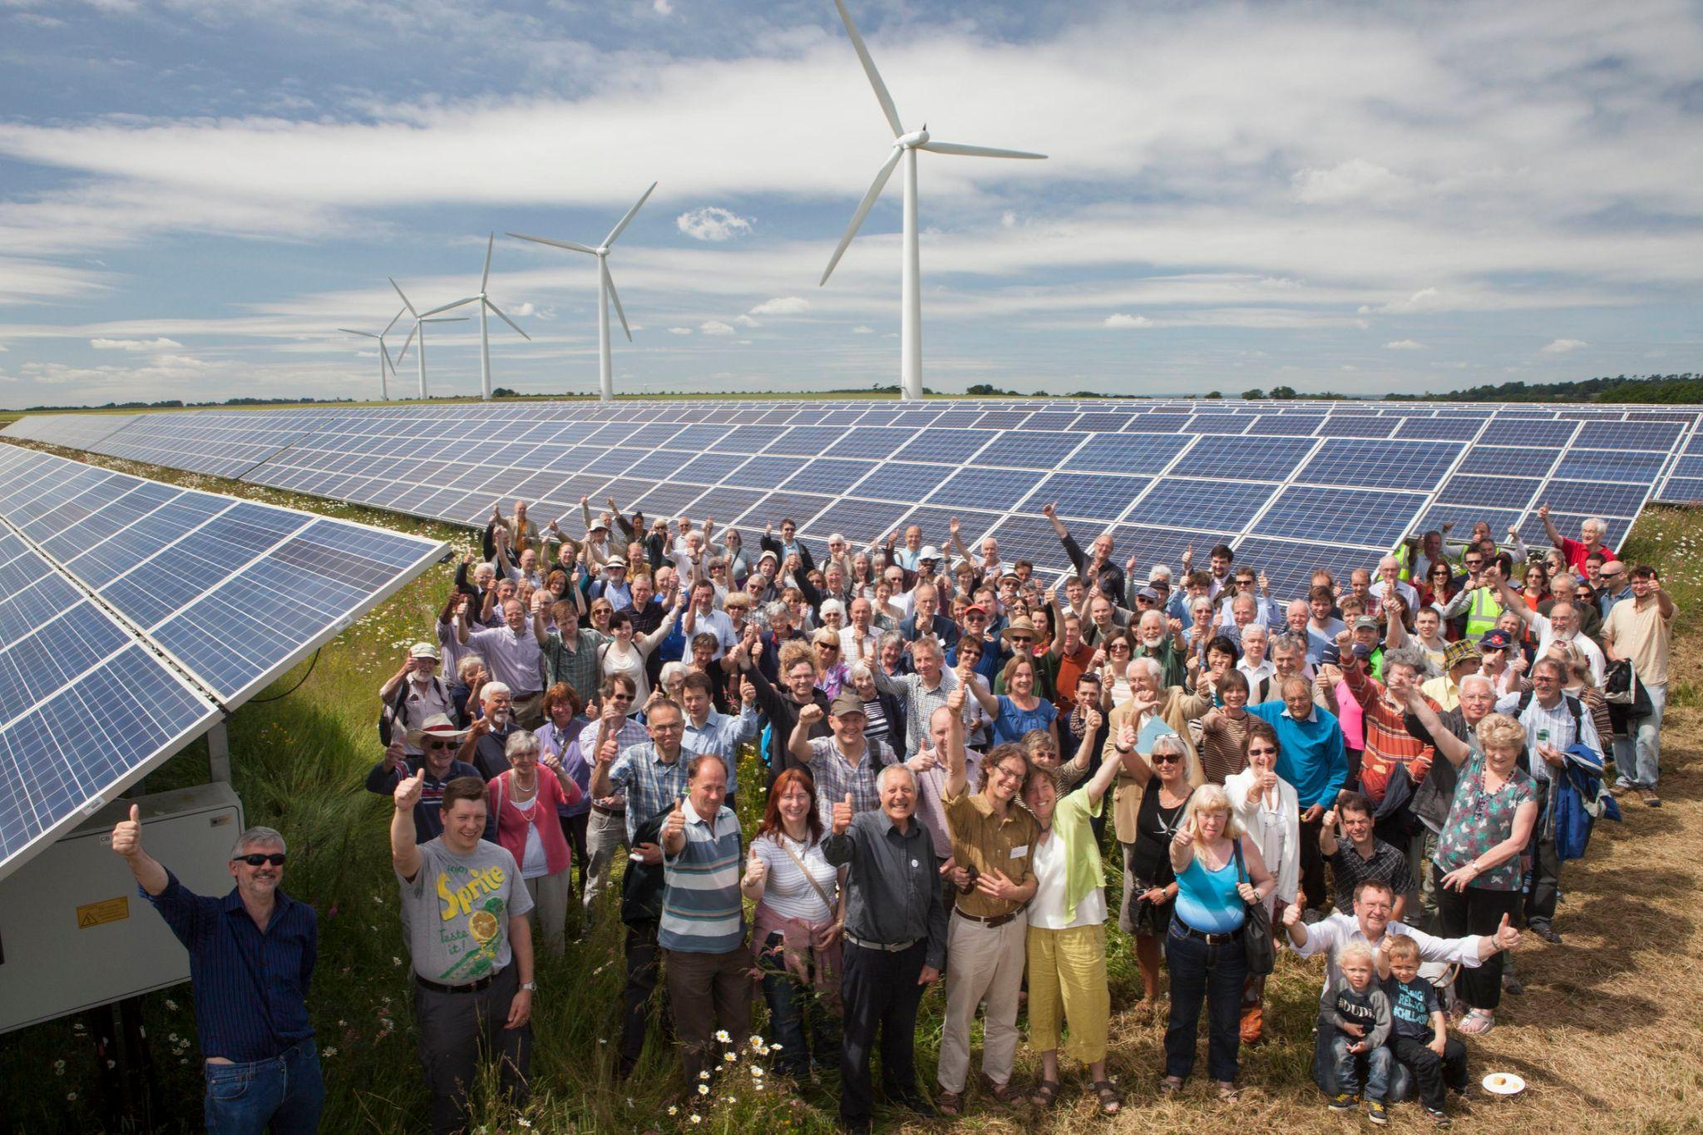
Putting people at the heart of energy transformation
Find out more at:
communityenergyengland.org
@Comm1NRG
bit.ly/CEE-YT
Please join us:
► bit.ly/Join-CE

Slide 10
Katherine Rooney Community Energy Manager SWNZH

Slide 11
The community energy sector in the South West
Katherine Rooney
Community Engagement Manager
Notes:
Introduce me, my role

Slide 12
Community energy in the South West
The Hub commissioned some work to carry out an assessment of the community energy sector in the South West.
Delivered by Community Energy South and a local partner team.

Slide 13
Community energy in the South West
The Hub commissioned some work to carry out an assessment of the community energy sector in the South West.
Delivered by Community Energy South and a local partner team.
The aim:
To identify the needs of the community energy sector, and define the potential role that the Hub could take in addressing those needs.

Slide 14
Community energy in the South West
The objectives:
Gain and in-depth understanding of the sector, it’s make up, level of expertise & current activity.
Understand the needs and wants of the sector & how the Hub can help meet these needs.
To support collaboration between the CE sector, local government and the private sector.
To identify key stakeholders who can address the challenges faced by the CE sector.

Slide 15
Community energy in the South West
The work involved:
Researching and categorising community energy organisations across the South West.
Workshops and engagement with community energy groups via the local partners.
Interviews with a broad range of stakeholders.
Interviews with energy and climate action representatives from 6 LA’s in the region.
Notes:
Involved – but isn’t limited to – this is a summary! The main outputs are a report with recommendations, plus some mapping data enabling us to present the information about group type, stakeholders and other supporting conditions on a map.

Slide 16
Community energy in the South West
Highlights:
70 community energy groups identified in the SW region.
- 8 within tiers 3 & 4.
- 62 within tiers 1 & 2, with highly variable degrees of capability, support and appetite to expand or scale.
Supportive, experienced and impactful stakeholders.
Supportive, understanding and interested local authorities.
Notes:
There are some really nice findings – one highlight being the examination of the number and type of CE groups we have in the SW. They used a 4 tier grading system for the groups, with 1 being an emerging or very new group, and 4 being a well established and professionalised group. Using that system

Slide 17
Community energy in the South West
Key recommendations:
The central finding is that healthy local energy ecosystems are the crucial element of a thriving community energy sector.

Slide 18
Community energy in the South West
Key recommendations:
The central finding is that healthy local energy ecosystems are the crucial element of a thriving community energy sector.
The key actors in this healthy ecosystem are:
- Local Authorities - County, District, Town & Parish Councillors - Community energy organisations - Existing community energy networks - Supply chains - Informed and engaged public -DNOs - Capacity builders and support organisations - Local asset holders - Regional Area Energy Planners - Net Zero Hub - Commercial renewables developers

Slide 19
Community energy in the South West
The proposed role of the local authority as a key actor in a healthy local energy ecosystem:
Policy makers
Economic developers
Convenors
Asset providers
Procurement & Commissioning
Notes:
This is the proposed role as per the report outcome and, along with the other recommendations and proposals in the report, we are considering it – important for you all to know I’m not presenting any of this as ‘decisions made’ – but these are the proposals and recommendations that we are looking at and we will be having a workshop session imminently so that you can explore these in small groups and share your own views and experiences.

Slide 20
Community energy in the South West
Next steps:
Complete the report feedback review phase. - including presentations to community energy groups.
Use this work to inform the Hub’s direction and focus for supporting community energy in the South West. - In combination with the SW Hub RCEF evaluation report and a synthesis report of RCEF across all Hubs.
... Roll my sleeves up and get cracking!

