Slide 1
Welcome
Welcome
As the pressure to deliver on local 2030 climate commitments grows, how do we work together to create an energy ecosystem that encourages and facilitates the pace of net zero delivery that we require?

Slide 2
Welcome to the day
Welcome to the SWNZH conference
Why I am here today
Why we are pleased to find the space to all meet in person
Our hopes for the day

Slide 3
SW Net Zero Hub Plan for the day Our current work and support going forward
Phillip Morris
Strategic Stakeholder Engagement Manager

Slide 4
Housekeeping & approach to the day
Session is until 4:30pm
Lunch at 12noon, coffee at 2:45pm
No fire alarm planned
Sessions are either presentations followed by Q&A or workshops
All sessions in this room at your table. Move around as you wish between tables.
We will be taking the input we receive today and building into our plans for the future – your insight is valuable to us

Slide 5
Agenda
10am -10:30am: Registration and Coffee
10:30am – 11:15am: Why are we here today
11:15am – 12noon: Workshop 1 - A thriving Local Energy Ecosystem for Community Energy
12 noon -1pm: Lunch
1pm – 2:05pm Decarbonisation of Heat
2:05pm – 2:45pm: Workshop 2 - Financing Net Zero at scale
2:45pm -3:15pm: Coffee and Cake
3:15pm – 4:20pm Smart local area energy planning
4:20pm - Closing remarks

Slide 6
A reminder of who we are

Slide 7
What are the Net Zero Hubs?
Created by the Department for Energy Security and Net Zero in 2018, the Local Net Zero Hubs are a national network of five local partnerships.
The Hubs provide strategic and technical support to local authorities, public sector bodies, and community groups for free.
We support projects from the earliest stages of development and feasibility to investment and delivery.

Slide 8
What are the aims of the Net Zero Hubs?
The Local Net Zero Hubs' objectives are to:
Increase the number, quality and scale of local clean heat and energy projects
Enable local areas to attract private or public finance for Net Zero project
Raise awareness of the opportunity for, and benefits of, local energy investment
Support regional co-ordination and collaboration between local partners and share local learning

Slide 9
Purpose statement in the South West
The South West Net Zero Hub provides impartial advice, technical support and funding to public and not-for-profit organisations, to develop projects that accelerate emission reductions and enable the transition to a more sustainable future
Gov
(Dept for
Energy Security
& Net Zero)
Net Zero
Hubs
Local
Councils &
Public Sector
Third
& Private
Sectors

Slide 10
Our current work

Slide 11
Managing national programmes in the region
The Local Net Zero Hubs are working to deliver national projects locally, including:
Community Energy Fund – supporting the creation of community-led renewable energy projects
Domestic retrofit programmes – improving energy efficiency of low-income and social homes
Public Sector Decarbonisation Scheme – supporting wider public sector to develop net-zero organisational plans and develop investment grade proposals for funding
Local Energy Advice Demonstrator – piloting innovative ways to provide energy advice to hard-to-reach communities and for those living in hard-to-treat homes

Slide 12
Energy project development support
Providing local technical resources and support to public sector net zero projects
We work on projects from the earliest phases of feasibility to investment and delivery.
£37.6M in private finance has been secured from projects supported by the Hub. ​
26 projects are currently being supported or were successfully completed with Hub support, with total capital value of £647.9M. ​
Projects supported by the Hub contribute to estimated lifetime emissions savings of 0.61M tonnes CO2e. ​

Slide 13
Energy Project Development
Some key projects at present:
Complex sites and virtual power purchase agreements
Cornwall Council solar PV projects
Retrofit Skills work (Phase 1 & 2)
South Gloucestershire heat from mines
Some upcoming projects:
Local Area Energy Planning
Plymouth District Heat Cluster Feasibility Study
Able To Pay loan fund
Notes:
LAEP: working with five areas across the SW on a beginning phase of decarbonisation planning, helping shape governance, local area characterisation and engagement. Crucially this beginning phase will also start to shape the ecosystem required for delivery of a pipeline of projects that will result from the plan including shaping the role of the local authority, strategic partnerships needed for delivery and the finance framework needed for investment.
South Gloucestershire Heat from Mines: SEL contract started February, and due to conclude July. covers a large part of South Gloucestershire, and borders with Bristol, to include the Areas of Interest IDed in the Coal Authority report (i.e. where there are lots of seams underground offering most likely potential for resource). 4 areas of high heat demand IDed as candidate areas + 1 area to test a (somewhat theoretical) residential-focused network option. Heating + cooling modelling
Marine Aquarium: The hub is commissioning a study on behalf of Plymouth City Council. This study aims to investigate the feasibility of a localised district heating cluster in the Sutton Harbour area of Plymouth with a primary focus on assessing the shallow geothermal opportunities within the local area. The study has a specific focus on identifying a connected solution for the National Marine Aquarium (NMA) site as a key anchor load, alongside other local buildings.

Slide 14
The Local Net Zero Fund (LNZF)
£1 million grant fund
Available to local authorities to increase the number, scale and quality of net zero projects in the region.
Grants to be spent on revenue funding. This can include staff salaries, consultancy fees and statutory fees (e.g. permits, planning)
Those who receive funding from LNZF will have 12 months to deliver their funded works.
Available to Tier 1 and Tier 2 local authorities (unitary, county, district and borough level) and combined authorities within South West England and the Solent area
Very positive response. 38 applications with £1 million fund fully allocated subject to Board approval.
We will be looking at how we can support those projects that were unsuccessful.

Slide 15
Funding & investment support
Project Development Support
Financial Modelling
Bespoke modelling at either individual project or portfolio level
Securing Capital
Support on capital source and mix, equity, debt and mezzanine options evaluation
Financial procurement and due diligence support
“Cookie Cutter” options for standard projects
Brokering investors and projects
Early engagement
Project financial options appraisal
The Funding & Investment Manager is well placed to support the Project Development Team (PDT) working with their 42 Local Authorities (PSBs) to use private and or community finance with LA grants, loans, and subsidies to do more public goods and deliver their LA regional priorities while simultaneously managing their LA investment risk responsibly.
SW Net Zero Investment Fund: Active fund development discussion with Bristol & Bath Regional Capital and Amber Infrastructure to create a net zero investment vehicle for the SW Region with the West of England Combined Authority as a potential seed public sector investor.
Notes:
Notional fund value £100m with a £30m first close. Intent to take the learning from the Amber Infrastructure investment managed £500m Mayor of London’s Energy Efficiency Fund (MEEF) and apply it outside the capital as a regional product to support net zero delivery. Target funding model 70% Debt and 30% equity mix with a range of investment from net zero infrastructure to high growth net zero business capital investment. The Plymouth and South Devon Freeport net zero cluster supported by Hub engagement form an element of the proposed deal pipeline. Target timeline to potential launch Q4.

Slide 16
Net Zero Investment Readiness Assessment Service
Local and combined authorities can apply for relevant projects (or project portfolios) to be assessed by the Hub team, who will review project finances and any outstanding work required for external investment.
This will include:
Assessment of any further technical and due diligence works required
Commercial business case review
Cashflow analysis
Benchmarking against external funder requirements
This process should provide a helpful roadmap for local authority projects seeking external financing options.

Slide 17
Retrofit delivery
LAD2
£51,170,000 Budget
4580 minimum
SHDF ROUND1
£4,663,818 Budget
475 homes
HUG1
£1m Budget
44 homes
7 Lots across the SW
8 Consortium RSL members
SHDF 2.1
over 6000 delivered
Notes:
This is the dashboard view from Lad 2
Key outcomes 47.73 million spent
6037 homes treated
Over 7890 measure installed.
Working with 3 organisations across 7 lots across the SW

Slide 18
Public Sector Decarbonisation Skills Service
We have worked with over 70 organisations assessing 400 buildings and supported £10m worth of successful applications for decarbonisation funding.
We have provided support to:
Identify and deliver low-carbon opportunities to public sector organisations
Develop net-zero organisational plans
Develop carbon reduction proposals to gain internal approvals and make an application to current and future government funding opportunities, including in particular to the Public Sector Decarbonisation Scheme
Focus on proposals that have either stalled or abandoned due to lack of project management and delivery capacity

Slide 19
Community Energy Fund
13 projects were successful in the CEF window 1 bidding round, and are now starting to develop their feasibility studies
6 window 2 applications were agreed at the Board on Tuesday
To date we have allocated £684,114 of the available funding.
Good regional spread of projects

Slide 20
Skills and Supply Chain Development
Phase 1 - April 2023 - we published the South West Net Zero Hub Retrofit Skills Report for the South West Region. Key findings from this DESNZ funded project:
Significant present and future shortages in key skills (e.g. It would take 200 years to install enough air source heat pumps (ASHPs) to achieve 2050 targets)
Provision of retrofit training in the South West is increasing, but is insufficient to meet net-zero targets
There are wider skills shortages in the construction sector
Phase 2 - September 2023 - we were asked to support DESNZ on their skills pilot that built upon the 2023 research through compiling a richer evidence base to hopefully deliver new skills programmes via the Hub.
We are at the final stages of the evidence gathering and have submitted our report to DESNEZ - SWNZH Retrofit Road Map report - communicating early May 2024 with the outcomes
The hub anticipates piloting solutions to improve the provision of retrofit careers advice to school and college leavers across the region (subject to approval).
Notes:
. The Regional Skills Pilot is funded by DESNZ and aims to identify the necessary steps to develop the local supply chain in the region, to be ready to deliver the required home improvements to meet Net Zero

Slide 21
Going forward

Slide 22
Going forward
New hub manager
MOU in place until March 2025 – delivery until Sept 2025
In discussion on future MOU with DESNZ
Management of Community Energy Fund and Local Energy Advice Demonstrator programmes through to 2025
Explore further support for the community energy sector
Governance update
Theory of Change

Slide 23
Theory of Change
Building on the work of IOD Park
Has included further external stakeholder interviews
Planning to put our best foot forward in a fast evolving world – ensure we stay relevant, effective and efficient
Will build any relevant information form the workshops today into this process
The process will support future recruitment so we get the rights skills in place

Slide 24
National Hub Working Groups
North West | North East & Yorkshire | Midlands | South West | Greater South East
Energy Networks | Heat Networks | Non-Domestic Buildings | Places & Planning | Domestic Retrofit
Technical Assistance | Industry & Commerce | Comms & Stakeholder Engagement | Green Finance | Transport
Communities Net Zero | Training & Development |  | Data, Project Pipelines

Slide 25
Olivia Blunn Head of Local Net Zero Policy and Finance Department for Energy Security and Net Zero

Slide 26
Policy Support for Local Net Zero Delivery
25 April 2024
Olivia Blunn - Head of Local Net Zero Policy and Finance, Department for Energy Security and Net Zero

Slide 27
Local Net Zero Team
Local Net Zero Hubs
Local Net Zero Accelerator
Delivery and Demonstration
Analysis
Policy
Green Finance
Policy and Green Finance
Analysis

Slide 28
UK’S NET ZERO ACHIEVEMENTS
Having emissions whilst growing the economy
Increasing renewables
Overachieving!
Supporting Jobs
Financial backing for net zero targets

Slide 29
GOVERNMENT SUPPORT FOR LOCAL NET ZERO
Local Net Zero Accelerator
Green Finance
Local Net Zero Forum
Devolution
Freeports
Community Energy
Energy Planning

Slide 30
LOCAL NET ZERO ACCELERATOR
OFFICIAL : SENSITIVE
£19m programme to support local government in attracting private sector investment for green growth
Two Local Net Zero Accelerators.
A City Leap Replicator
Local Net Zero Finance Support Service

Slide 31
GREEN FINANCE
OFFICIAL : SENSITIVE
Blended finance - Shared Outcomes Fund
Local Investment in Natural Capital (LINC) pilot in Cornwall
This Photo by Unknown Author is licensed under CC BY

Slide 32
LOCAL NET ZERO FORUM
OFFICIAL : SENSITIVE
OFFICIAL : SENSITIVE
Representatives from national and local government to discuss key local net zero policy and delivery issues
Official and Ministerial level

Slide 33
DEVOLUTION
OFFICIAL : SENSITIVE
9 devolution deals since August 2022
Cornwall, Devon and Torbay
This Photo by Unknown Author is licensed under CC BY-SA-NC

Slide 34
FREEPORTS
OFFICIAL : SENSITIVE
OFFICIAL : SENSITIVE
Freeports required to demonstrate contribution to net zero
Plymouth and South Devon Freeport
Solent Freeport
Image: Plymouth & South Devon Freeport

Slide 35
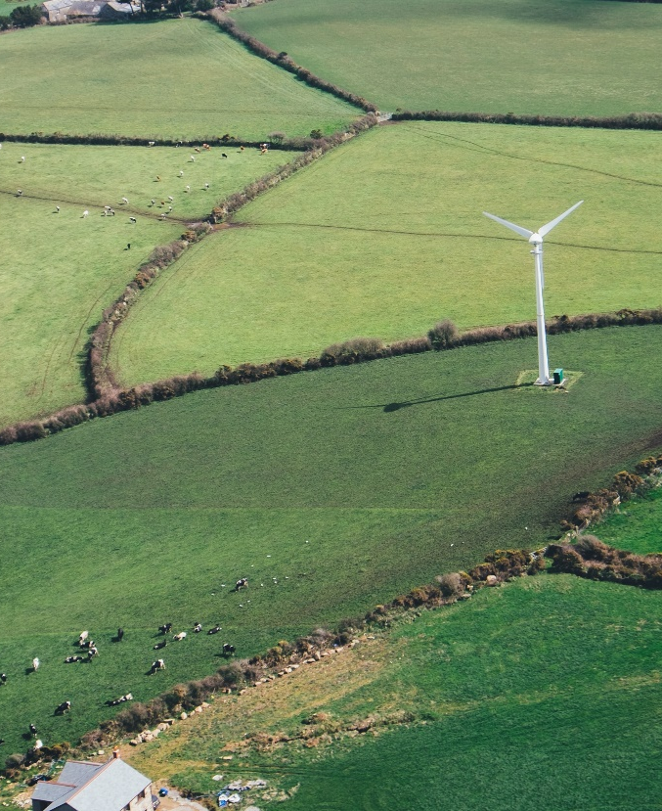
COMMUNITY ENERGY
OFFICIAL : SENSITIVE
£10 million Community Energy Fund
UK Growth Funding
Ofgem – Voluntary Redress Scheme
Community Energy Contact Group
Call for Evidence
Annual Report

Slide 36
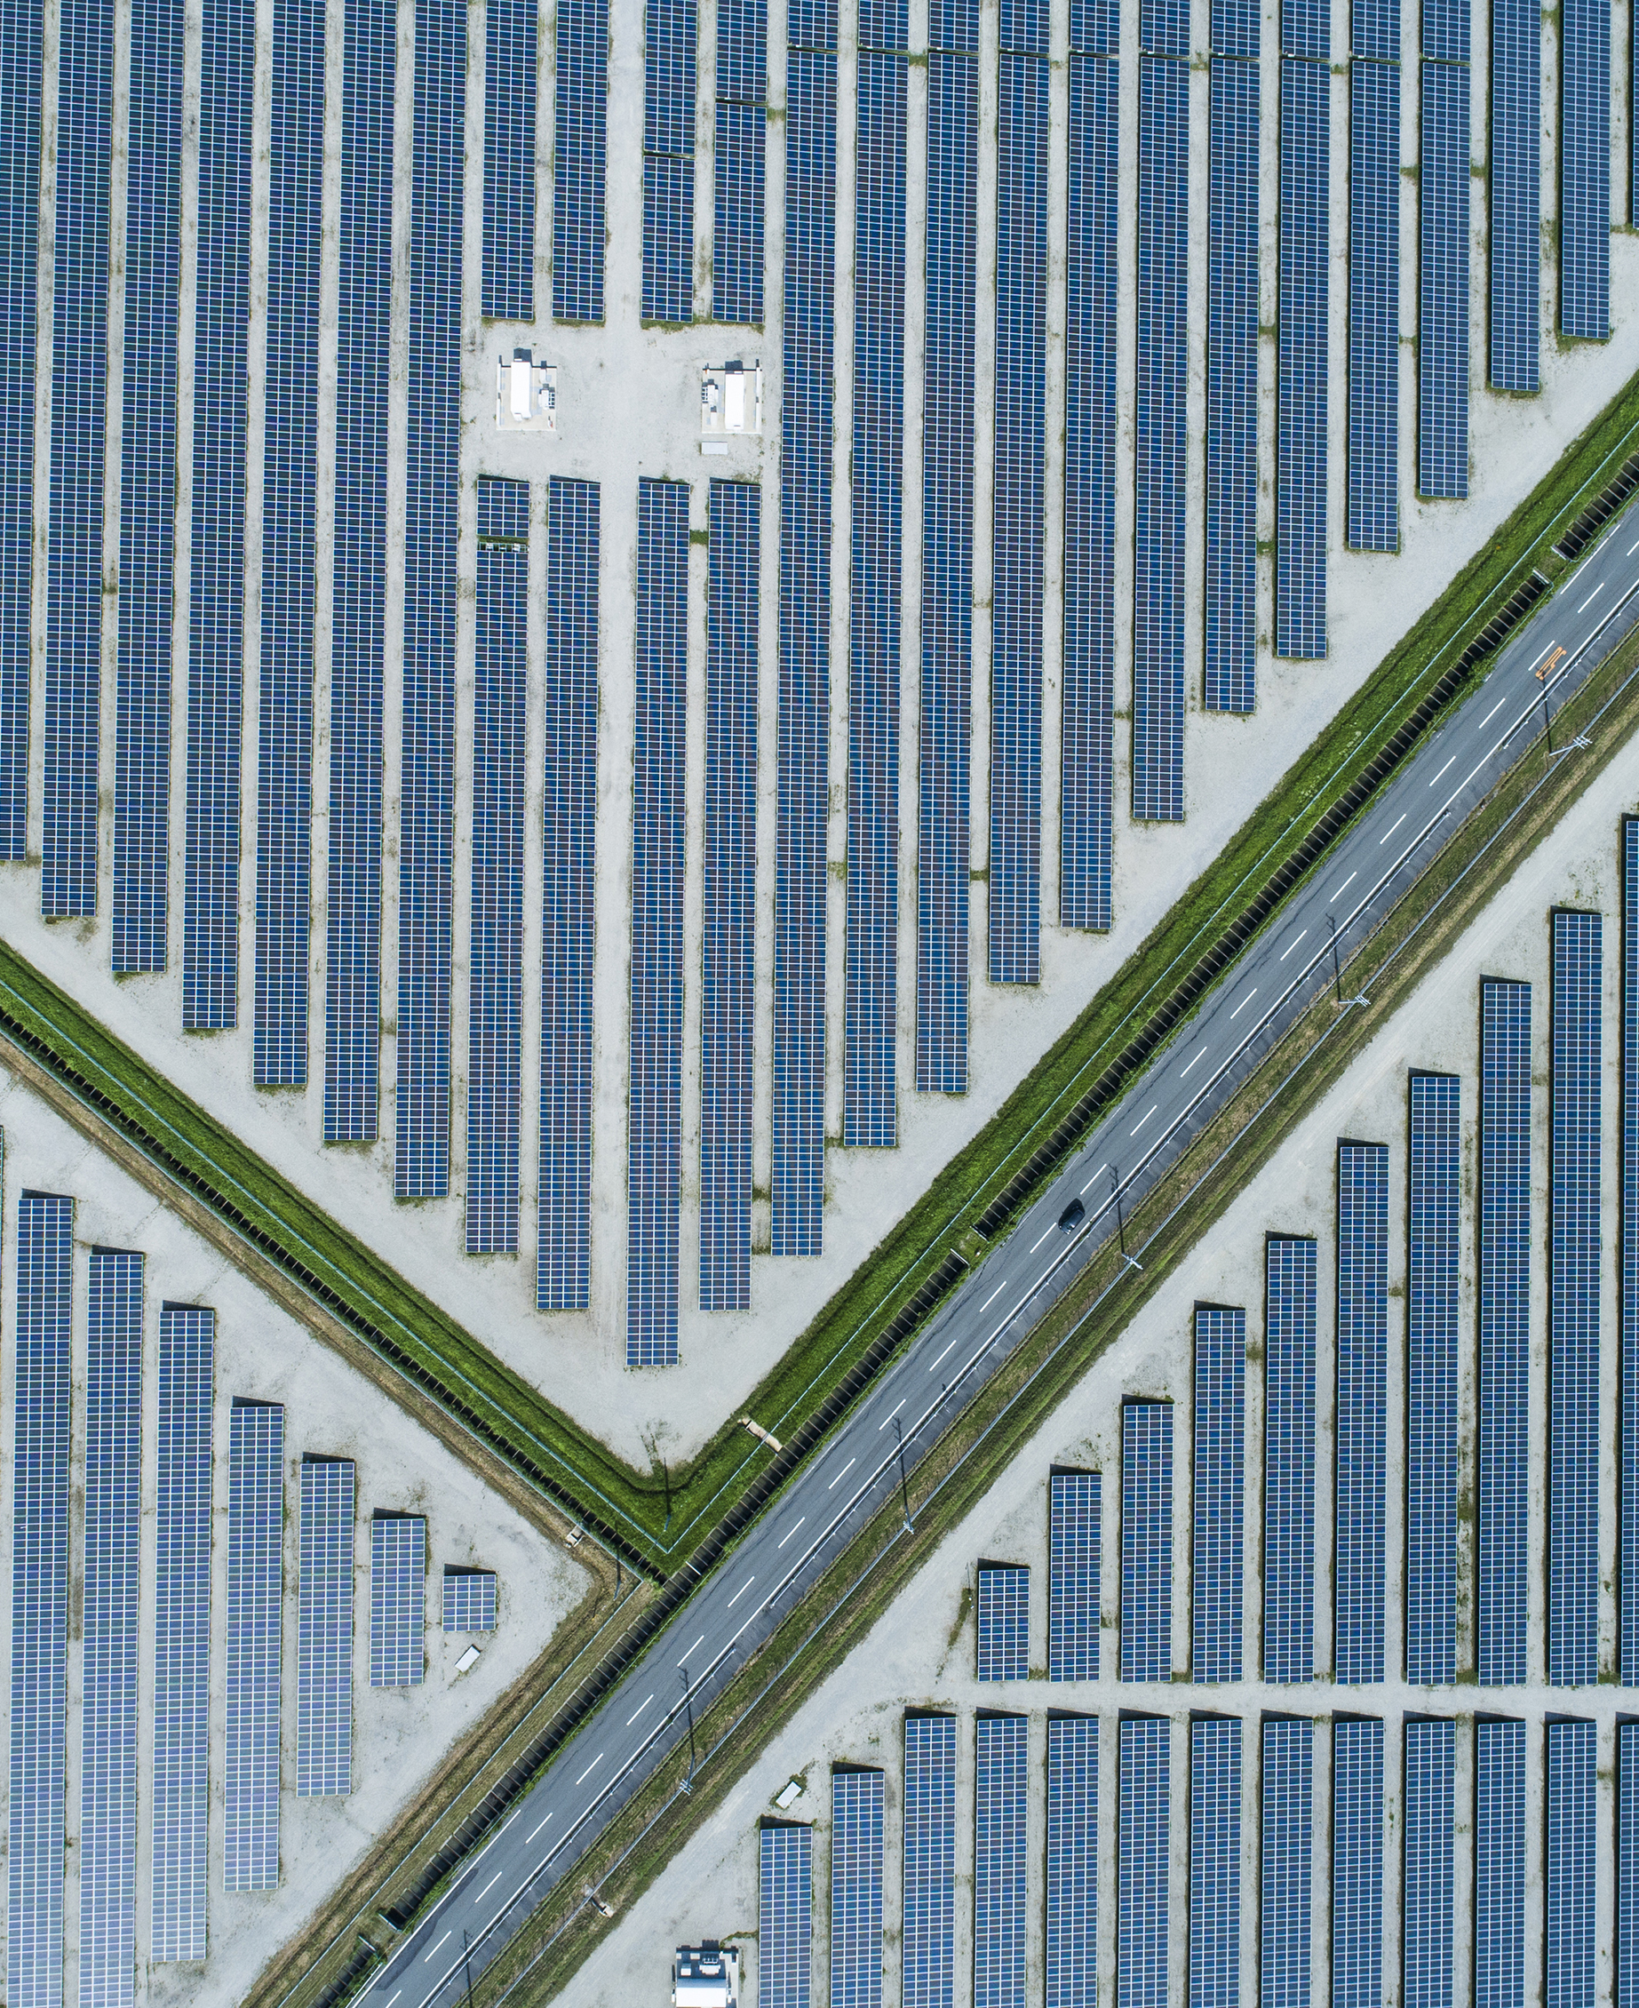
ENERGY PLANNING
OFFICIAL : SENSITIVE
Ofgem & Regional Energy System Planners
LAEPs

Slide 37
Thank you
OFFICIAL : SENSITIVE

